Slide 1
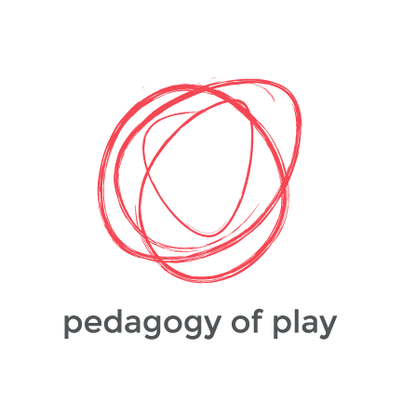
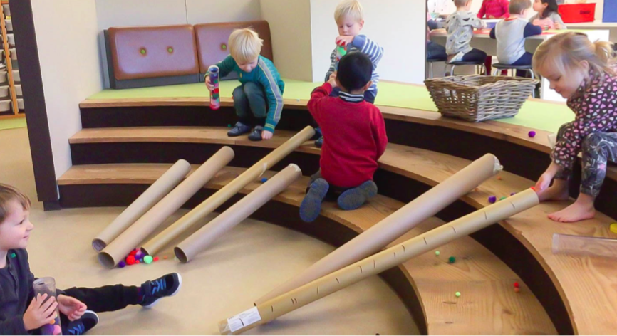
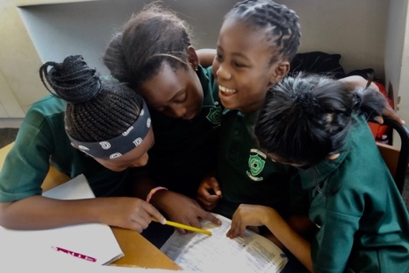
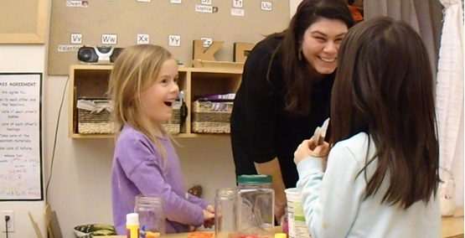
Understanding Learning Through Play Across Cultural Contexts:
The Indicators of Playful Learning
From the Pedagogy of Play Team
Project Zero
© 2023 President and Fellows of Harvard College. This work is licensed under Creative Commons Attribution-NonCommercial-ShareAlike 4.0 International. Funded by the LEGO Foundation, this resource was developed by Pedagogy of Play at Project Zero.

Slide 2
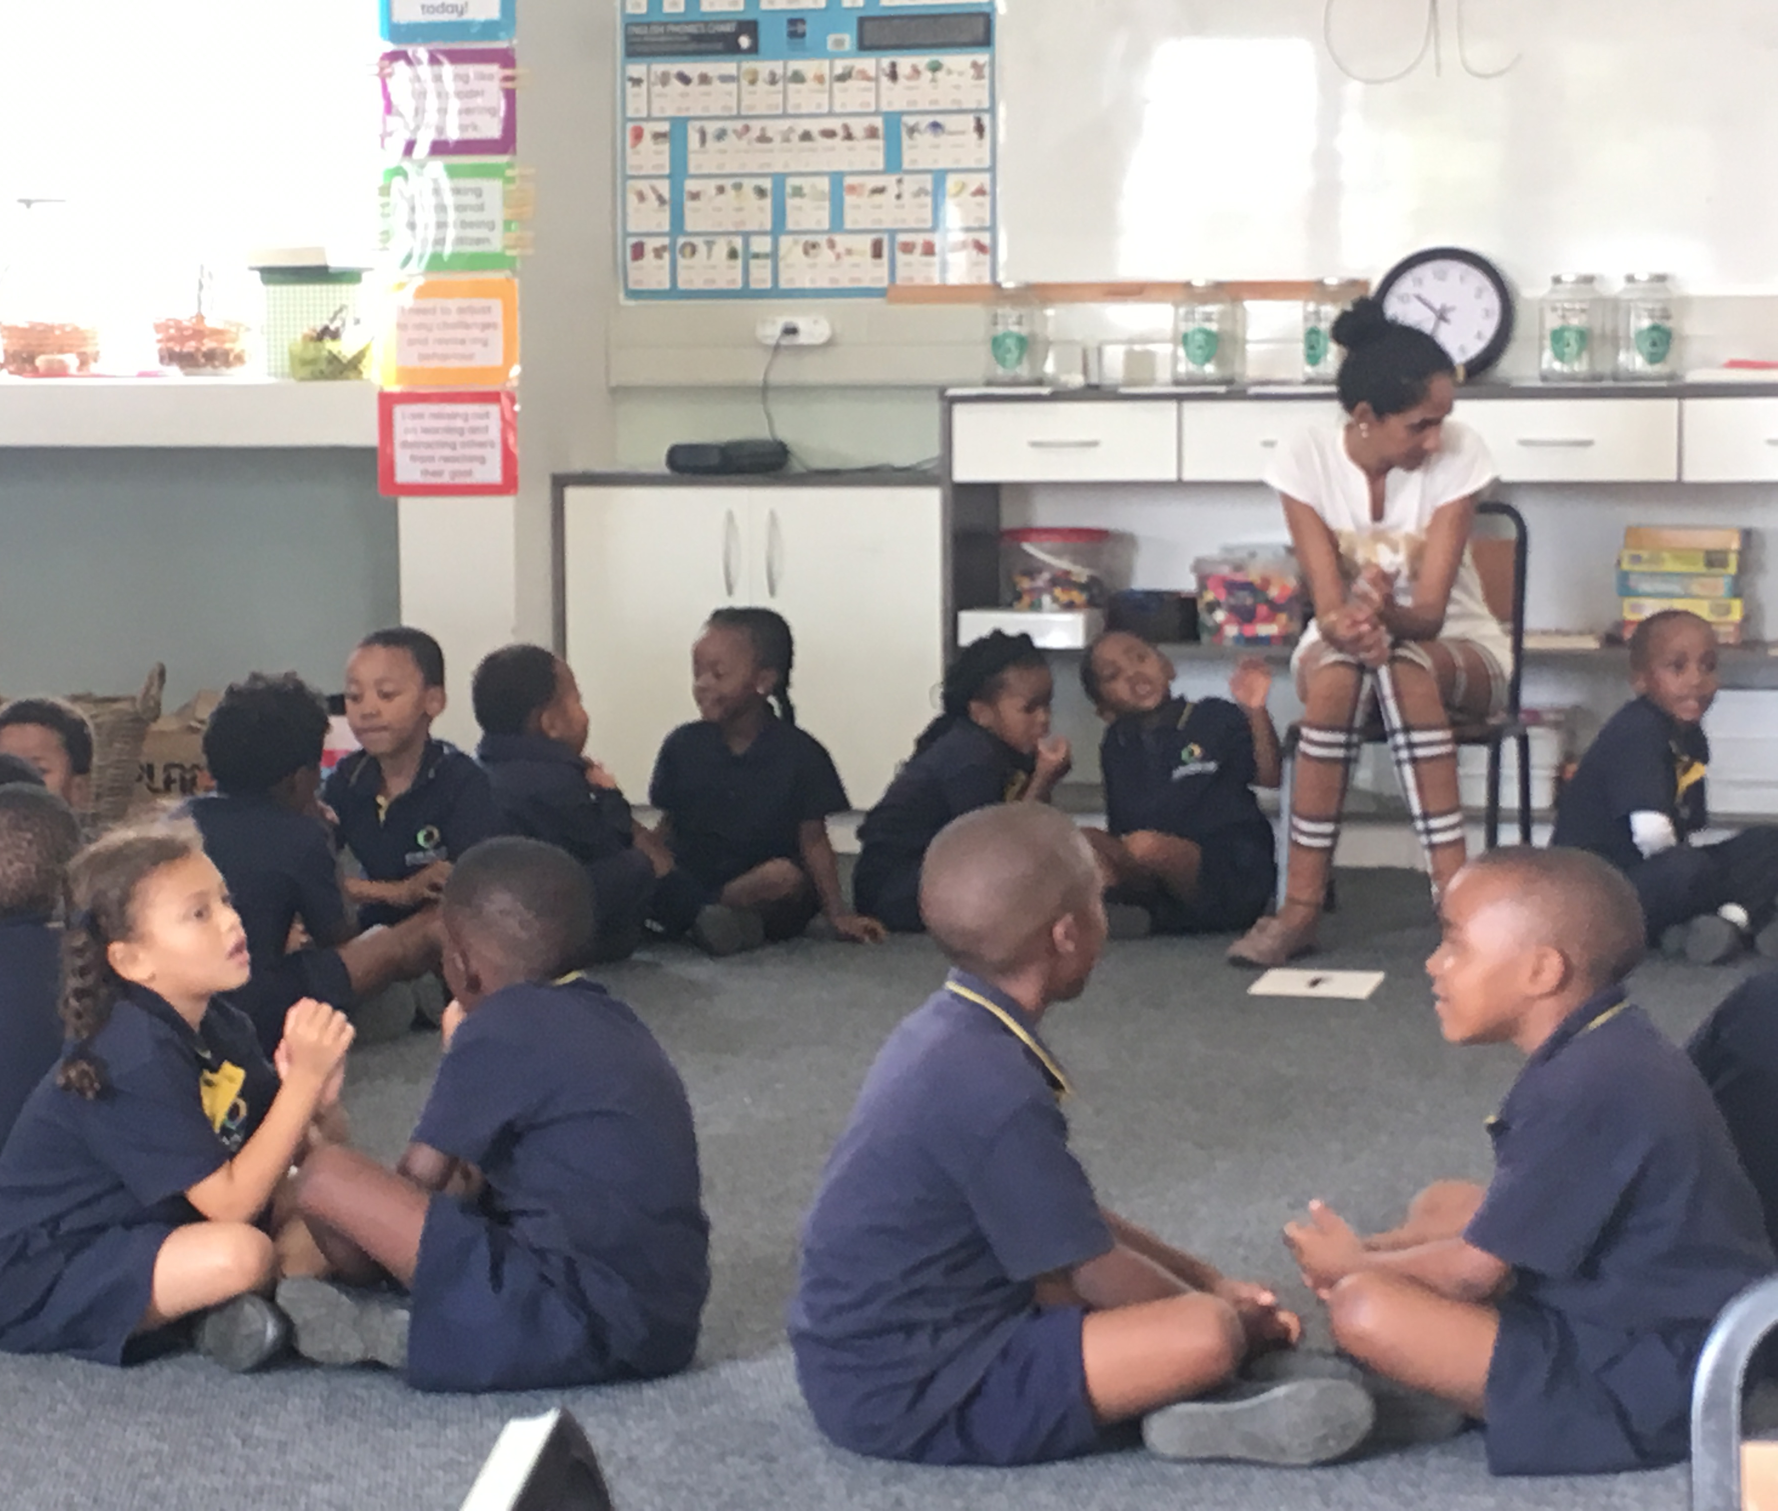
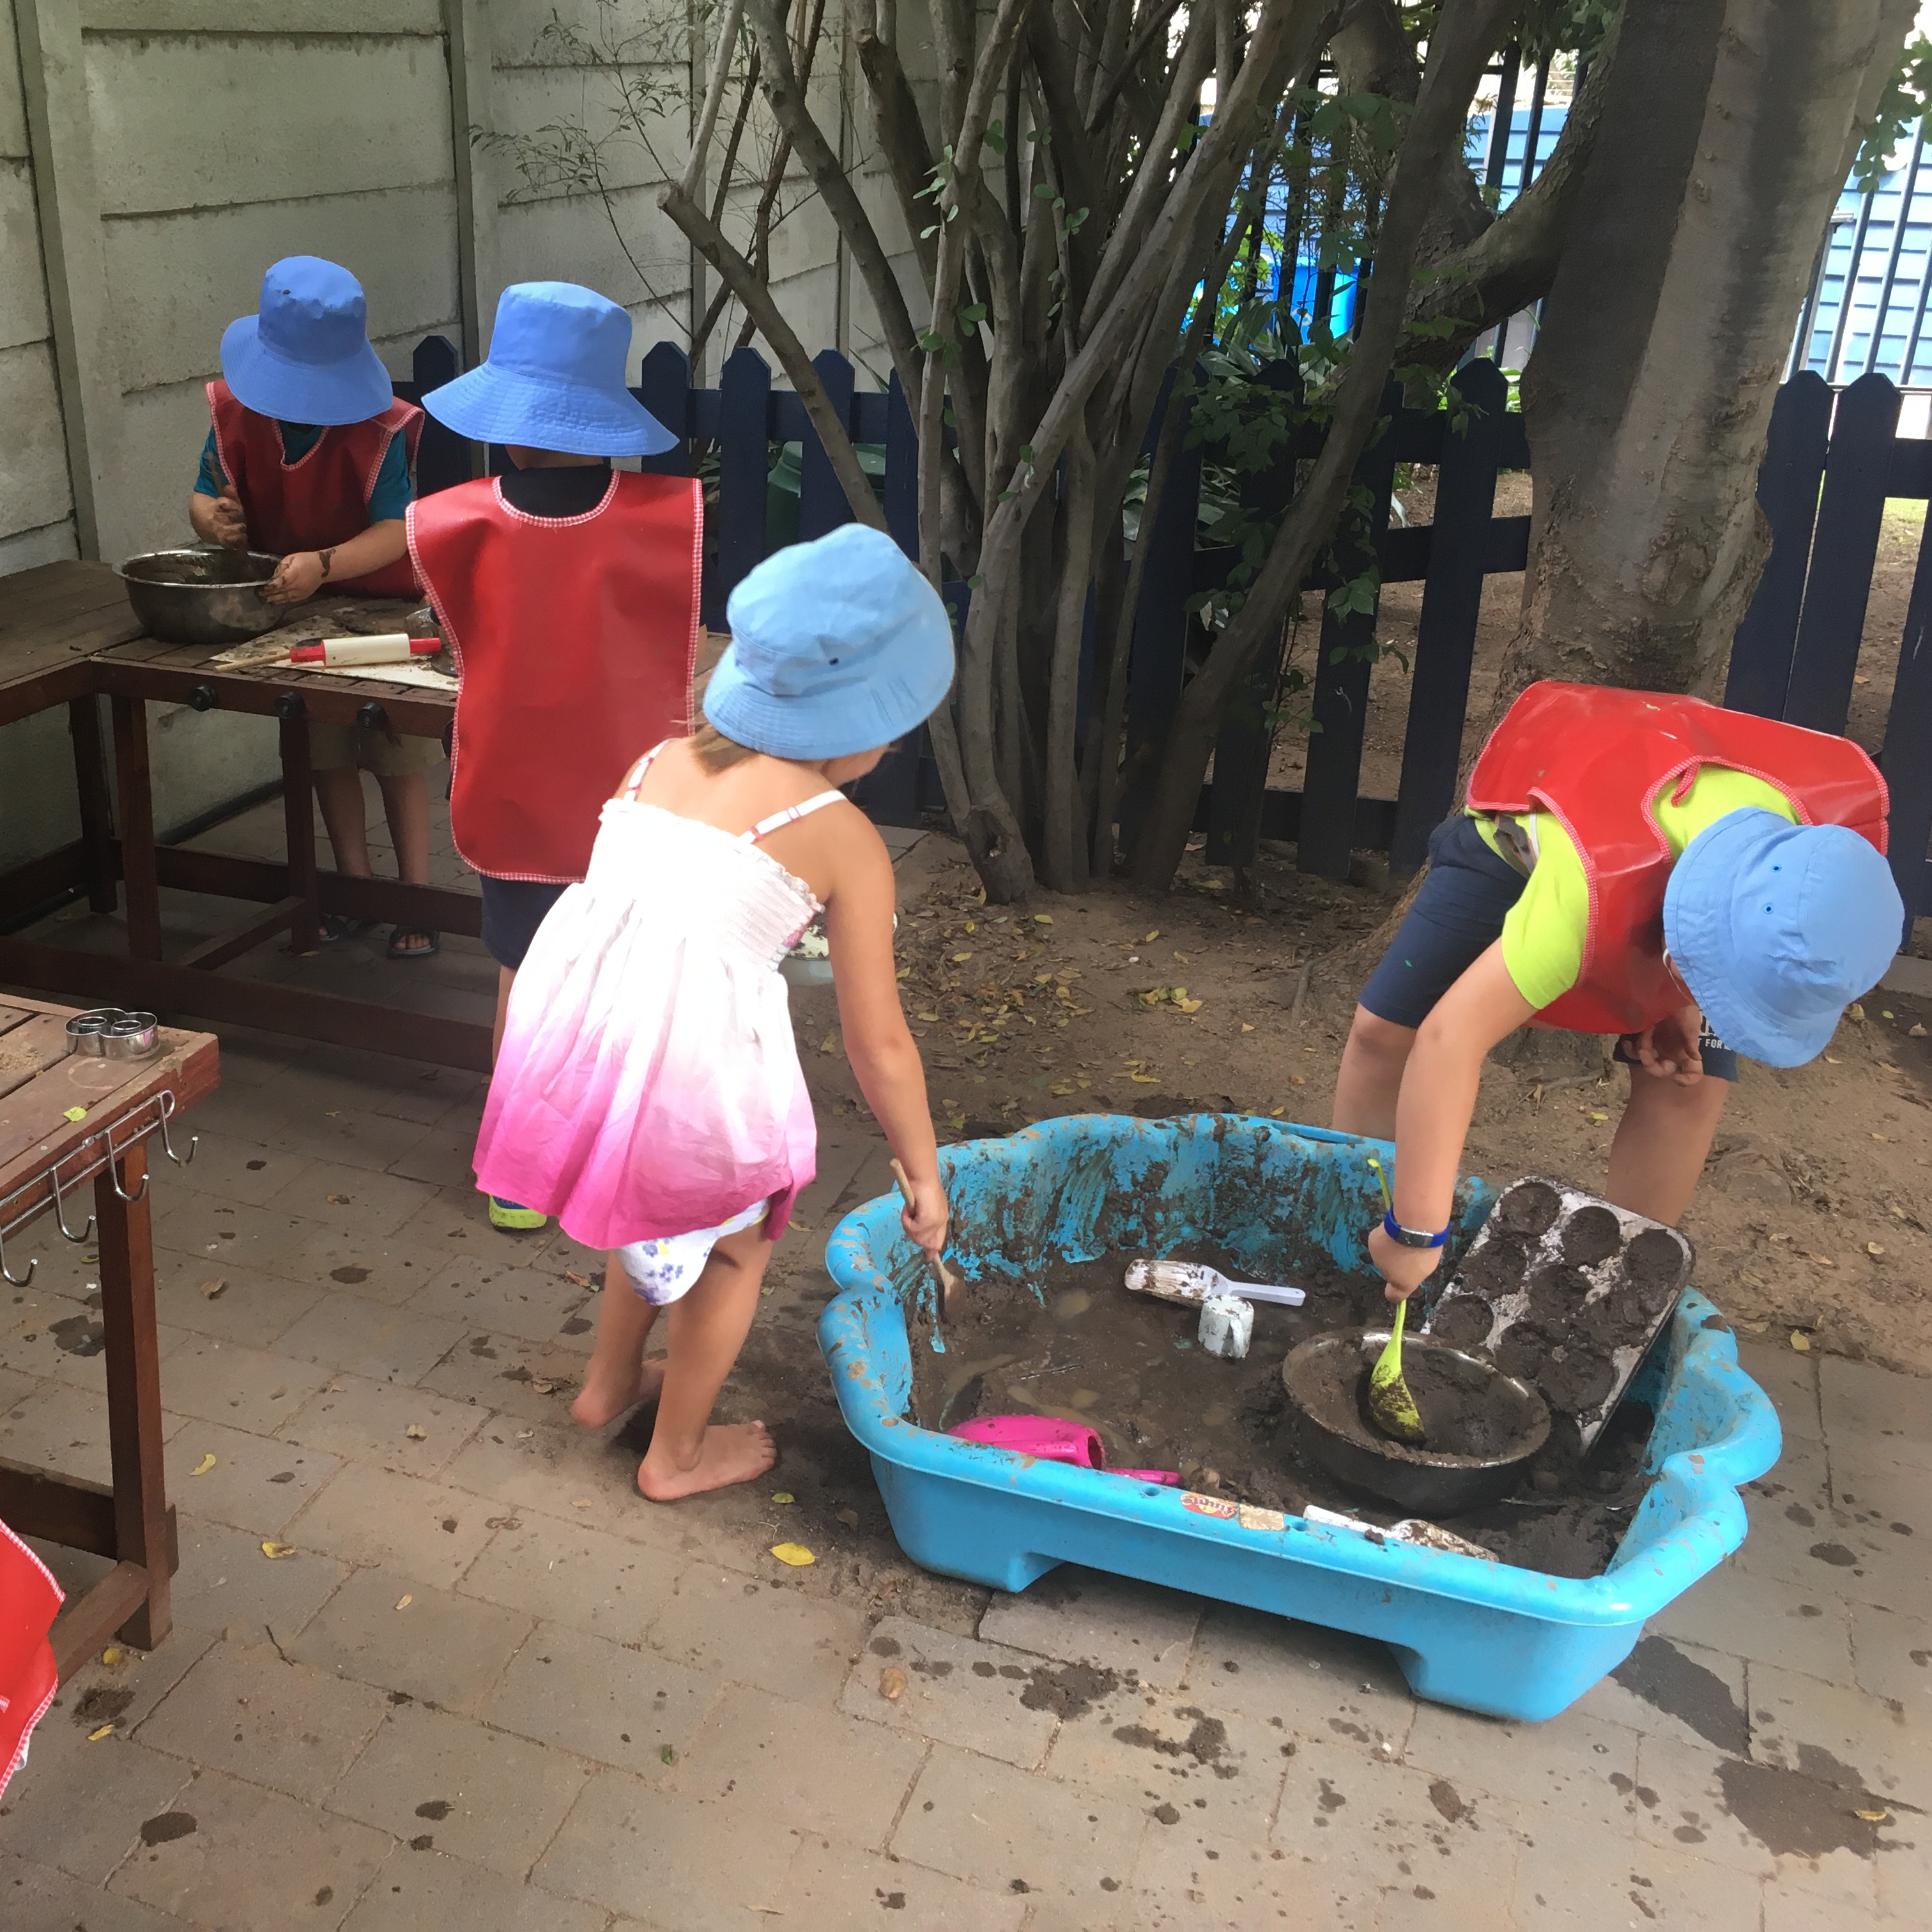
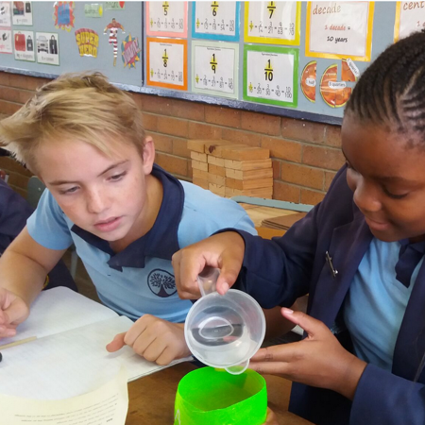
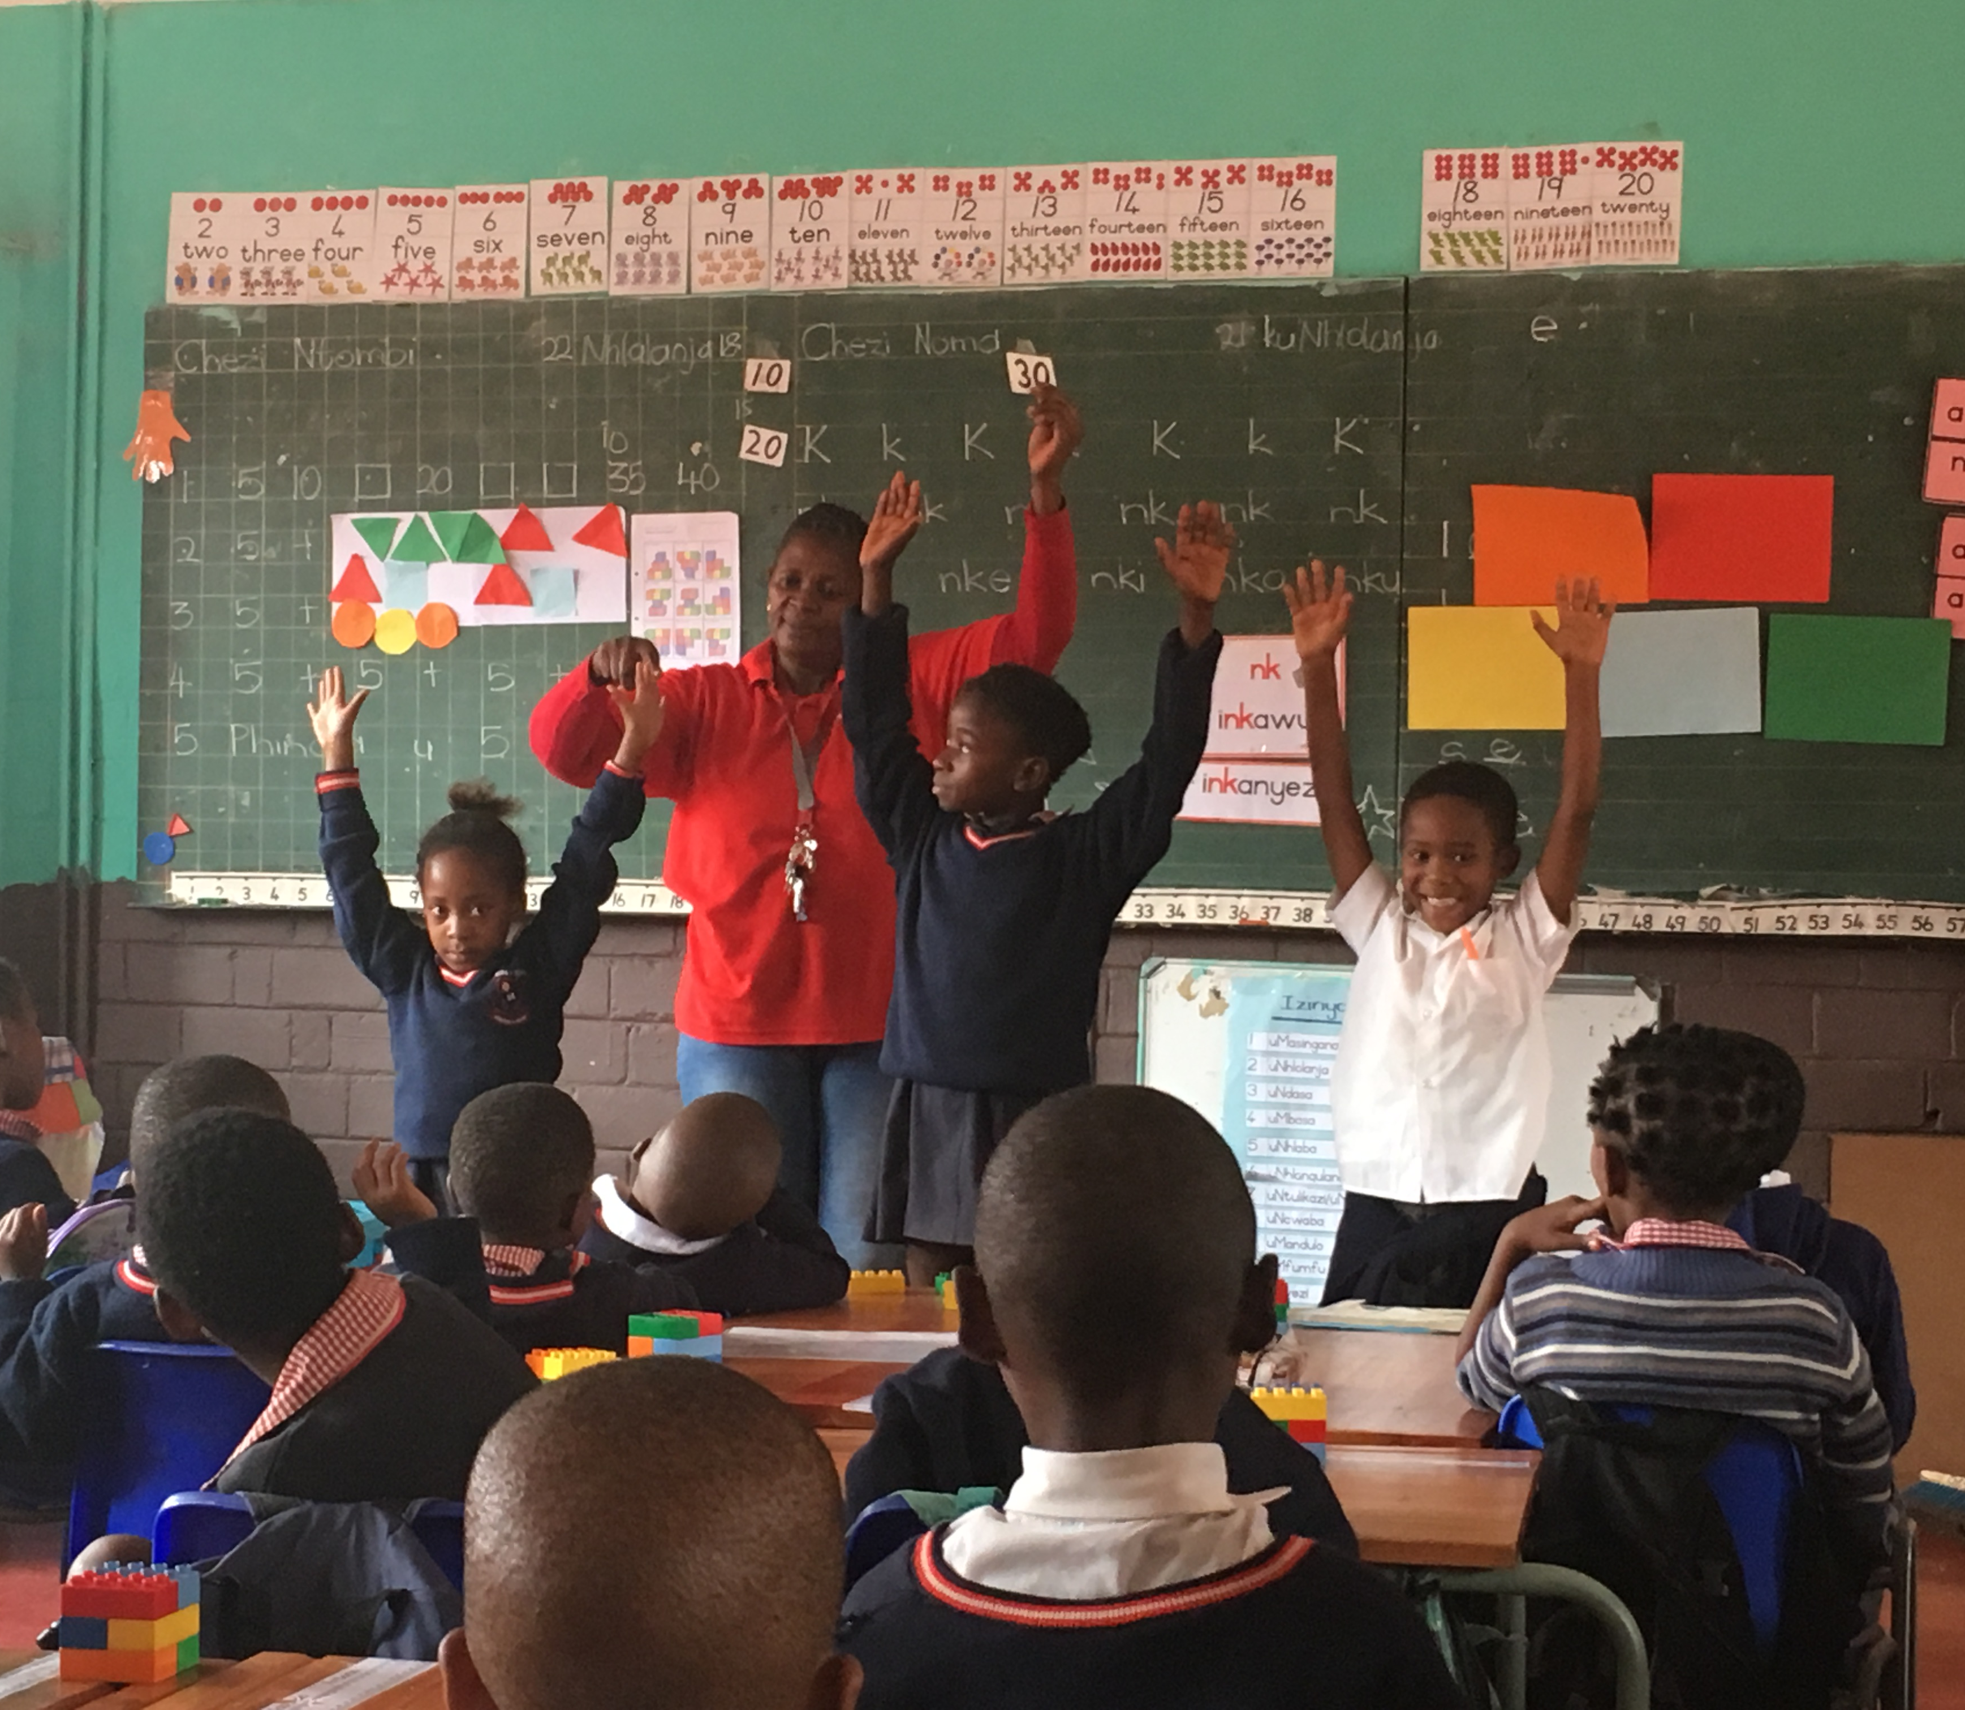
Play is both universal and culturally determined
Who children play with
How they play
Where and when they play
When/if they should stop playing
…all of these ideas are culturally constructed
Notes:
Play is a cultural construct. Who children play with, how they play, where and when they play, and when it is thought they should stop playing (if ever) are determined by cultural contexts.

Slide 3

What does playful learning in schools look and feel like in different cultural contexts?
Notes:
Since 2015, researchers from the Pedagogy of Play project have been focused on understanding and promoting playful learning in school contexts.
Understanding what learning through play in schools looks and feels like is important to educators, both for planning playful learning experiences, as well as for assessing when and how learning through play has taken place.
Because learning through play is a cultural construct, the PoP team engaged in collaborative research with educators in several different geographies to create culturally-specific definitions of what learning through play in schools looks like and feels like.

Slide 4
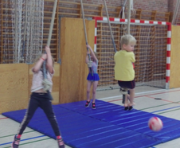
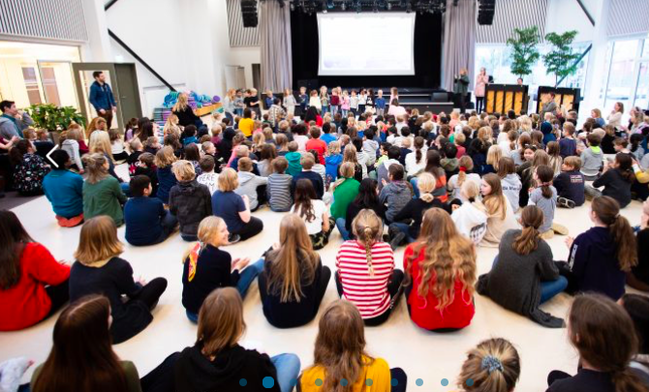
International School of Billund
Denmark
Notes:
The Pedagogy of Play research project began in Billund, Denmark, in collaboration with the International School of Billund

Slide 5
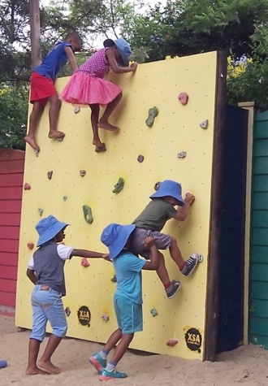
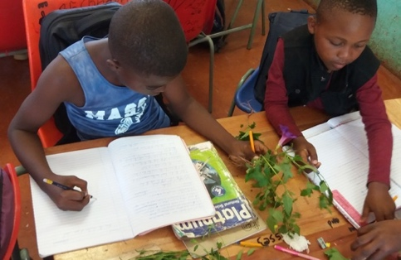
3 South African Schools
Notes:
…continued with 3 schools in Johannesberg, South Africa

Slide 6
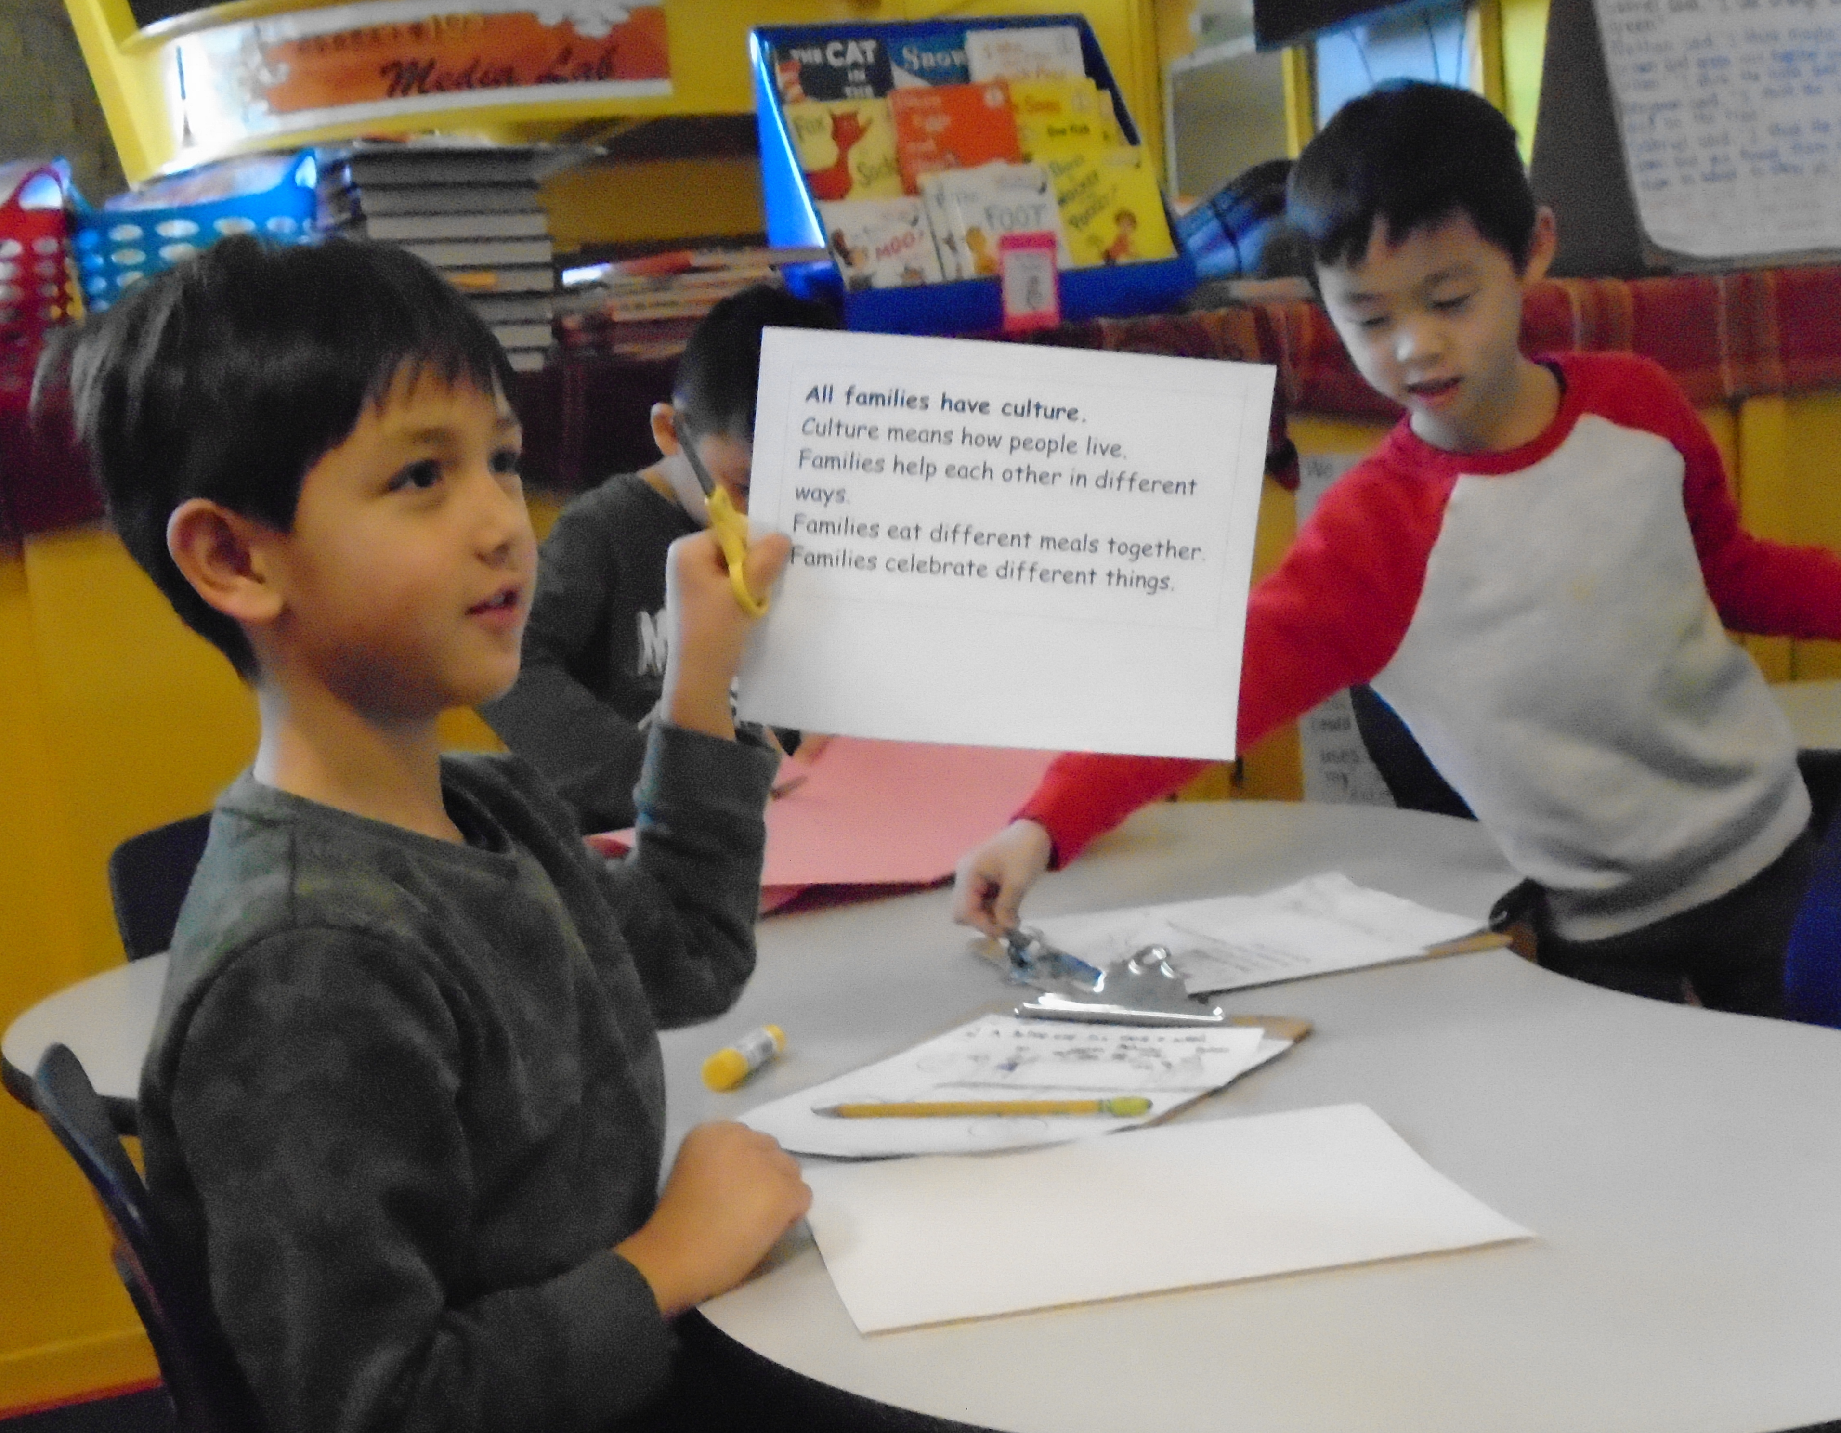
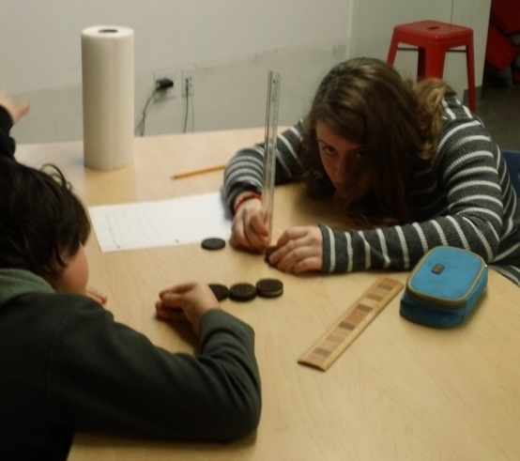
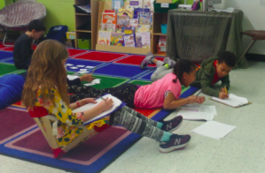
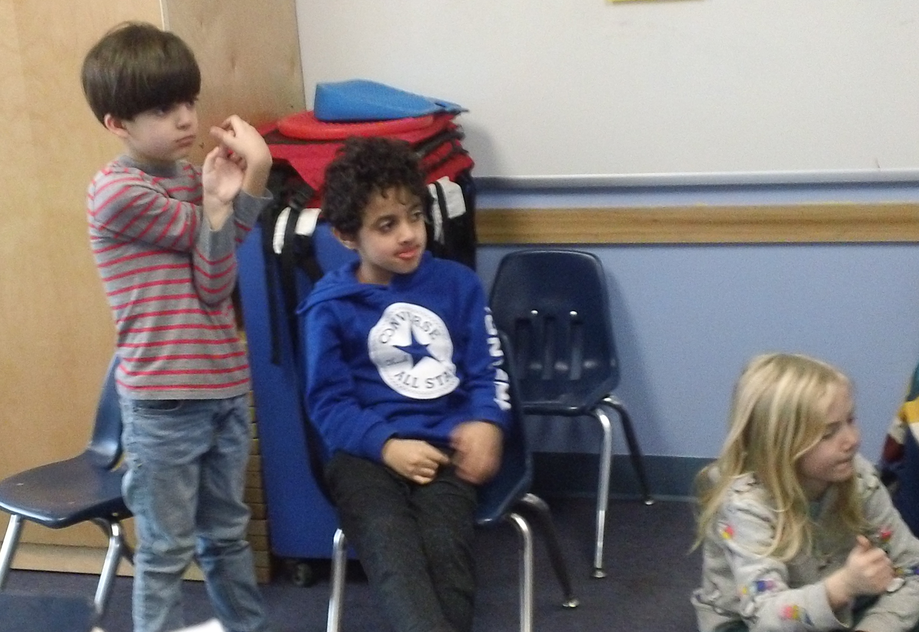
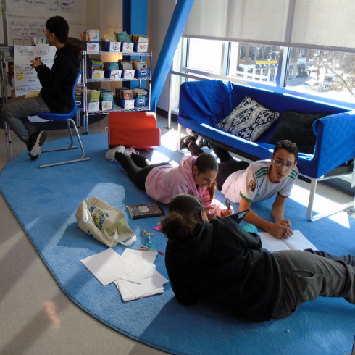
6 Schools in the Boston Area
Notes:
6 schools in the Boston area in the U.S. …

Slide 7
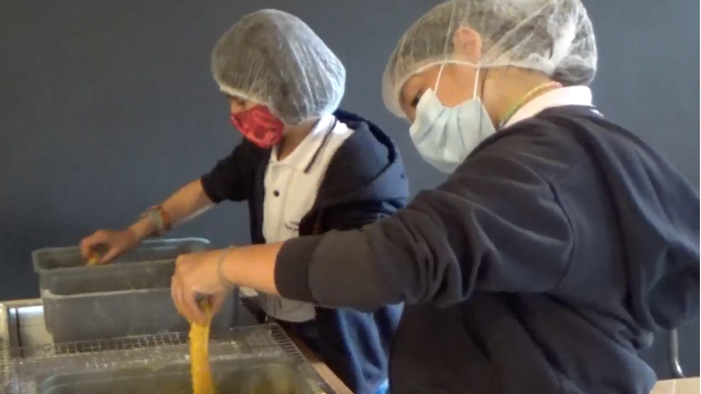
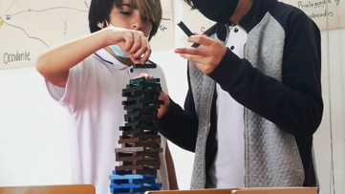
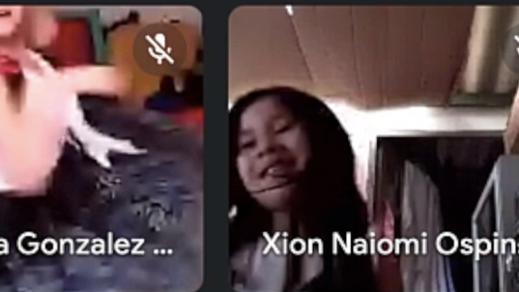
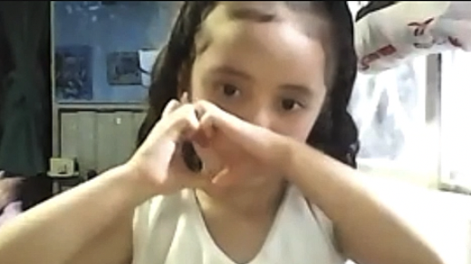
5 Schools in Colombia
Notes:
And 5 schools in Colombia.
In each of these contexts, PoP worked with local educators to observe, discuss, and define what learning through play looks and feels like. Here’s what the process involved:

Slide 8
Methodology: Developing the Indicators
Site selection – purposive sampling:
  Variety of SES, school type
  Interested in incorporating playful learning
Data sources:
  Extensive classroom observations
  In-depth semi-structured interviews with classroom teachers, administrators, and children
  Focus groups with children
  Playful activities to surface playful learning experiences
Analysis:
  Emic, open coding
  Thematic analysis
  Return to the conceptual literature to inform analytic approach
  Co-construction through iterative analysis and feedback with local educators
Notes:
First, a review of literature on learning through play, which provided an underpinning and foundational understanding of previously established definitions of learning through play. This literature review informed our selection of particular school sites in each geography – for example, we asked local educators to help identify school and classrooms by asking about their commitment to developing student agency, encouraging their curiosity and having school be fun (at least some of the time), as we understood from the literature that these elements were integral to playful learning.
Observations – following focus children
3 semi-structured observations per teacher to explore beliefs, attitudes, and practices for LtP
Focus groups with learners
Playful activities e.g. telling a story about a playful learning experience you facilitated or experienced; drawing or creating a model of an experience
Emic, open coding: reviewing interviews and observations to surface key concepts, words used to define learning through play
Triangulation
See methods sections of SA and USA working papers for more information

Slide 9
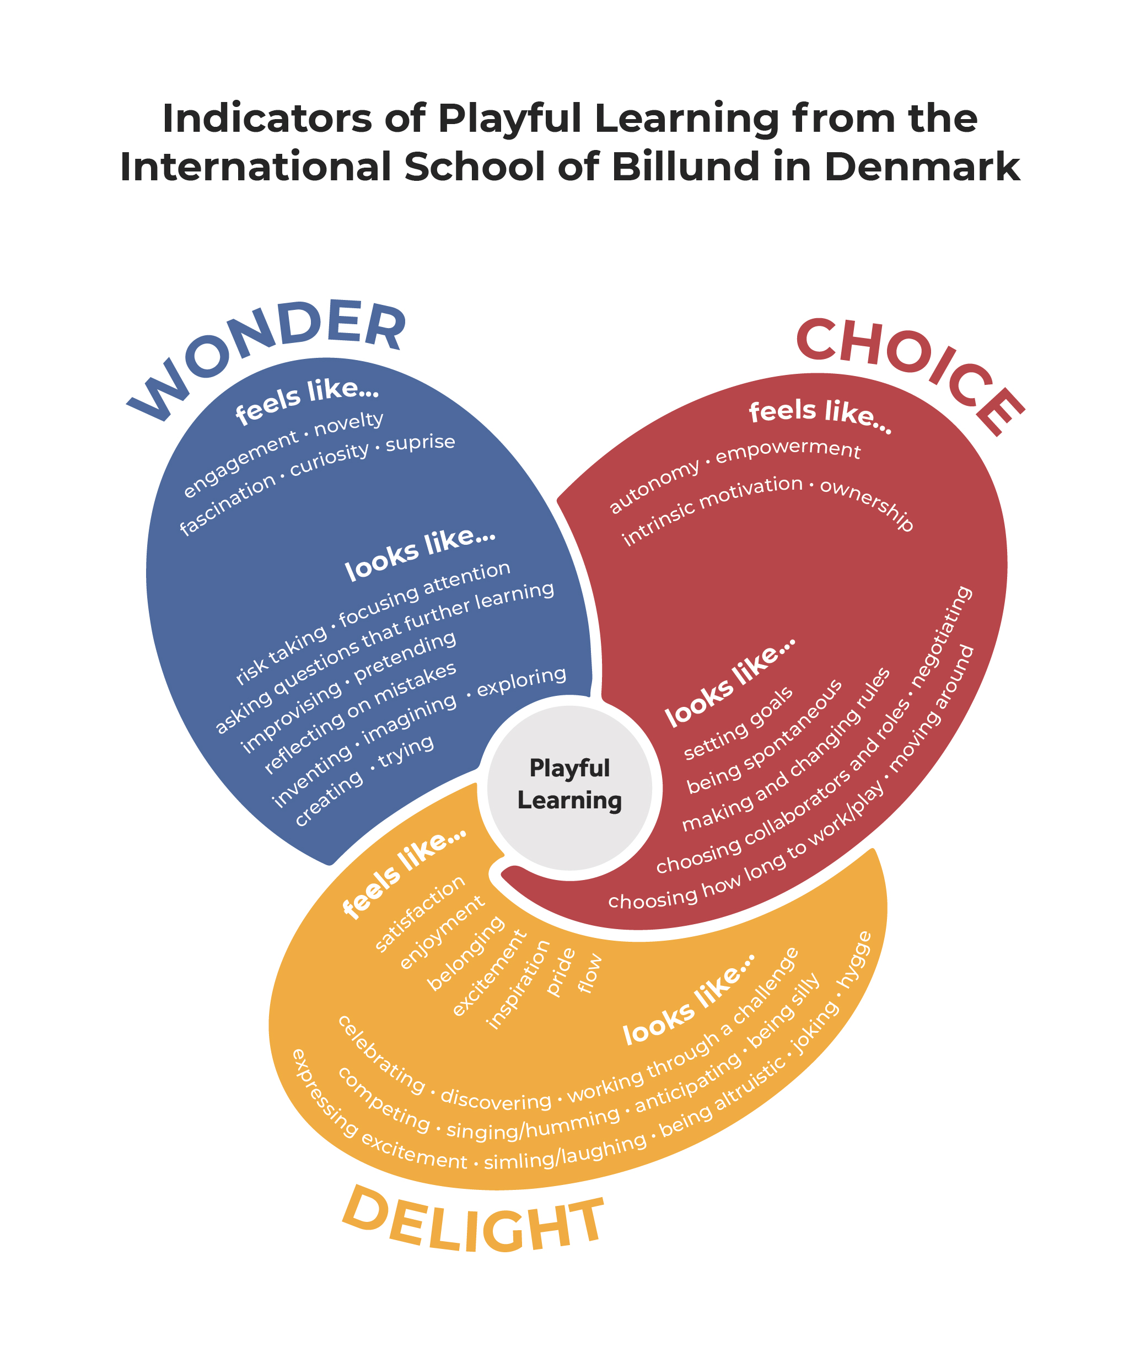
Notes:
And here’s what was found. At ISB, the most prominent ideas that surfaced to define LtP clustered in these three areas – choice, wonder, and delight. In this model, playful learning is likely happening at the nexus of the three indicators.

Slide 10
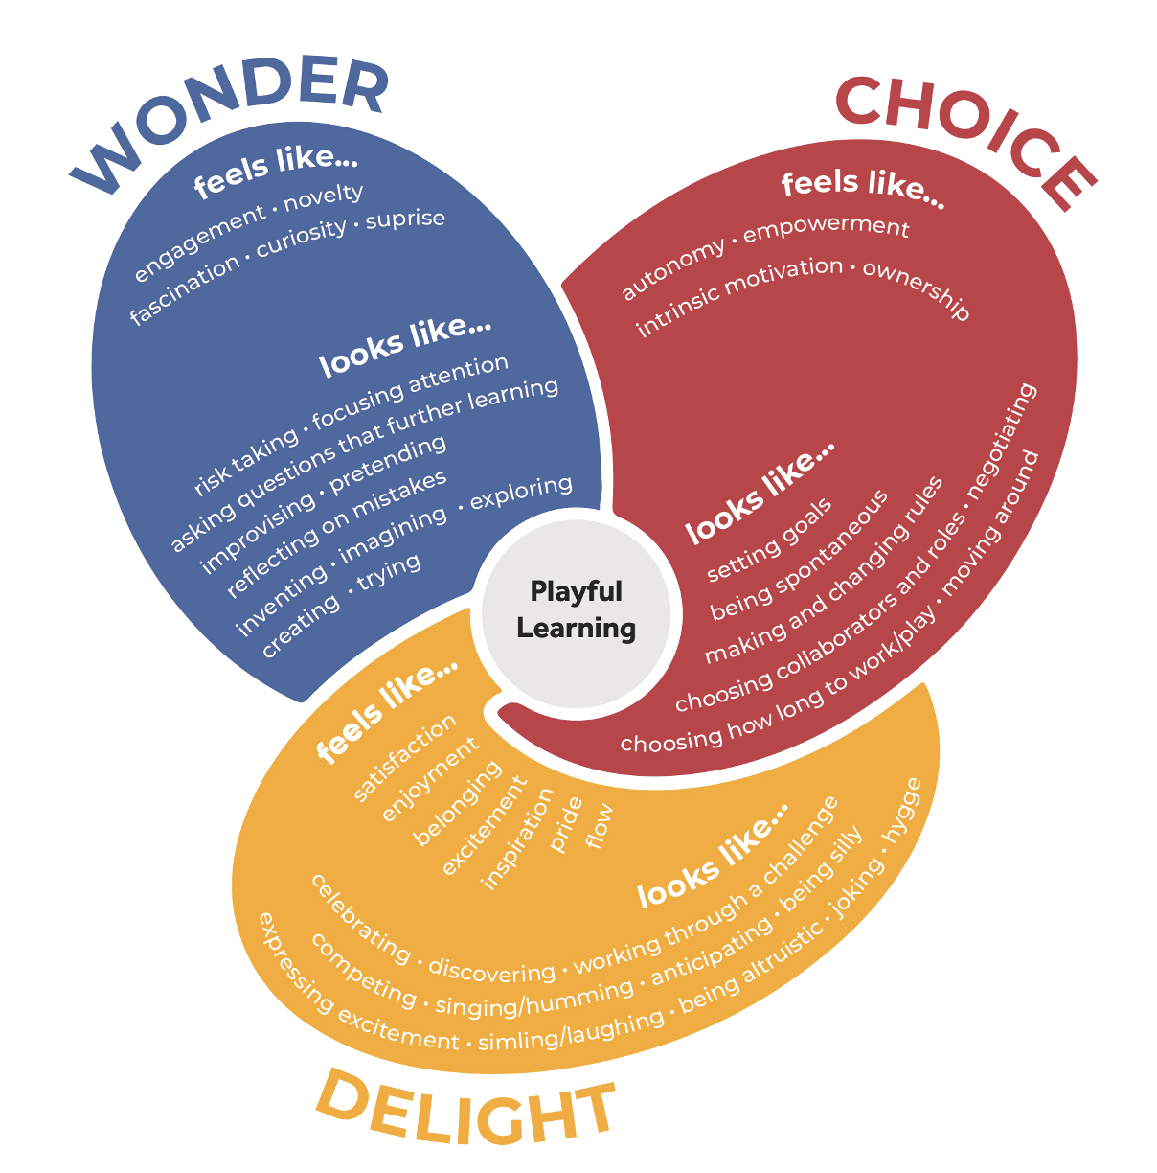
Subjective and Objective
What does playful learning look like? (objective)
What does it feel like? (subjective)
Notes:
Learning through play can be understood both subjectively (what the learners experience) and objectively (what can be observed). So there are indicators for both of these experiences - let’s take a look:

Slide 11
Choice
feels like...
autonomy
empowerment
intrinsic motivation
ownership
looks like...
setting goals
negotiating
choosing how long to work/play
choosing collaborators and roles
influencing the direction of learning
making and changing rules
being spontaneous
moving around
Wonder
feels like...
engagement
novelty
fascination
curiosity
surprise
looks like...
risk taking
trying
reflecting on mistakes
asking questions
focusing attention
improvising
pretending
inventing
imagining
exploring
creating
Delight
feels like...
satisfaction
enjoyment
belonging
pride
excitement
inspiration
flow
looks like...
celebrating
discovering
being silly
competing
singing/humming
smiling/laughing
anticipating
joking
hygge
being altruistic
expressing excitement
working through a challenge
Notes:
The “feels like” indicators are about what learners experience (the subjective)
The “looks like” describe what can be observed by someone watching a playful learning experience

Slide 12
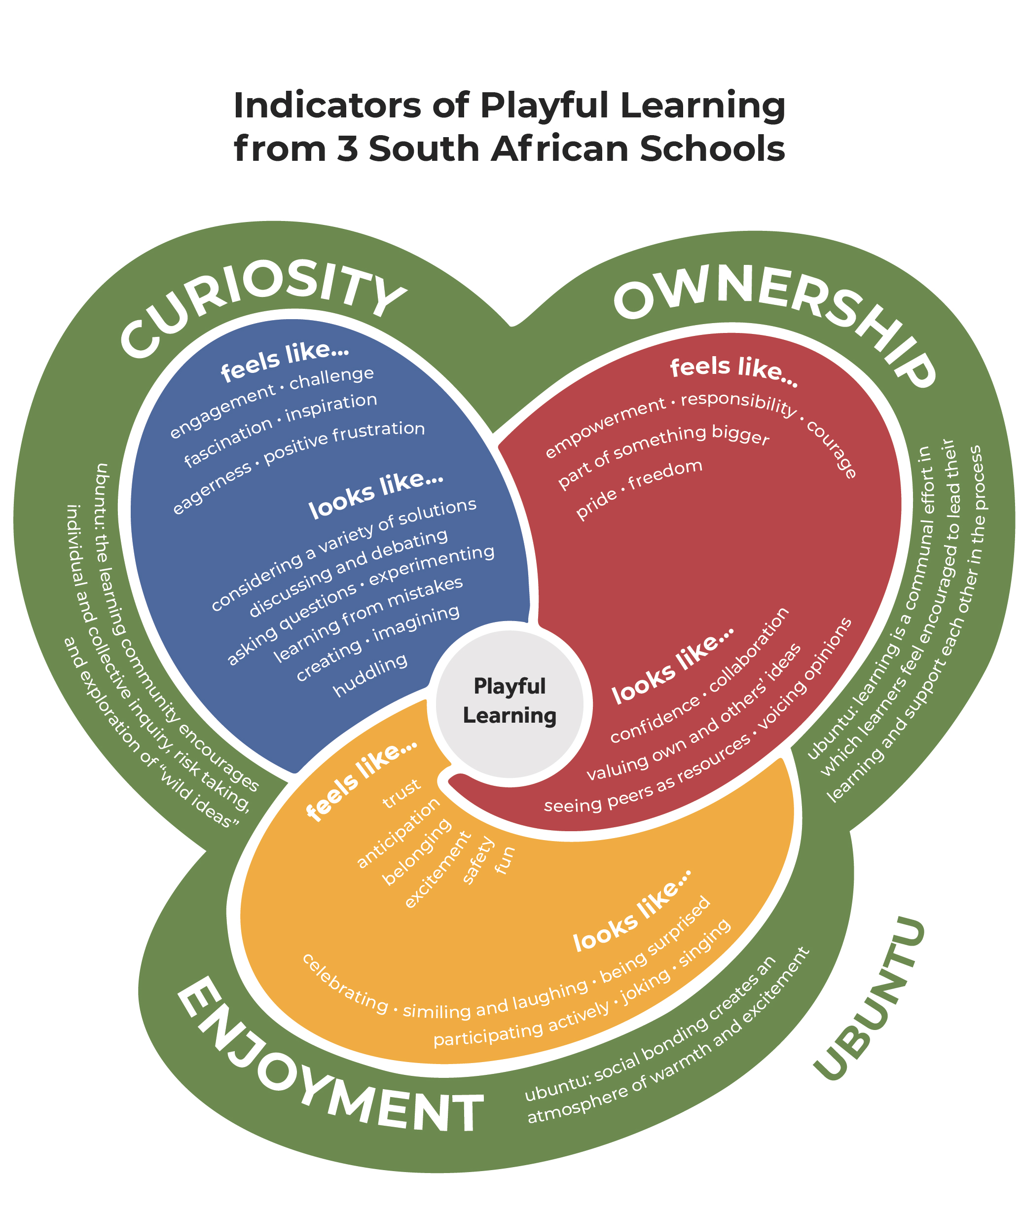
Notes:
In research at several schools in South Africa, PoP found that playful learning involved a sense of ownership, was characterized by feelings of enjoyment, and where learners felt a sense of curiosity. Also in South Africa you'll note the yellow surround of ubuntu – a concept that is present in feelings of ownership, curiosity and enjoyment that includes a sense of generosity, harmony, and interconnectedness.

Slide 13
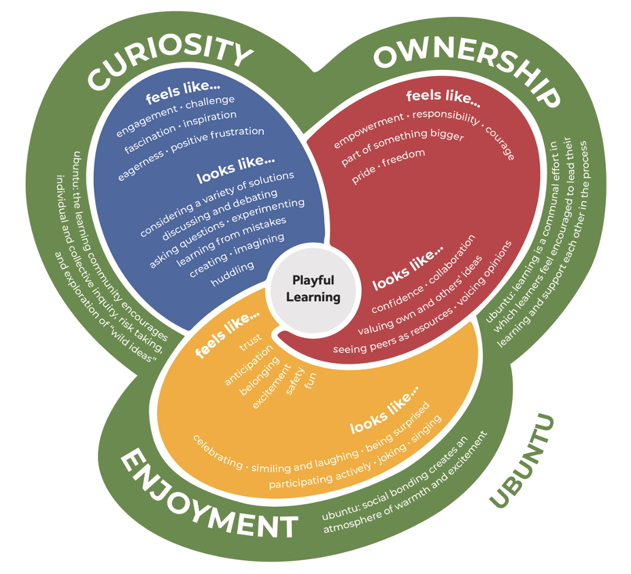
Ownership
feels like...
empowerment
responsibility
courage
pride
freedom
part of something bigger
looks like...
valuing own and others’ ideas
seeing peers as resources
confidence
collaboration
voicing opinions
ubuntu
learning is a communal effort in which learners feel encouraged to lead their learning and support each other in the process
Curiosity
feels like...
engagement
challenge
fascination
inspiration
eagerness
positive frustration
looks like...
considering a variety of solutions
discussing and debating
asking questions
learning from mistakes
experimenting
creating
imagining
huddling
ubuntu
the learning community encourages individual and collective inquiry, risk taking, and exploration of “wild ideas”
Enjoyment
feels like...
trust
anticipation
belonging
excitement
safety
fun
looks like...
celebrating
smiling and laughing
being surprised
participating actively
joking
singing
ubuntu
social bonding creates an atmosphere of warmth and excitement
Notes:
Here are the more detailed indicators from the SA schools.

Slide 14
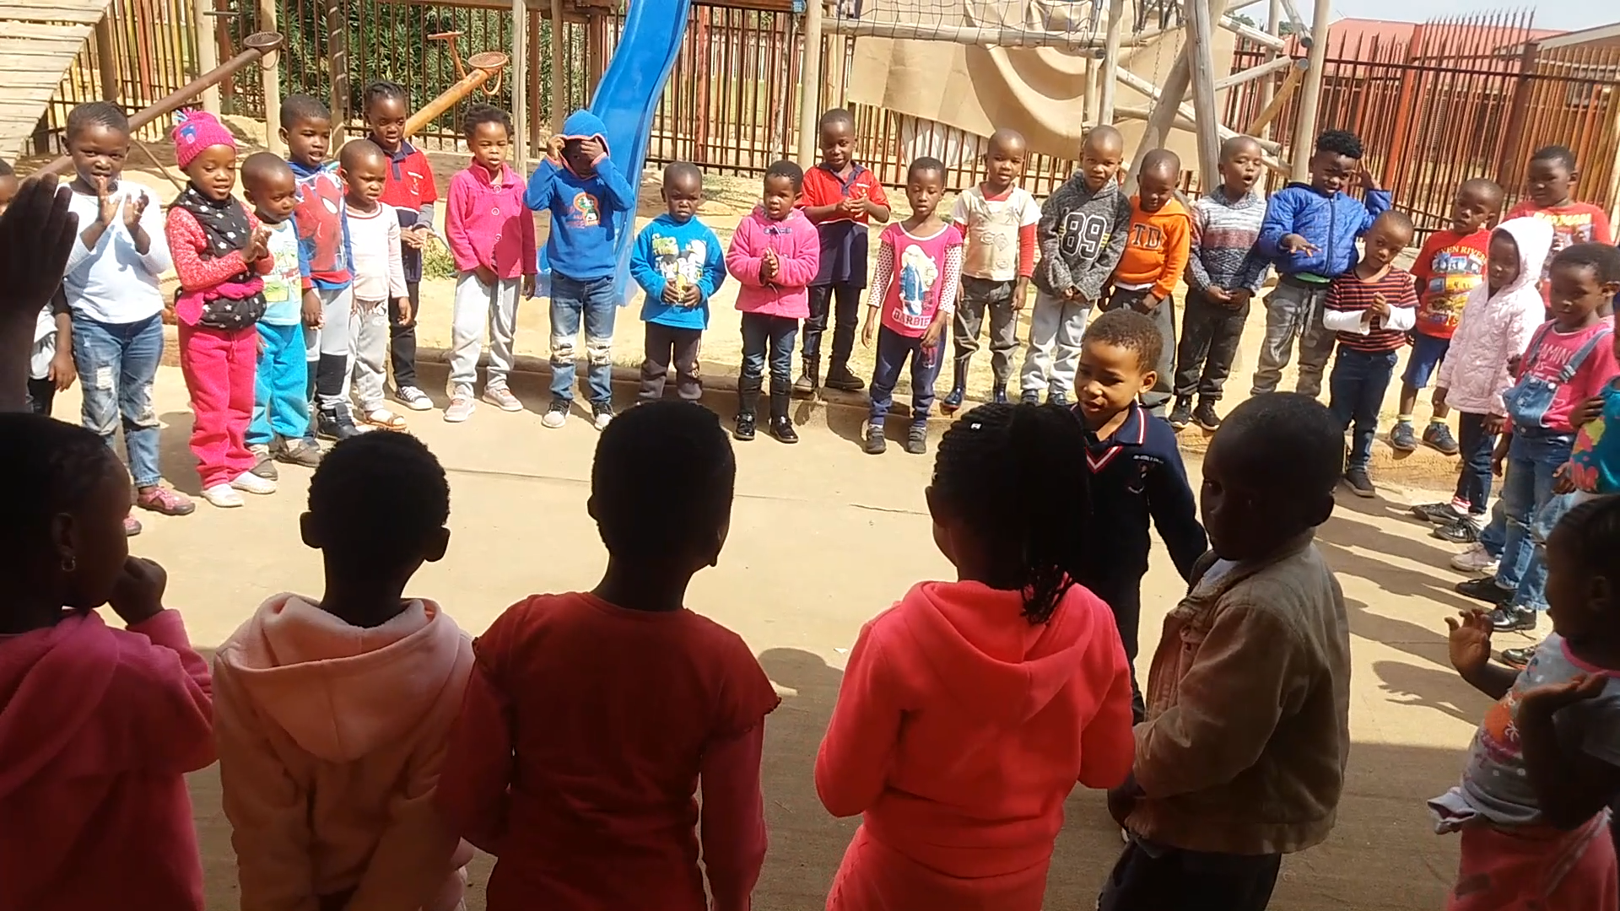
Notes:
Let’s try using those indicators to observe and unpack an experience of learning through play. This example is from the Esikhisini orimary school in Johannesburg, South Africa. The teacher, Kabezwane Chezi, is working with her Grade 2 learners on phonics – learning to spell a common word in English. Many of the children in the class are dual language learners and speak isiZulu, as well as a range of other languages, at home. Note that I’m not sharing this as an exemplar of playful learning, but rather as an interesting example that gives us a chance to test-drive the Indicators. Let’s watch, and then we will use the indicators as a way to discuss what we observe.
Here is a link our working paper about the South African indicators, in case you want to read more about this example and this school:
http://www.pz.harvard.edu/sites/default/files/Pedagogy%20of%20Play%20South%20Africa_Working%20Paper%20Final_Mar%207.pdf

Slide 15
Ownership
feels like...
empowerment
responsibility
courage
pride
freedom
part of something bigger
looks like...
valuing own and others’ ideas
seeing peers as resources
confidence
collaboration
voicing opinions
ubuntu
learning is a communal effort in which learners feel encouraged to lead their learning and support each other in the process
Curiosity
feels like...
engagement
challenge
fascination
inspiration
eagerness
positive frustration
looks like...
considering a variety of solutions
discussing and debating
asking questions
learning from mistakes
experimenting
creating
imagining
huddling
ubuntu
the learning community encourages individual and collective inquiry, risk taking, and exploration of “wild ideas”
Enjoyment
feels like...
trust
anticipation
belonging
excitement
safety
fun
looks like...
celebrating
smiling and laughing
being surprised
participating actively
joking
singing
ubuntu
social bonding creates an atmosphere of warmth and excitement
Notes:
I’ve expanded the “looks like” section here because we are observers – we can’t say what the experience “felt like” to the learners.
What did you see? Any of these indicators?
(hand out on paper, or use a digital platform to have students engage with this)

Slide 16
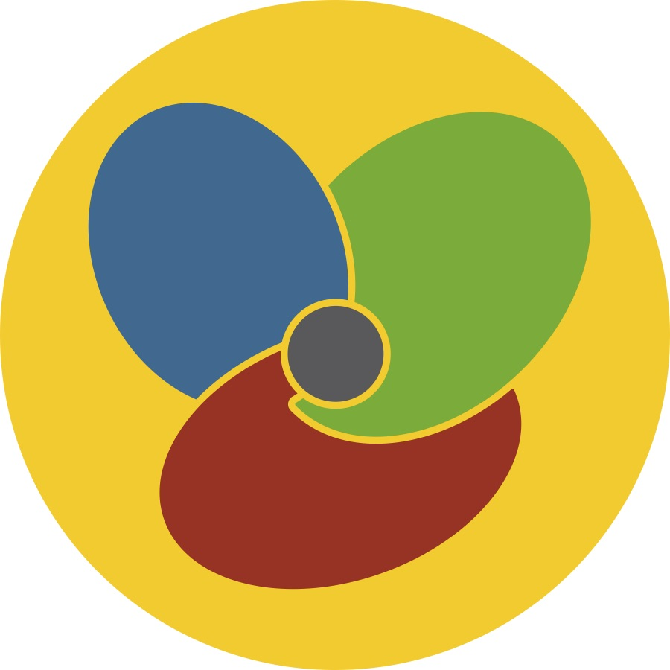
Ownership
feels like...
empowerment
responsibility
courage
pride
freedom
part of something bigger
looks like...
valuing own and
others’ ideas
seeing peers as
resources
confidence
collaboration
voicing opinions
ubuntu
learning is a communal effort in which learners feel encouraged to lead their learning and support each other in the process
Curiosity
feels like...
engagement
challenge
fascination
inspiration
eagerness
positive frustration
looks like...
considering a variety of solutions
discussing and debating
asking questions
learning from mistakes
experimenting
creating
imagining
huddling
ubuntu
the learning community encourages individual and collective inquiry, risk taking, and exploration of “wild ideas”
Enjoyment
feels like...
trust
anticipation
belonging
excitement
safety
fun
looks like...
celebrating
smiling and laughing
being surprised
participating actively
joking
singing
ubuntu
social bonding creates an atmosphere of warmth and excitement
Notes:
I’ve expanded the “looks like” section here because we are observers – we can’t say what the experience “felt like” to the learners.
What did you see? Any of these indicators?
(hand out on paper, or use a digital platform to have students engage with this)

Slide 17
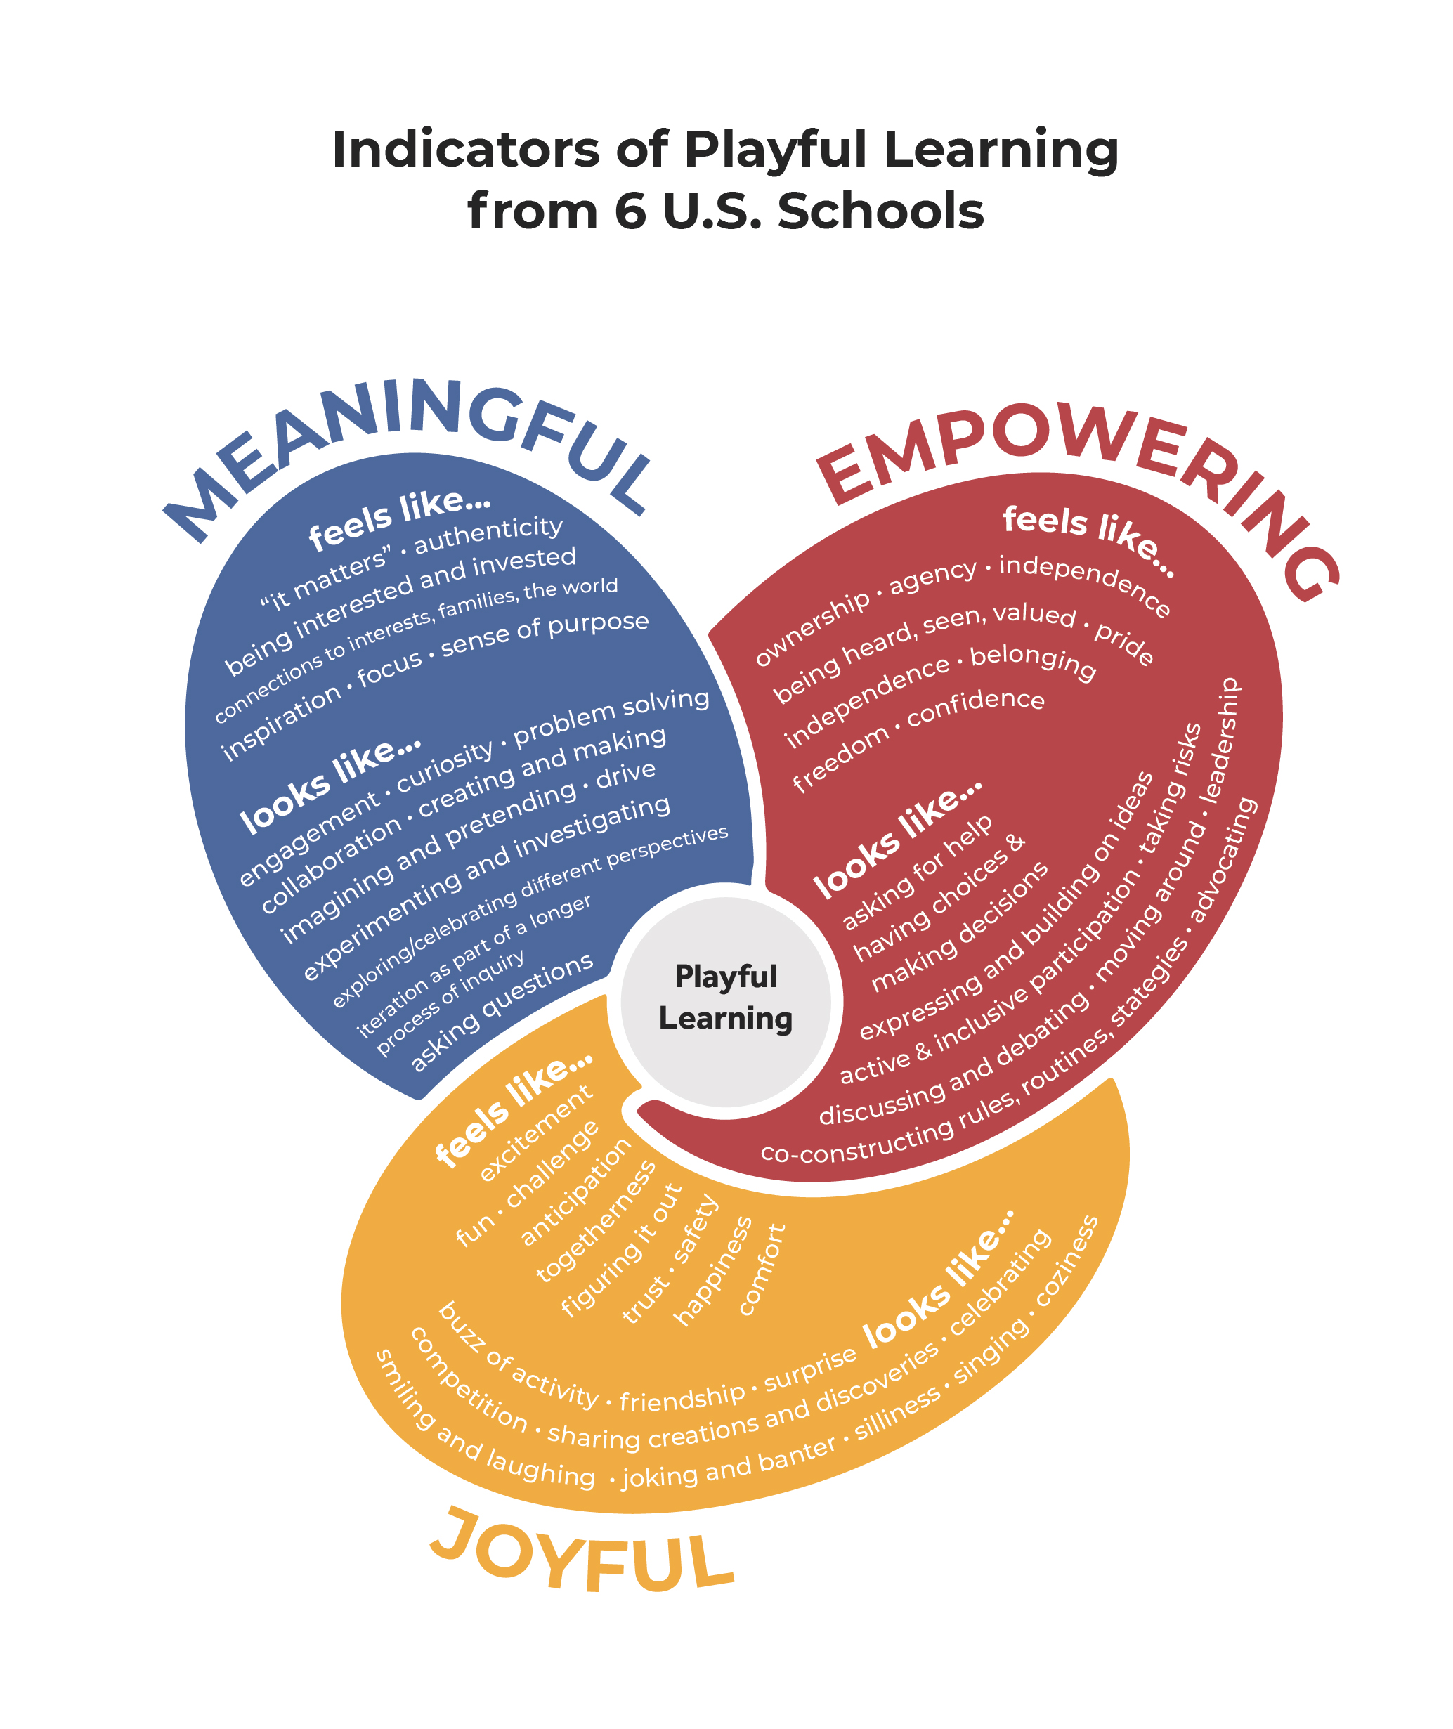
Notes:
Here are the indicators from the U.S. schools

Slide 18
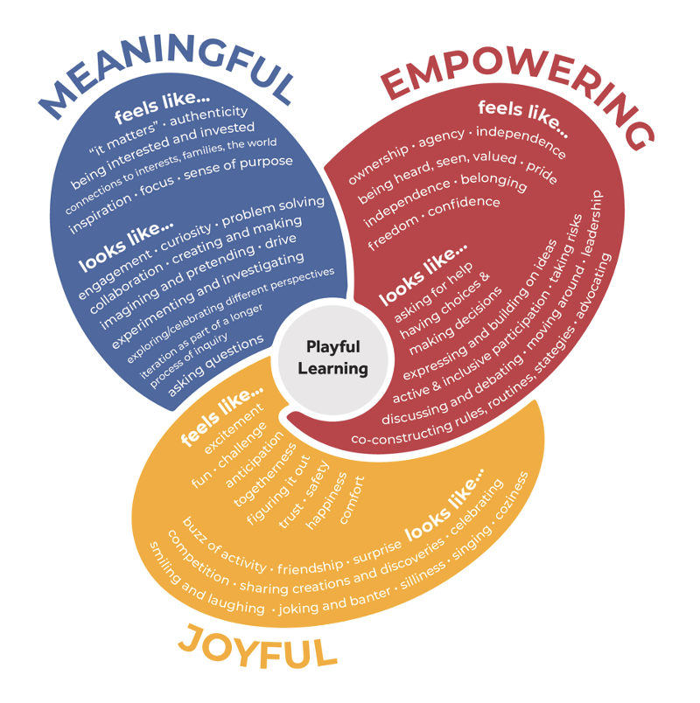
Empowering
feels like...
Ownership
Agency
Being heard and seen
Independence
Belonging
Pride
Freedom
Confidence
looks like...
Having choices and making decisions
Leadership
Taking risks
Co-constructing rules, routines,
strategies
Active and inclusive participation
Expressing and building on ideas
Discussing and debating
Asking for help
Moving around
Meaningful
feels like...
“It matters”
Being interested and invested
Connections to interests, families, the world
Authenticity
Inspiration
Sense of purpose
looks like...
Engagement
Curiosity
Collaboration
Drive
Creating and making
Imagining and pretending
Experimenting and investigating
Problem solving
Asking questions
Exploring different perspectives
Iteration as part of a longer
process of inquiry
Joyful
feels like...
Excitement
Challenge
Anticipation
Togetherness
Figuring it out
Trust
Safety
Comfort
Happiness
Fun
looks like...
Smiling and laughing
Surprise
Joking and banter
Friendship
Sharing creations and discoveries
Buzz of activity
Silliness
Competition
Singing
Celebrating
Coziness

Slide 19
Insert a U.S.-based video here from the video library to try out using the indicators from the U.S. schools

Slide 20
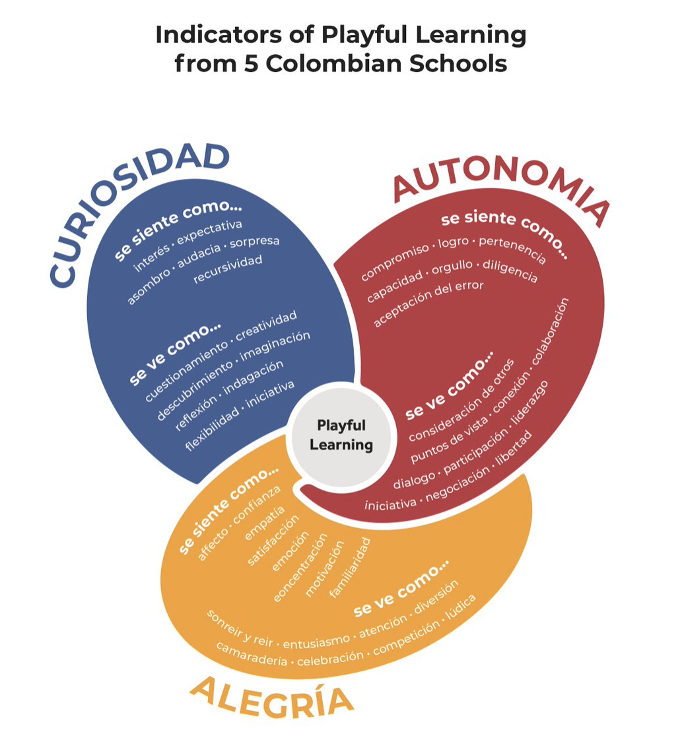
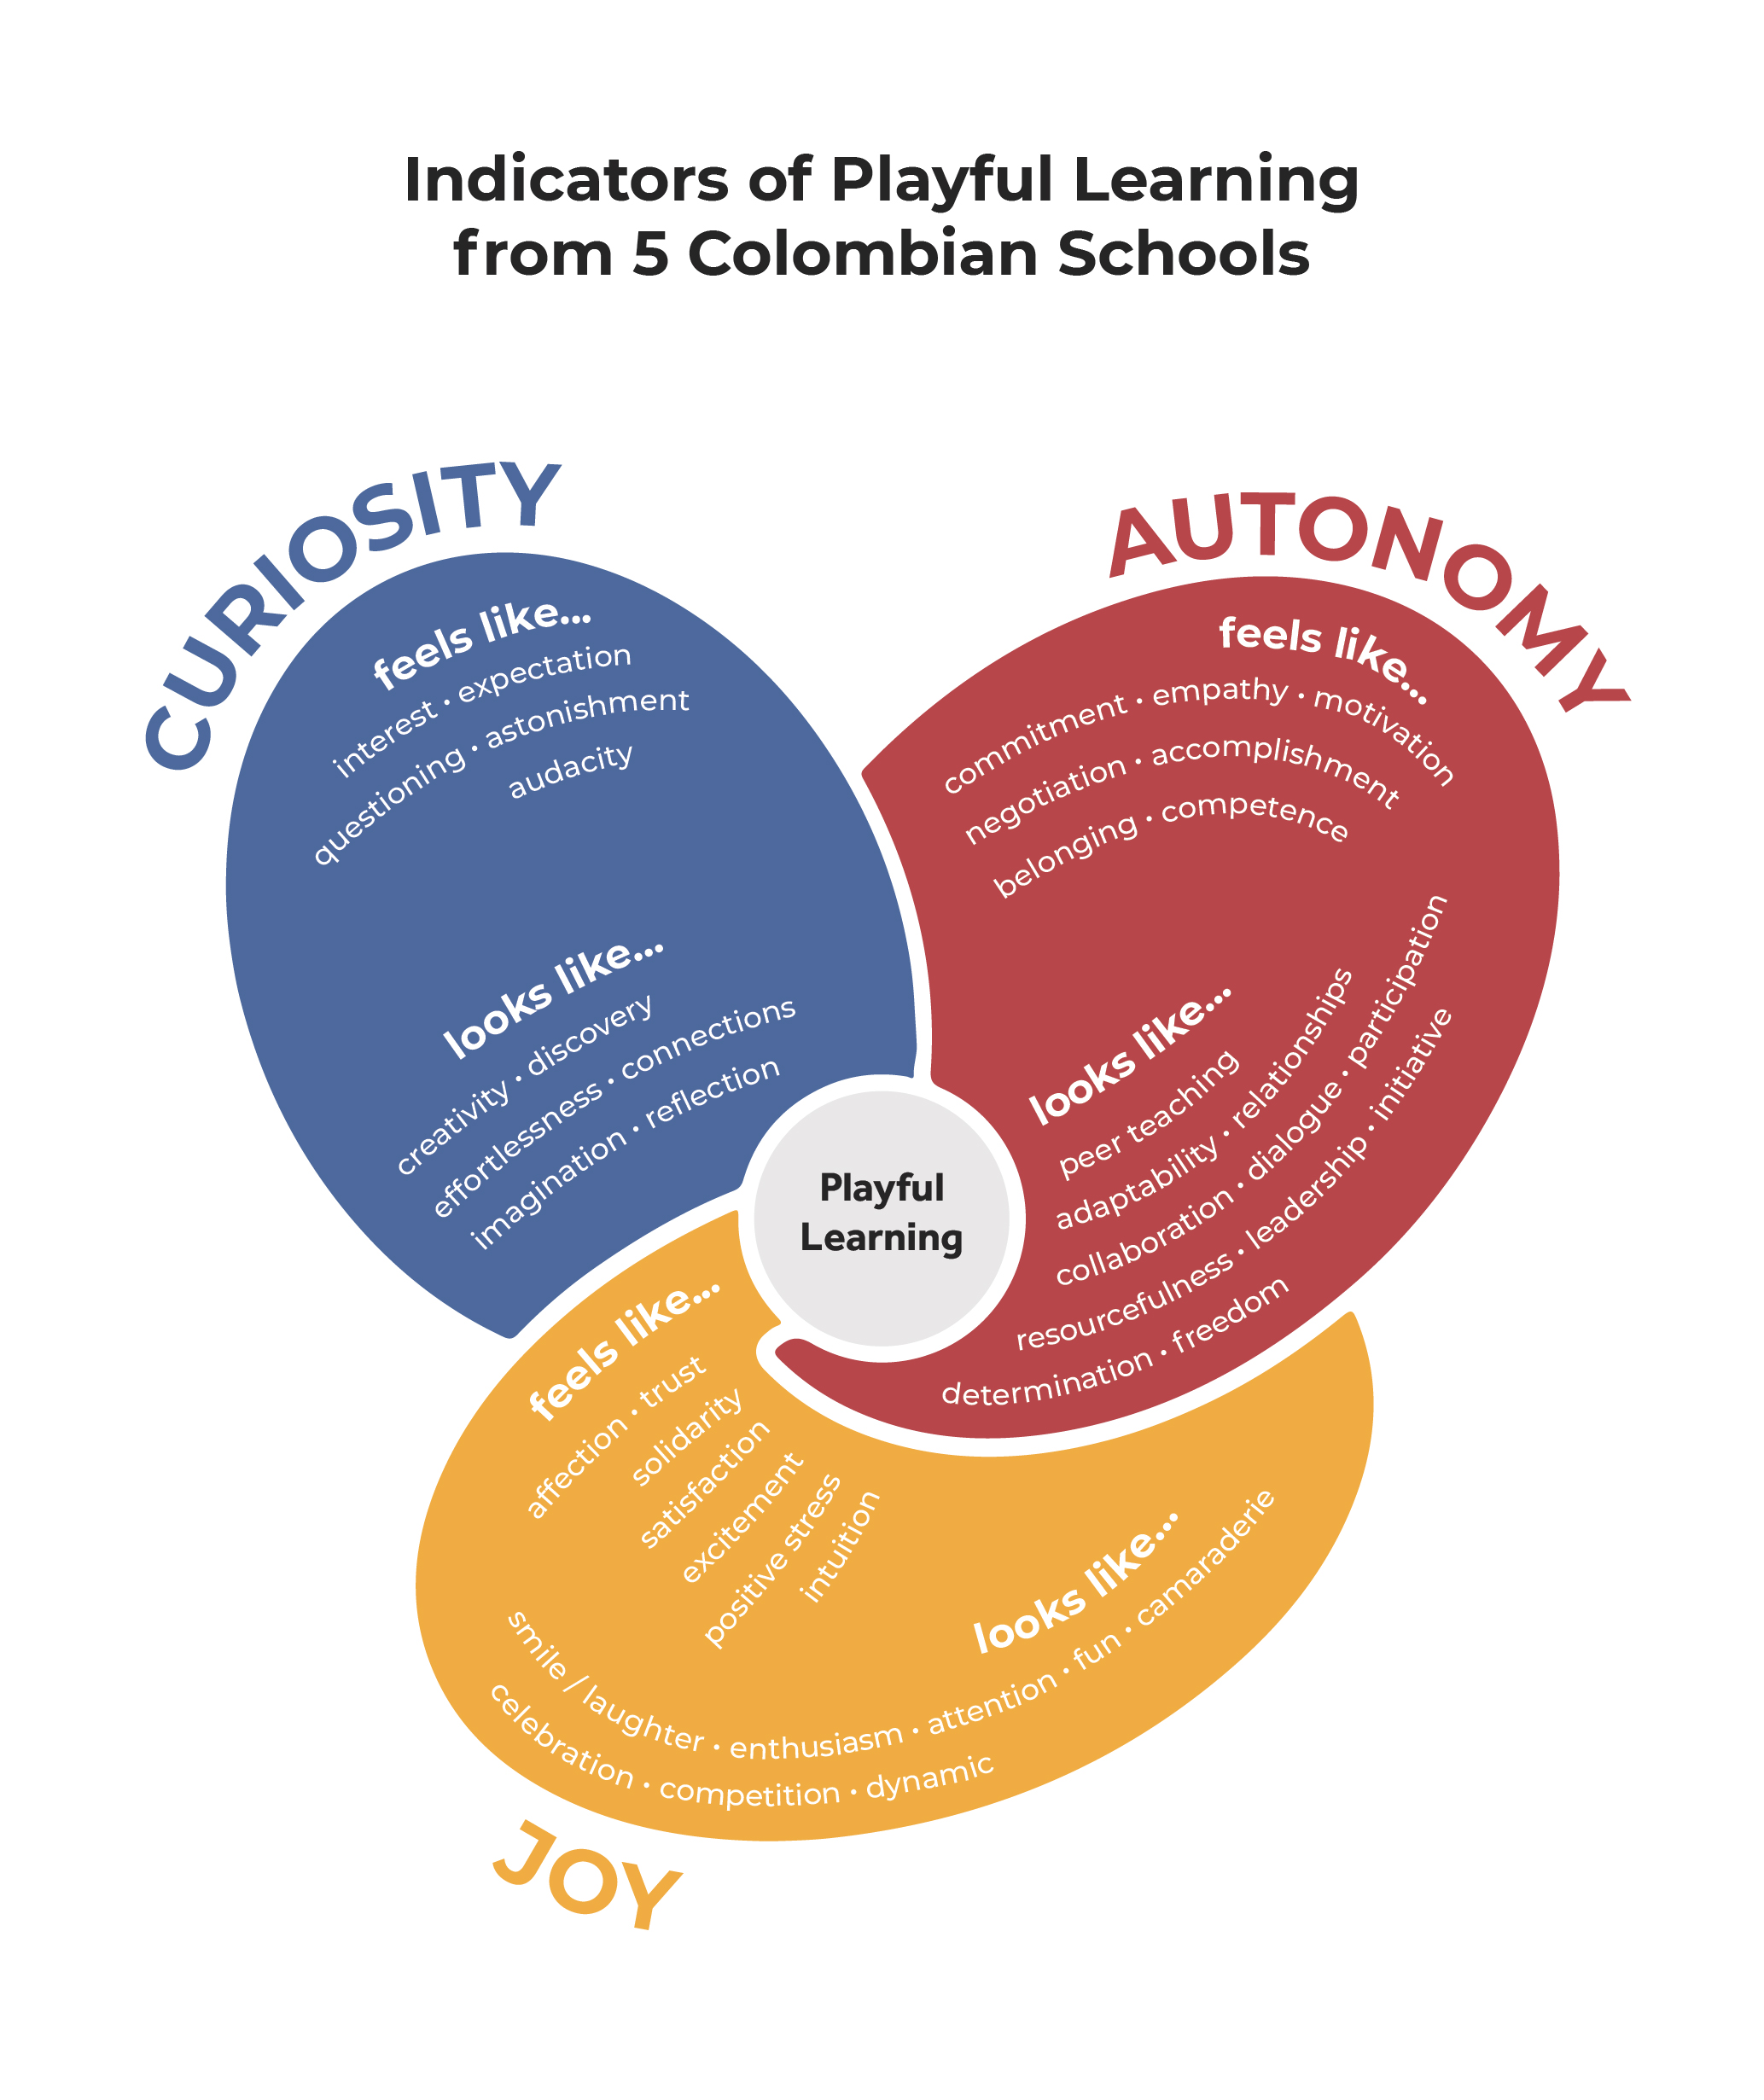
Indicators of Playful Learning
Ownership
Curiosity
Playful
Learning
Enjoyment
Notes:
Notice that while there are some similarities across the model, each model of playful learning is specific to the site in which the learning and teaching is happening; and each model is what we mean by having a common language of playful learning. So when educators talk about fostering a school where playful learning thrives, having these models allows everyone to be on the same page when talking about play. At ISB they want to foster a school full of choice, wonder, and delight; in SA they want to create an environment where children and teachers feel ownership, curiosity, and enjoyment. We have worked hard to use the language that teachers and students use so that the concepts and ideas are accessible to their cultural context. This is why it’s important, even if there are some similarities across the models, to have specific indicators for each context.
Having a shared understanding of what playful learning means in a particular context can help educators speak the same language about playful learning, which makes it more likely that they will be on the same page in working towards promoting learning through play experiences in their schools.

Slide 21
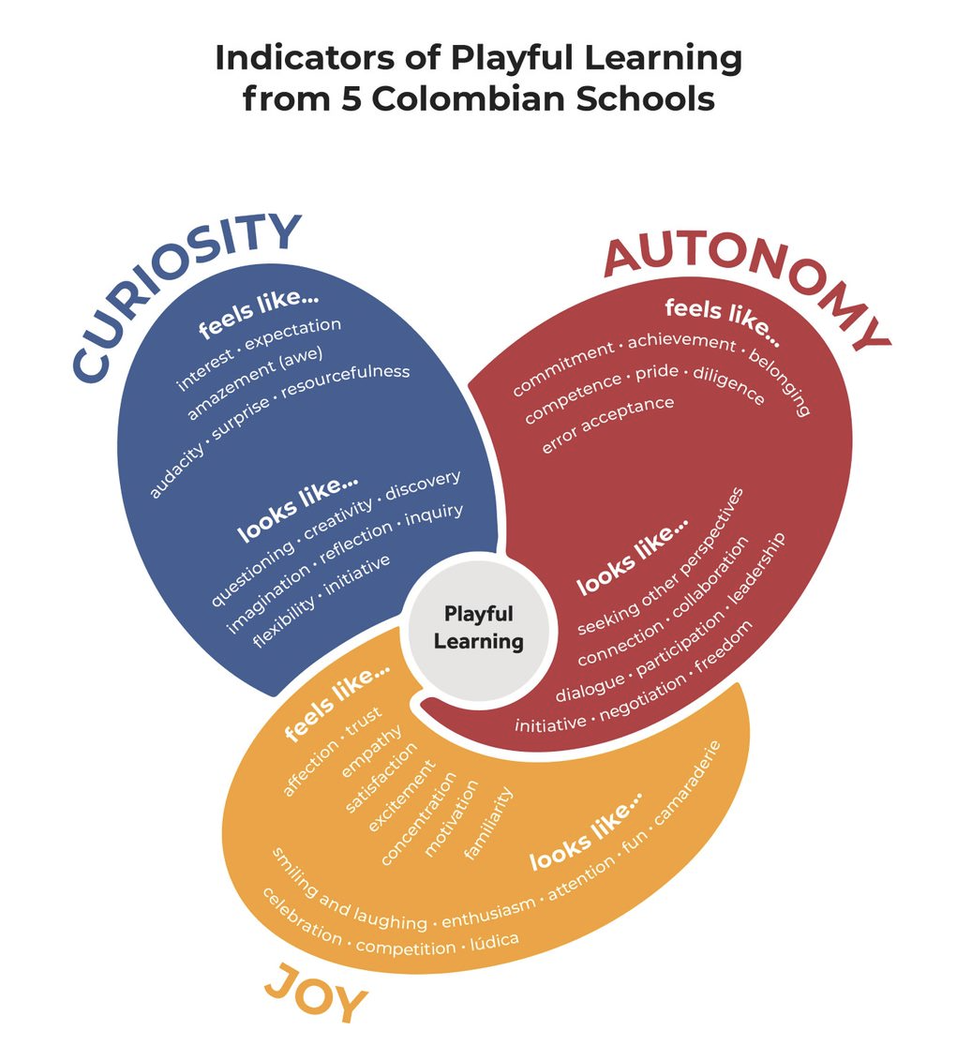

Slide 22
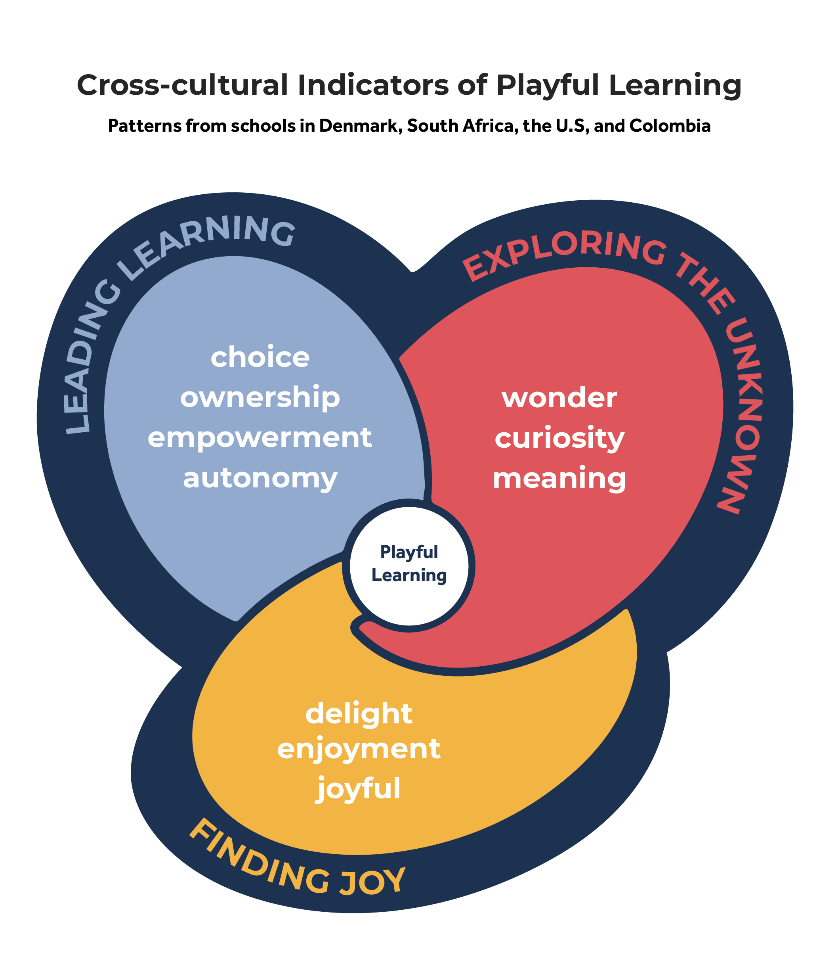
Notes:
This is a cross-cultural model that looks across all four of those contexts.
On the PoP website, you can also find a guide to creating indicators specific to your own school or context

Slide 23
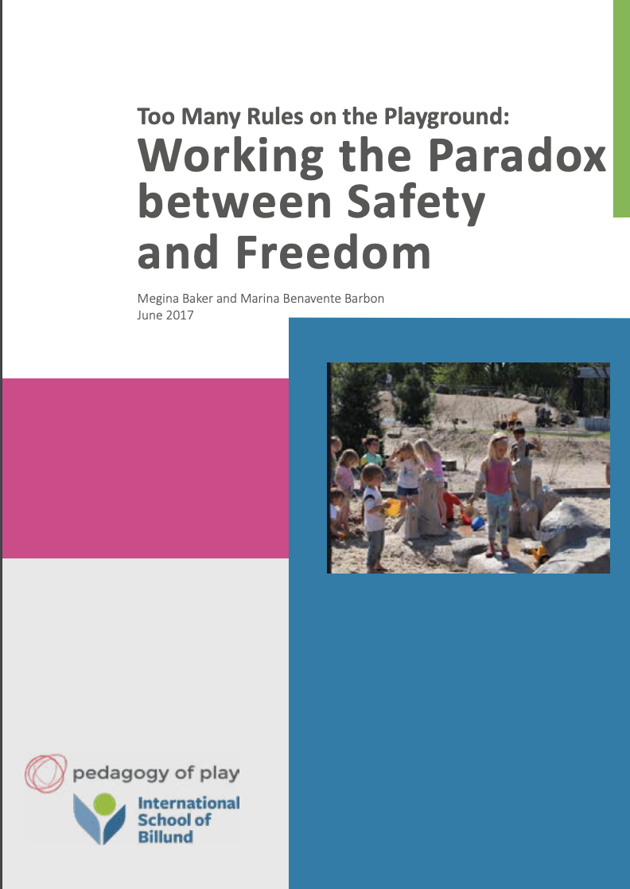
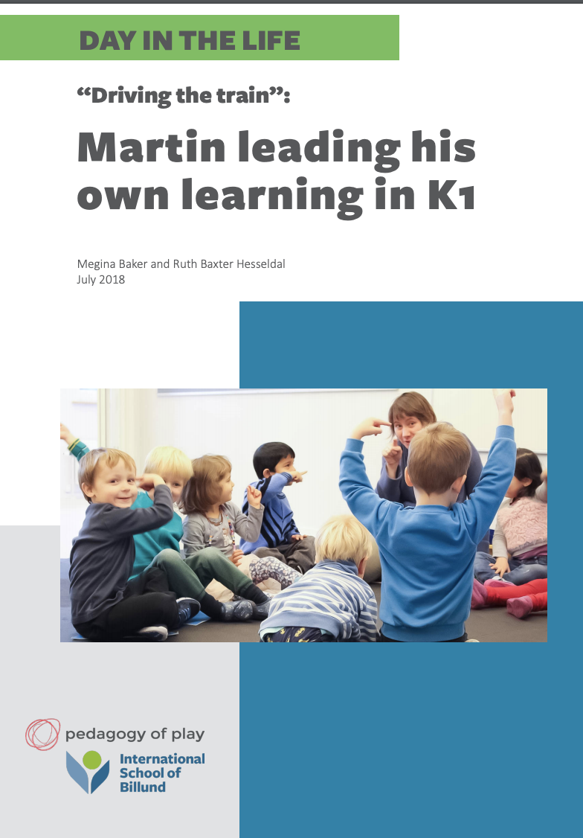
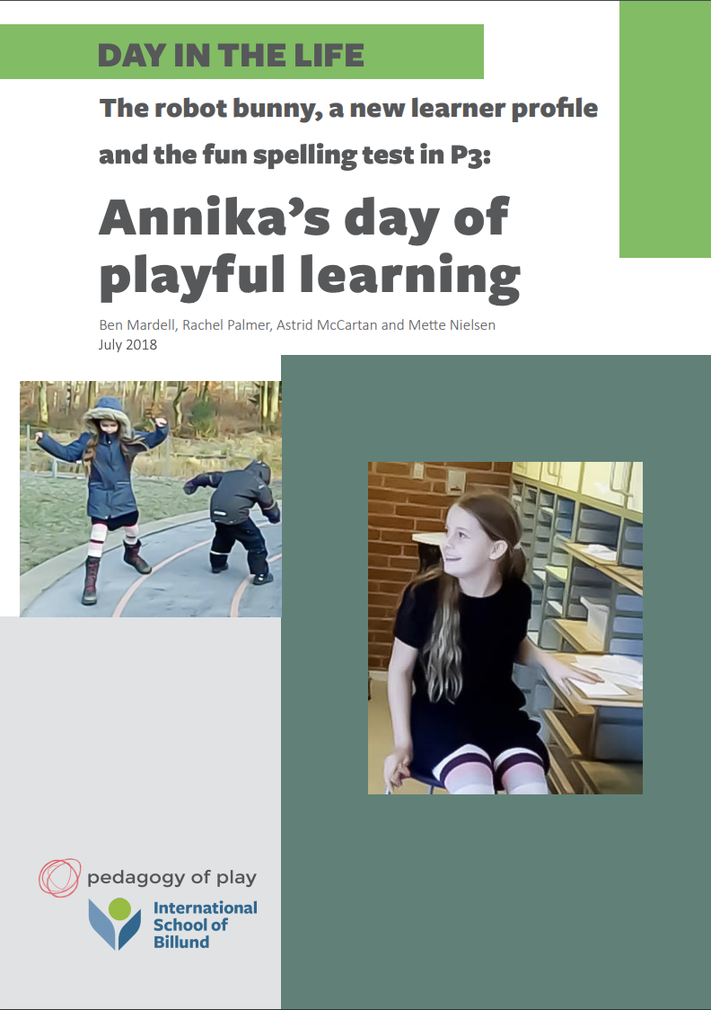
Breakout Discussions: PoP Pictures of Practice
In the Picture of Practice you read:
  What indicators of playful learning did you see evident in the examples shared?
  What intrigued or puzzled you?

Slide 24
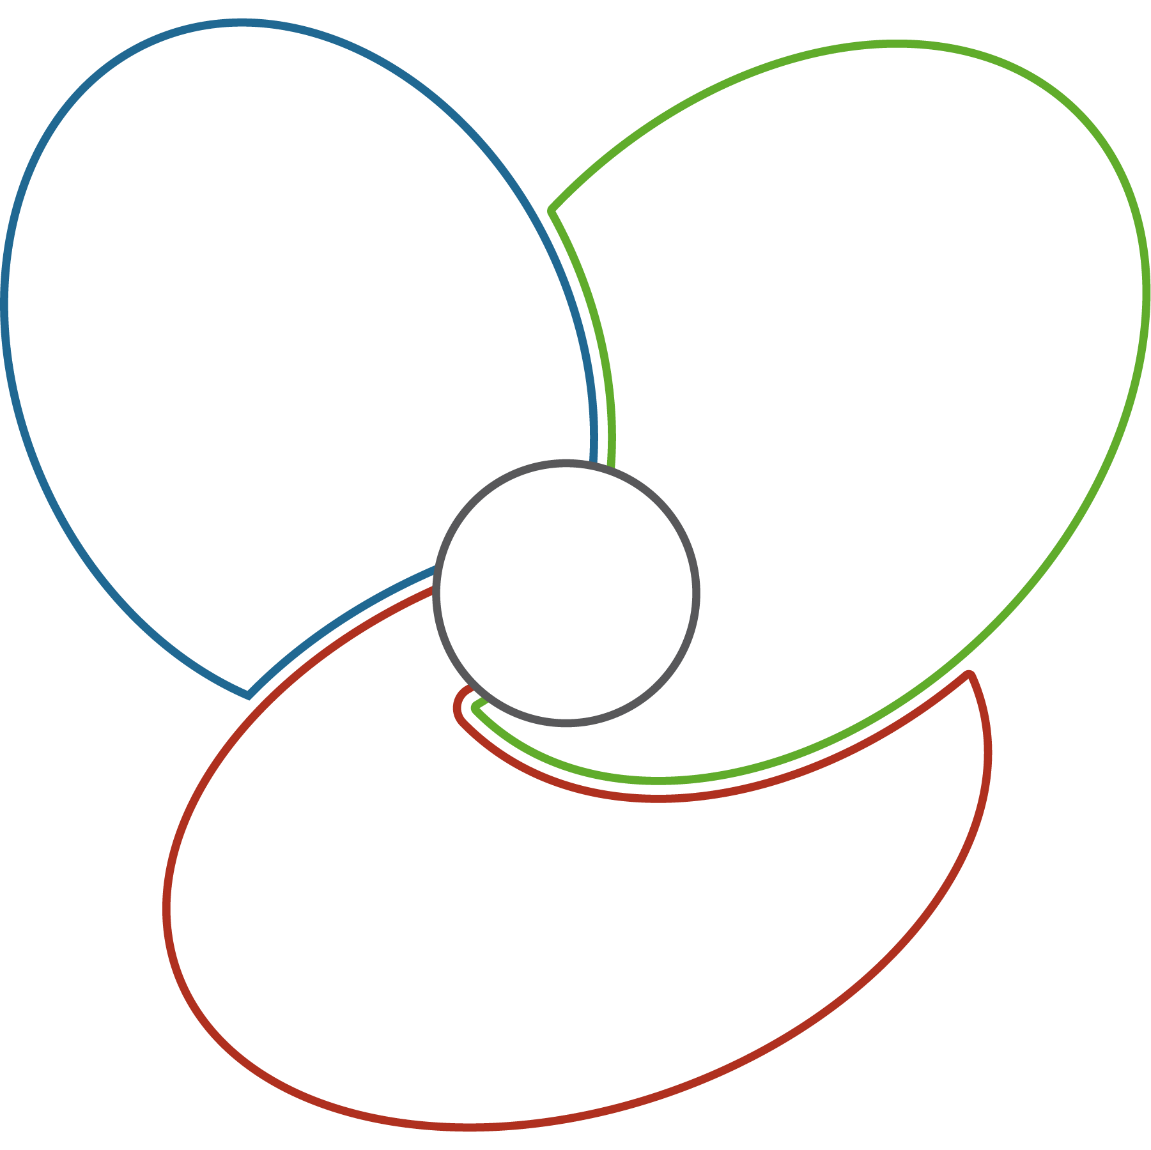
Our Indicators of Playful Learning
feels like...
feels like...
looks like...
looks like...
Playful
Learning
feels like...
looks like...
© 2019 President and Fellows of Harvard College. My/Our Indicators of Playful Learning was developed by Pedagogy of Play at Project Zero with educators from International School of Billund. Funded by the LEGO Foundation, the work is licensed under Creative Commons Attribution-NonCommercial 4.0 International.

