Slide 1
Introduction to Playful Participatory Research and Advocating for Play

Slide 2
Gameplan
Play as a right of children
Advocating for Play
The Great Play Debate
Introduction to Playful Participatory Research
Discussions – Teacher Research Examples
Documentation as a Tool for PPR
Making paper airplanes
Choosing PPR Questions
Stars and Wishes

Slide 3
“Play must be the right of every child. Not a privilege. After all, when regarded as a privilege, it is granted to some and denied to others, creating further inequities. Play as a right is what is fair and just. Although children will engage in play differently, play is a child’s right. It is currently being denied in the name of rigor and academics, both of which have been used as racist ways of keeping the status quo in place. That is, in low-income preschools and schools, we see mandates, which seek to standardize and manage. In wealthier preschools, we witness the possibilities of play unleashed.”
(Souto-Manning, 2017)

Slide 4
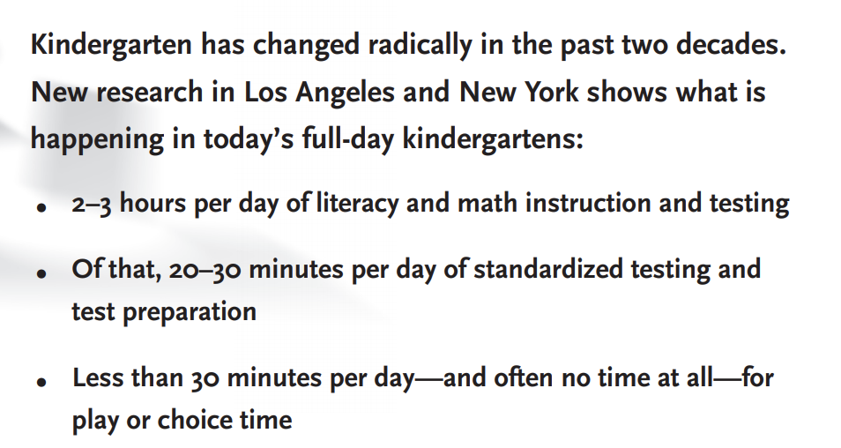
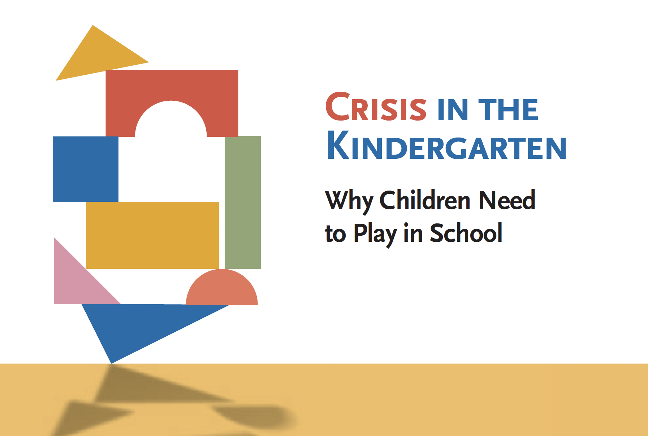

Slide 5
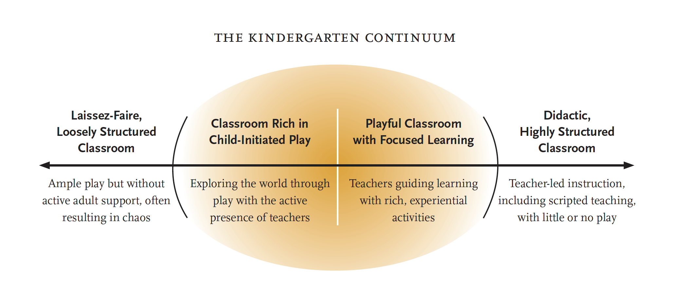
Has the crisis shifted since 2009?
Notes:
If teaching teachers of older learners, omit these slides and this reading. Or use to spark a discussion about the implications of limiting play in the early years and what impacts that can have on older learners in terms of their creativity, thinking, etc.

Slide 6
“When positioned as a privilege, play is granted to children who are in the dominant group while those in non-dominant groups are denied the right to play.” (Souto-Manning, 2017)
Have you seen or heard of examples of play as a privilege, not a right?

Slide 7
Crisis in Kindergarten report as Advocacy: Recommendations
1. Restore child-initiated play and experiential learning with the active support of teachers to their rightful place at the heart of kindergarten education.
2. Reassess kindergarten standards to ensure that they promote developmentally appropriate practices, and eliminate those that do not.
3. End the inappropriate use in kindergarten of standardized tests, which are prone to serious error especially when given to children under age eight.
4. Expand the early childhood research agenda to examine the long-term impact of current preschool and kindergarten practices on the development of children from diverse backgrounds.
5. Give teachers of young children first-rate preparation that emphasizes the full development of the child and the importance of play, nurtures children’s innate love of learning, and supports teachers’ own capacities for creativity, autonomy, and integrity.
6. Use the crisis of play’s disappearance from kindergarten to rally organizations and individuals to create a national movement for play in schools and communities.

Slide 8
How to advocate for more play
First, trust that you are a smart and powerful advocate for children!
Advocacy is easy – you can do it!
Get your story ready – be able to tell a quick story about the impact of increased playful learning for children you have worked with, and back it up with 1 research finding (e.g. from some of our readings in this course).

Slide 9
How to advocate for more play
Learn about who makes decisions about education in your community – local, state/district, nationally
Reach out to decision-makers and offer to be a resource in your area of expertise.
Welcome newly elected officials to office by sending letters, artwork from the children in your class
Use social media – write, share, and re-post resources and information about the importance of play
Share information with your school community – other teachers, administrators, families (e.g. during curriculum night, in family newsletters, during staff meetings)

Slide 10
Advocating for Play Examples

Slide 11
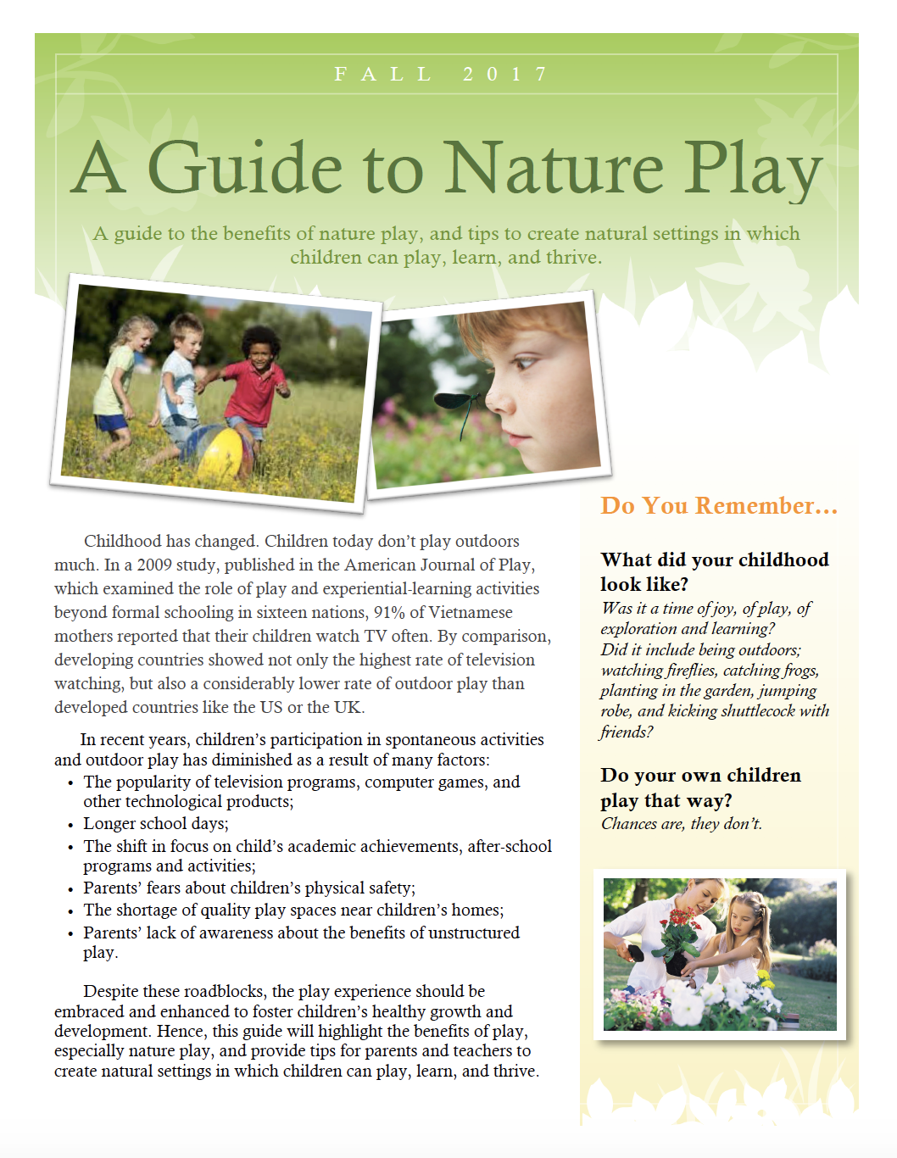
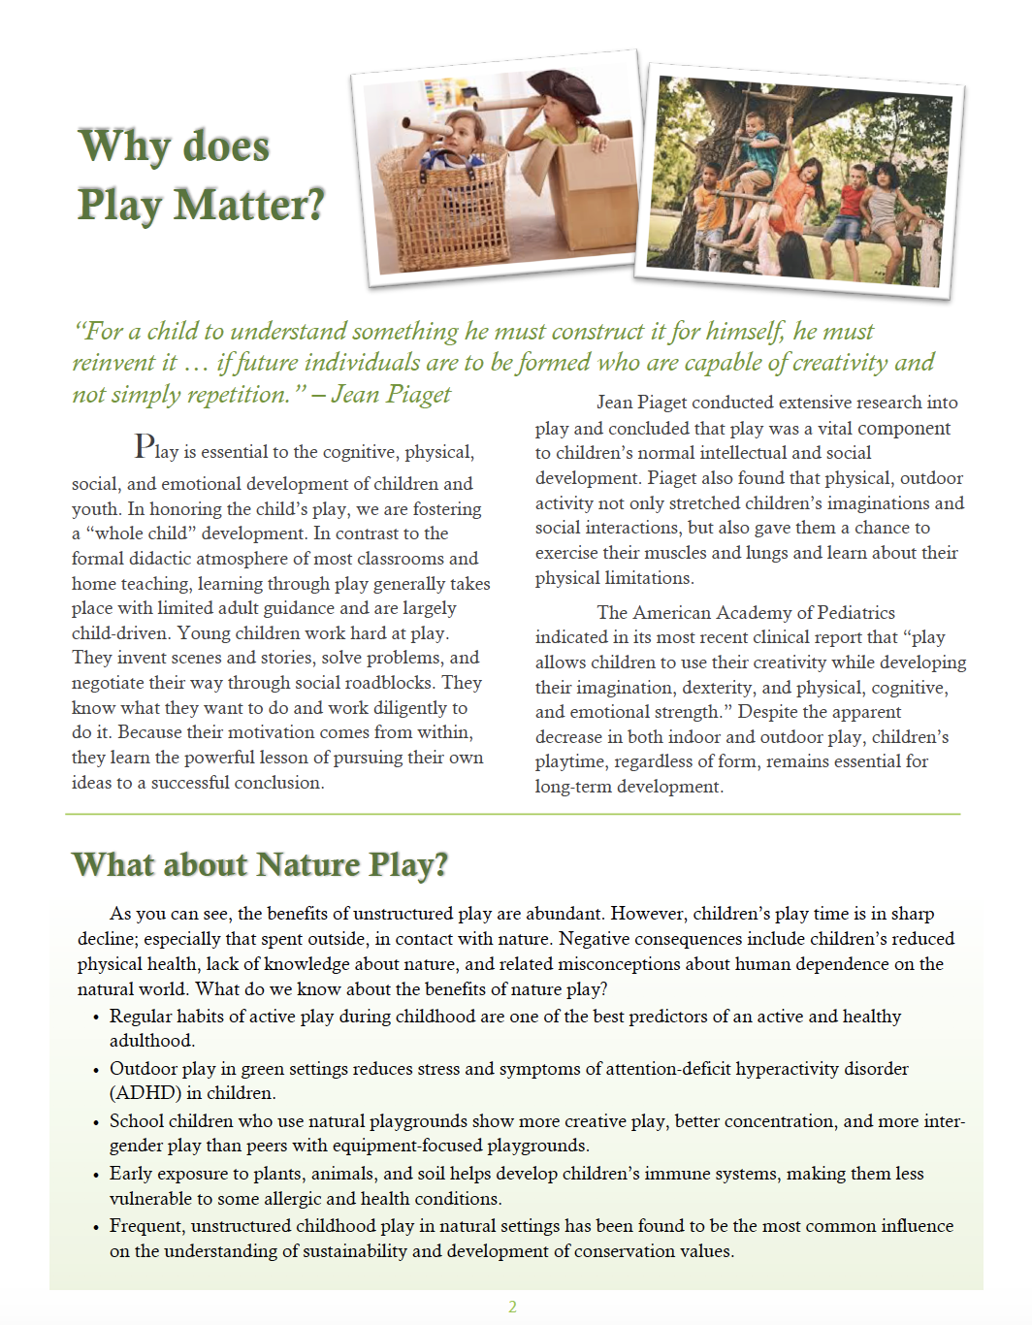

Slide 12
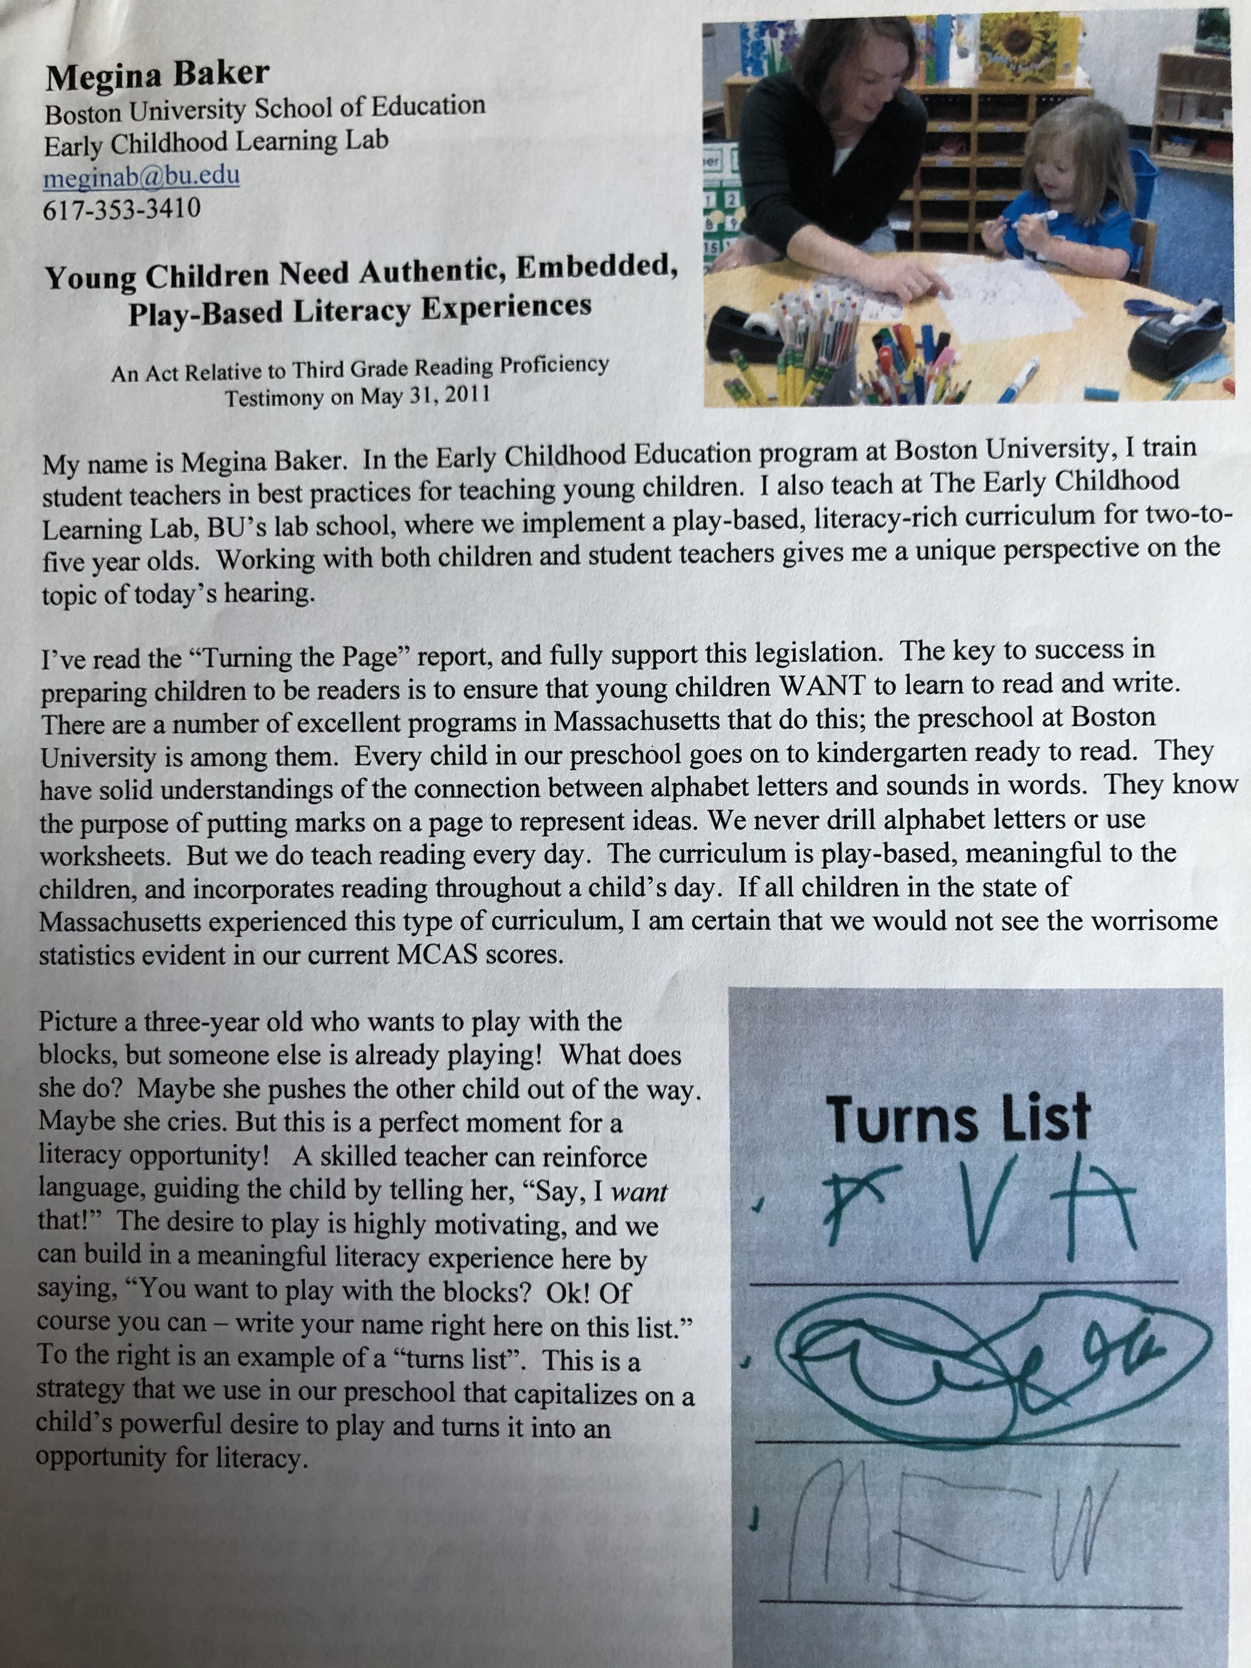
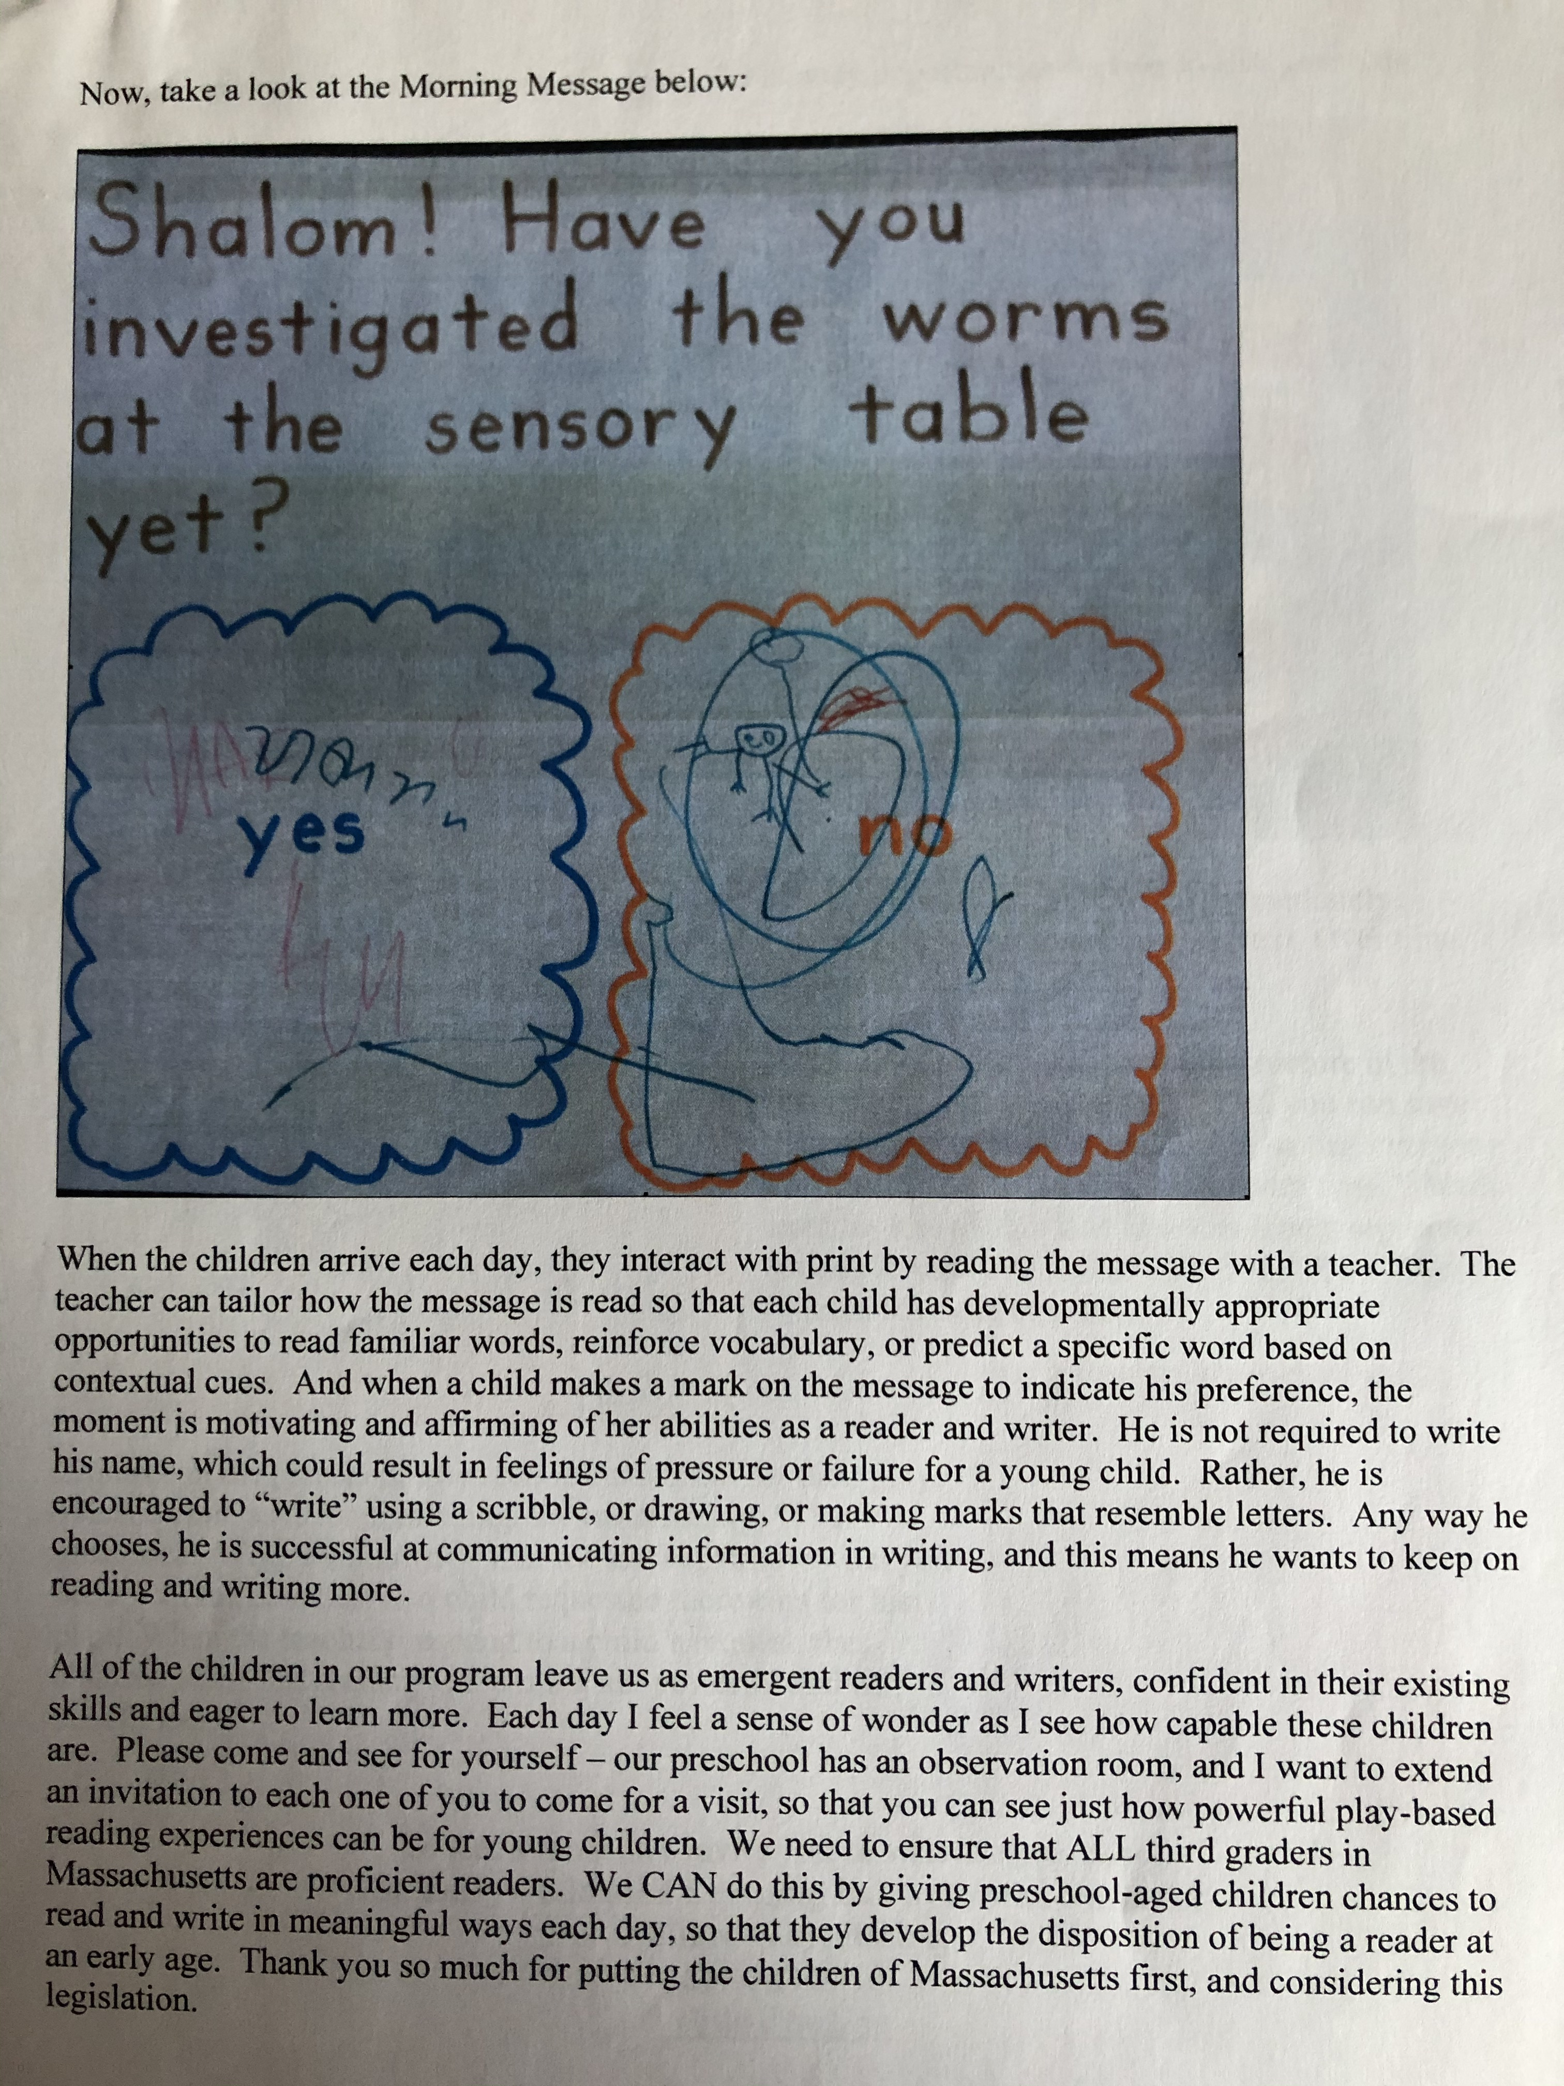
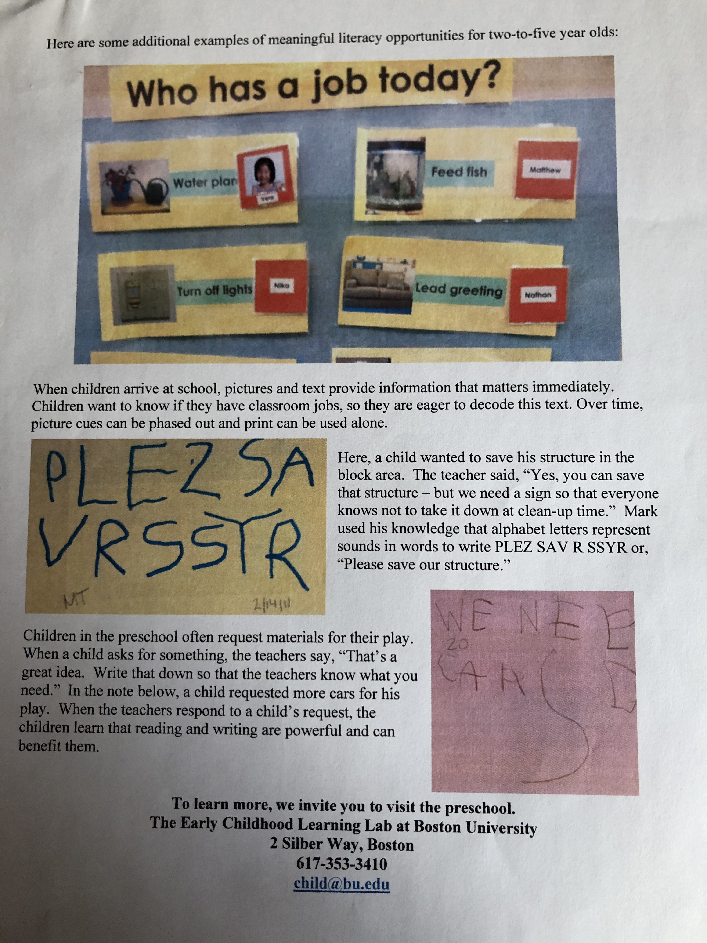
Testimony at State House Hearing

Slide 13
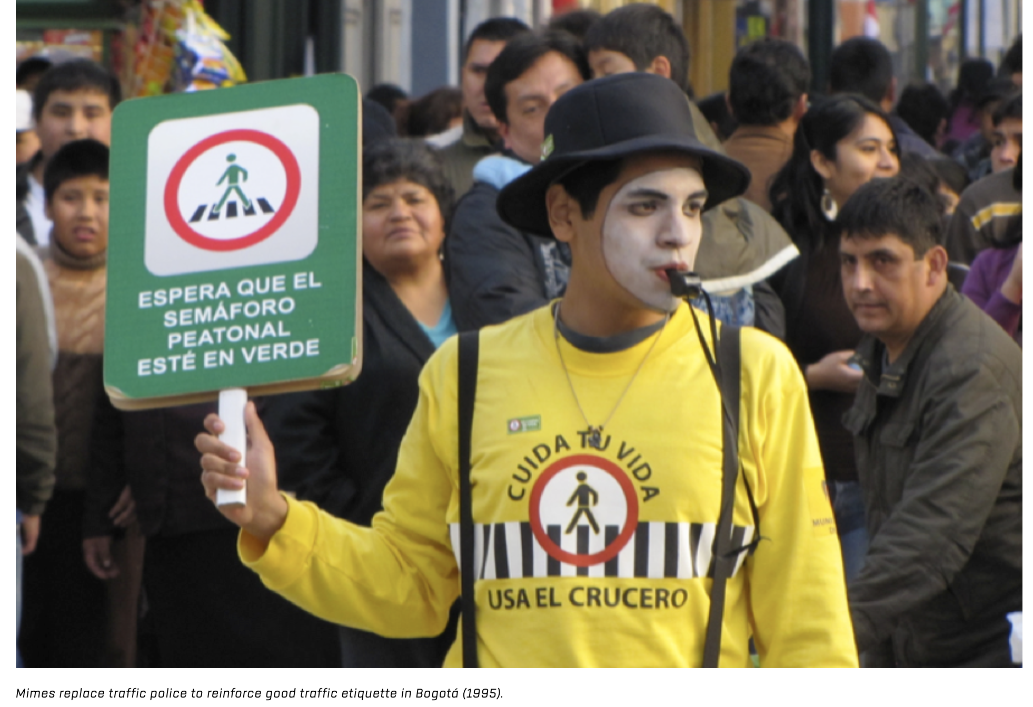
Playful Advocacy
https://creative-states.org/explore/its-time-we-play-our-way-out-of-intolerance/

Slide 14
Playful Participatory Research
A tool for for understanding and deepening learning through play

Slide 15
Quantitative
Qualitative
Mixed Methods
Notes:
When people talk about research, there are usually two main types: Either quantitative or qualitative. The research question determines the kind of approach that makes sense.
Quantitative research uses numerical data, statistical analysis, pretests and posttests, and tries to control variables to understand cause and effect.
Qualitative research uses data like interviews, observations, documentation. It’s good for building theory, or understanding experiences in-depth.
Sometimes these two are combined and called “mixed methods”

Slide 16
Participatory Action Research
Ethnography
Qualitative Research
Discourse Analysis
Practitioner Inquiry
Case Study
Phenomenology
Notes:
There are many different types of qualitative research – here are a few (click to animate).
Each of these types of research are considered valid and valuable to the field of education, even though some are generated by practitioners working in schools with children, others at universities or research centers. Participatory Action Research is research in communities, with an emphasis on action, and collaboration between university and community members
Practitioner Inquiry (see Cochran-Smith & Lytle’s work) happens in schools, with a focus on practitioners (teachers, administrators) generating and pursuing own questions.
Both of these kinds of research assume that participants should be involved in the research process.
Playful Participatory Research is a kind of research developed by the Pedagogy of Play research team that has overlaps with both of these.
Some say that practitioner-generated research is more powerful than other types of education research, because it involves a more democratic process. And some think it’s more valid because those who will use the results of the research are also involved in the process of research.

Slide 17
Notes:
Here are some examples of books that have been published by teacher researchers using a practitioner inquiry approach

Slide 18
The Playful Participatory Research Process
Choose
Choose a context and research question
Plan
Write up a plan for your PPR
Document
Document to explore your question
Play
Reflect
Share your documentation and explore playfully with others; read, watch, or listen to learn more; repeat
review your documentation and notes from exploring your PPR question with others and reflect on what you've learned about your question
Share
Share what you learned by writing, making a poster, presenting to colleagues…
Notes:
In PPR, teacher researchers…
-Pose questions and puzzles that matter to them in their teaching, and are also of interest to other educators
Gather documentation in their own classrooms to explore their questions
Read, play, and learn with others in inquiry groups or more informally by engaging with colleagues
Exploring playfully can mean using a playful protocol for looking at and reflecting on documentation (will share in a minute) or engaging in playful provocations (like working with materials from your play kit to explore ideas, or trying out an activity before trying in your classroom)
Share what they learn more widely with other educators

Slide 19
Playful Participatory Research
Examples
Notes:
So they were getting and giving mixed messages -- one, to support play and learning, and the other to keep tight to the many rules and regulations at the school.
The kindergarten teachers regularly get together in study groups to have conversations about what they are noticing around play and school. And they recognized this mixed messaging was a big problem – reflects the idea of paradoxes that Ben mentioned. They began to collect videos and observations of how children were using the playground, and they used this documentation to explore questions they were having about their practice.
They brought this documentation to leadership, explored their ideas. And – in part because of the trust they felt from leadership, and because they had the documentation to present their ideas and explore the question - they felt safe in experimenting with an idea with the children.
SLIDE

Slide 20
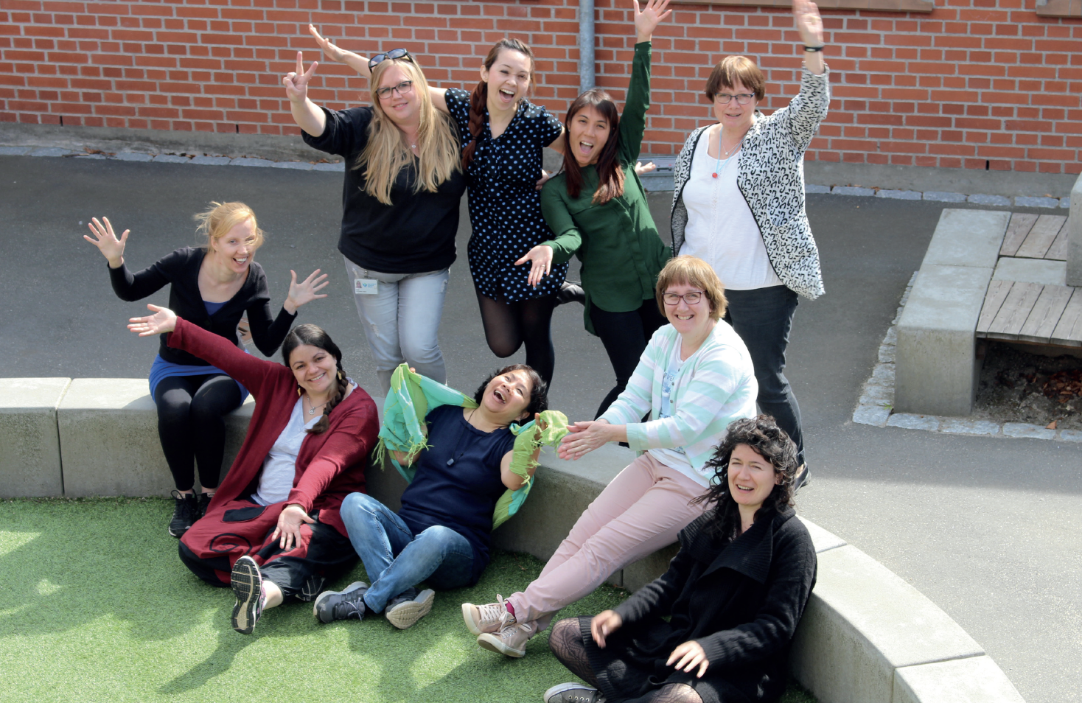
A Playful Participatory Research Example: The Kindergarten Study group International School of Billund, Denmark
Notes:
I want to end by sharing a story from a kindergarten classroom in Denmark. At the International School of Billund, the vision and mission of the school are designed with play at the center. It is a school of learning through play. And yet, the kindergarten teachers were finding that during recess time they were saying no more than yes
SLIDE

Slide 21
“We keep getting messages about learning through play, but I kept feeling like I have to stop it.”
Marina, K3 teacher
Notes:
So they were getting and giving mixed messages -- one, to support play and learning, and the other to keep tight to the many rules and regulations at the school.
The kindergarten teachers regularly get together in study groups to have conversations about what they are noticing around play and school. And they recognized this mixed messaging was a big problem – reflects the idea of paradoxes that Ben mentioned. They began to collect videos and observations of how children were using the playground, and they used this documentation to explore questions they were having about their practice.
They brought this documentation to leadership, explored their ideas. And – in part because of the trust they felt from leadership, and because they had the documentation to present their ideas and explore the question - they felt safe in experimenting with an idea with the children.
SLIDE

Slide 22
Some of the kindergarten teachers at the International School of Billund in Denmark were finding that during recess time, they were saying no more than yes:
No going up the slide
Ride bicycles only on the bike track, in one direction
Do not climb on the trees
Do not play with apples that fall from the tree
No throwing items over the fence
It is not allowed to dig outside of the sandbox
It is not allowed to play with tree branches

Slide 23
What happens when there are less rules on the playground?
Notes:
So they were getting and giving mixed messages -- one, to support play and learning, and the other to keep tight to the many rules and regulations at the school.
The kindergarten teachers regularly get together in study groups to have conversations about what they are noticing around play and school. And they recognized this mixed messaging was a big problem. They began to collect videos and observations of how children were using the playground, and they used this documentation to explore questions they were having about their practice.
They brought this documentation to leadership, explored their ideas. And – in part because of the trust they felt from leadership, and because they had the documentation to present their ideas and explore the question - they felt safe in experimenting with an idea with the children.

Slide 24
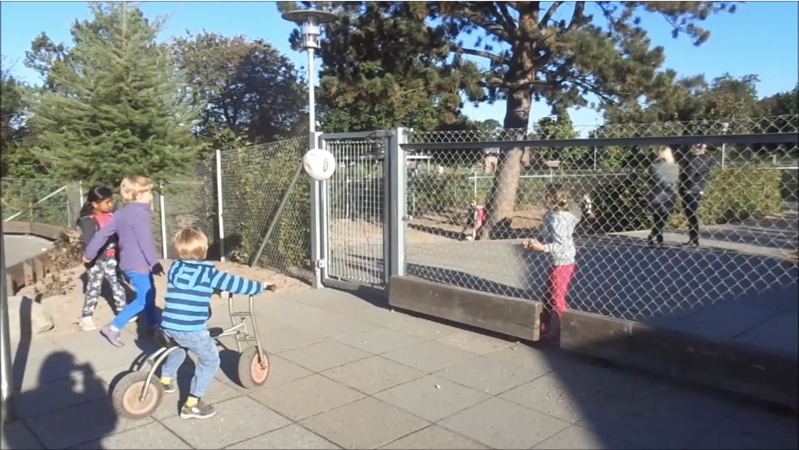
Notes:
An example of the documentation they collected- this is a screenshot from a video the teachers took of children playing on the playground with the 2 new rules in place.

Slide 25
Looking Playfully at Documentation Protocol (20-25 min)
Listening: The presenting teacher names their question and gives context about the documentation they are sharing (2 min)
Looking: Look carefully at the documentation for a few minutes (2-3 min)
Clarifying: Presenter answers short, fact-based questions from the group (2 min)
Noticing and Wondering: a round of “I notice” (just saying what you see/hear in the documentation without judgement), and then ”I wonder” statements. The presenter listens and is silent (4 min)
Pretending: Take on roles and act out a scenario captured in the documentation (2-3 min)
Noticing/Wondering again: Did the playing help you notice anything new? (2 min)
Inspiring: Repeat the presenter’s question. What could the presenter try as next steps in their teaching? Or share ideas of what to document next. (5 min)
Closing: The presenter has the last word to share their take-aways/questions. (2 min)
Notes:
Bringing that documentation to your inquiry group, or a few colleagues during a common planning time, use a protocol like this one to look carefully and play with the documentation to get new ideas. You can use the same protocol every time

Slide 26
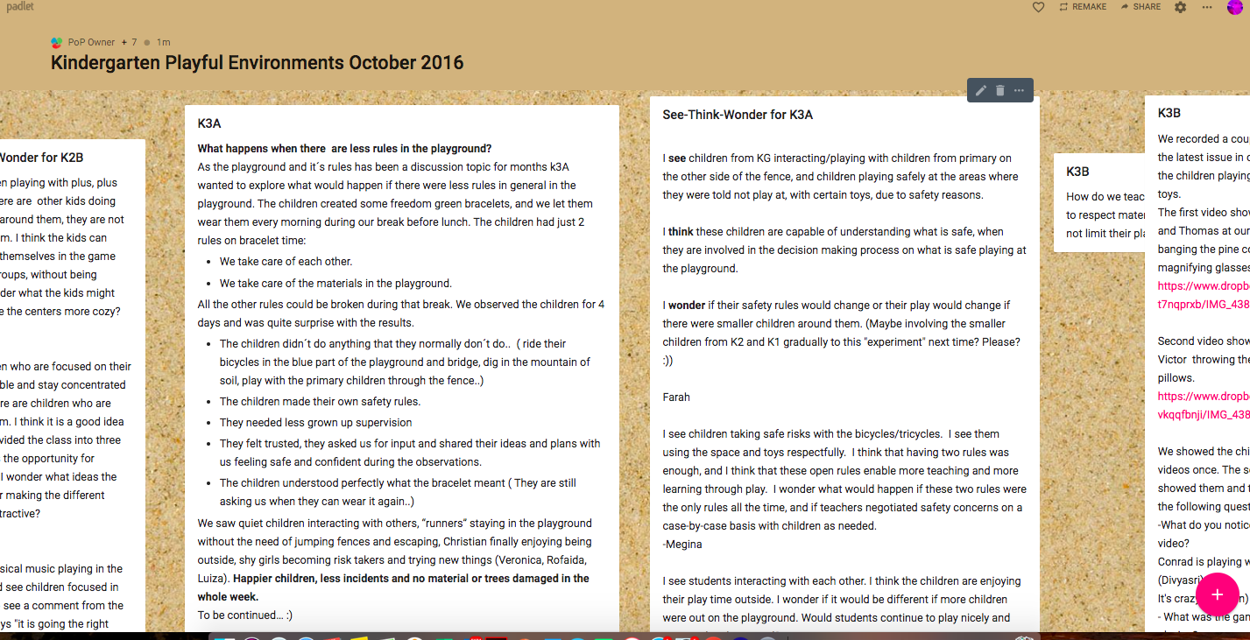
Notes:
It’s helpful to have an online space to store and share documentation – this is example is from Padlet. Here’s an example of some posted documentation, and other colleagues in the inquiry group adding “see-think-wonder” comments about that documentation.

Slide 27
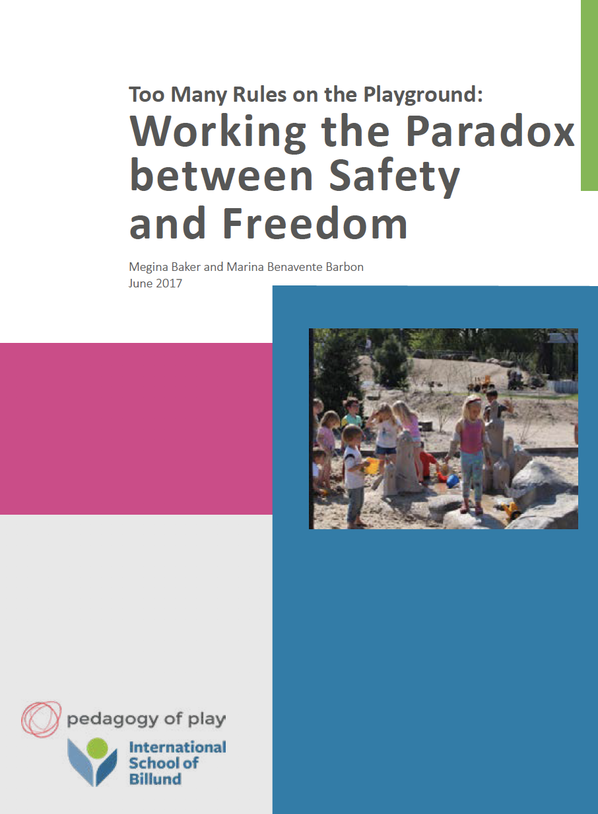
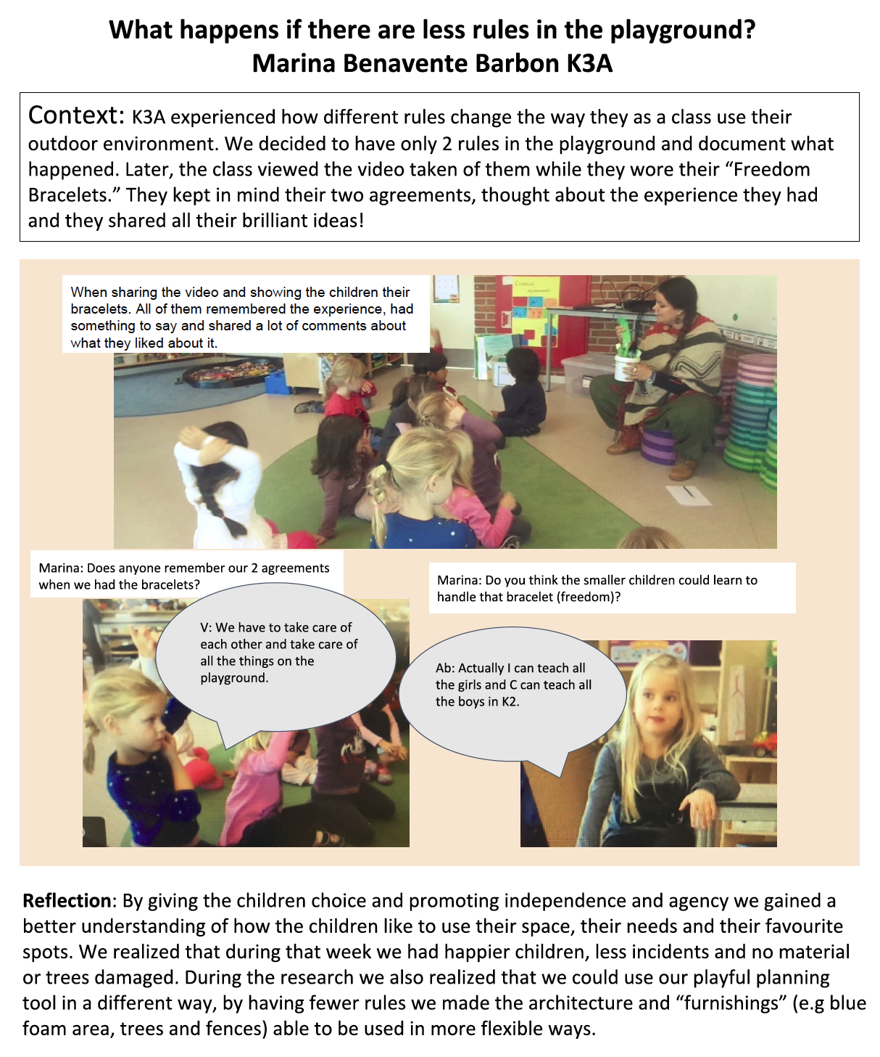
Notes:
Here’s how these teachers shared their PPR research – in a poster they shared at a school-wide gathering, and later in an article that was published on the school website

Slide 28
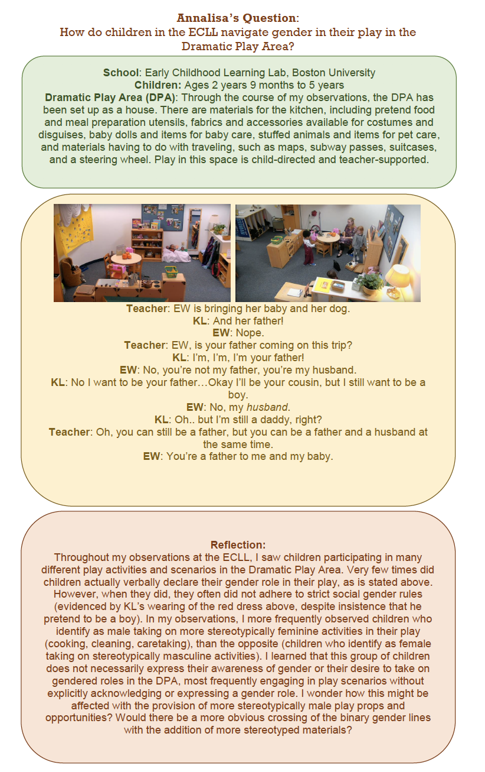
Sample
Mini-Poster
Notes:
Here’s an example of a poster that one student created to share her PPR process with the class. You’ll be creating posters or presentations similar to this

Slide 29
Teacher research articles: small group discussions
Pretend you are hosting a Playful Participatory Research conference and need to find excellent teacher researchers to speak about their work. Discuss the article that you read with your group, considering:
Was the author a teacher researcher? Why?
What were their research questions?
What kinds of data/documentation were gathered to explore this question?
Was the research process playful? Would you call this PPR or regular teacher research?
What surprised you/intrigued you about what you read?

Slide 30
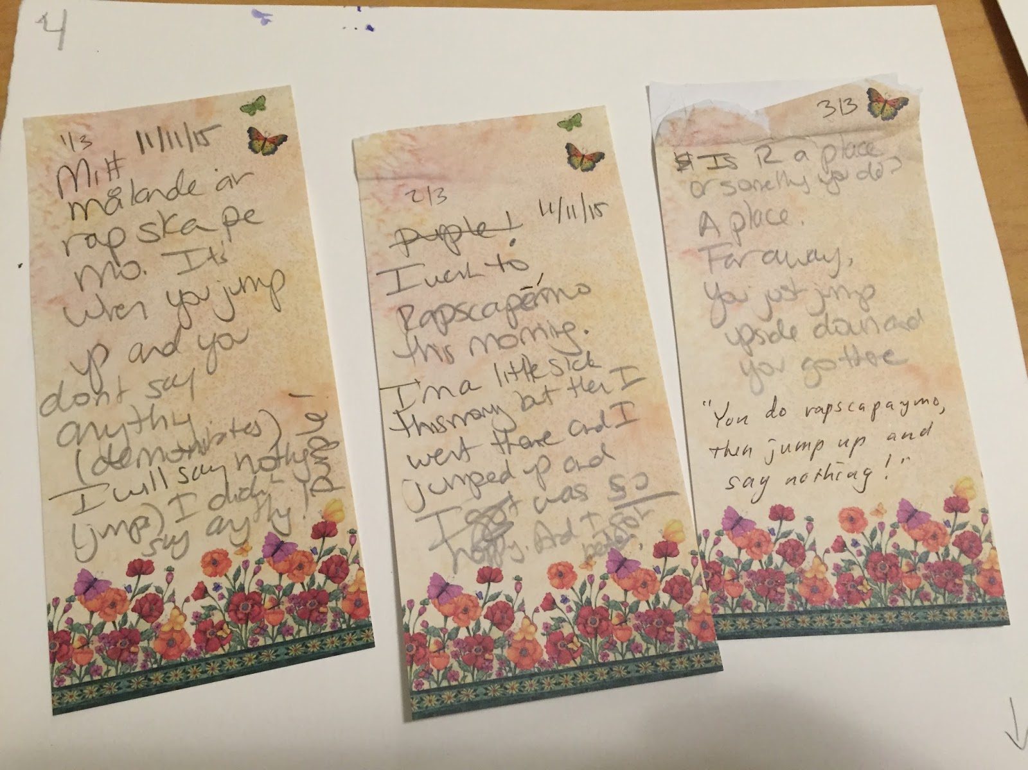
Documentation
A tool for learning about play
Notes:
The next slides introduce the idea of documentation and how to do it.

Slide 31
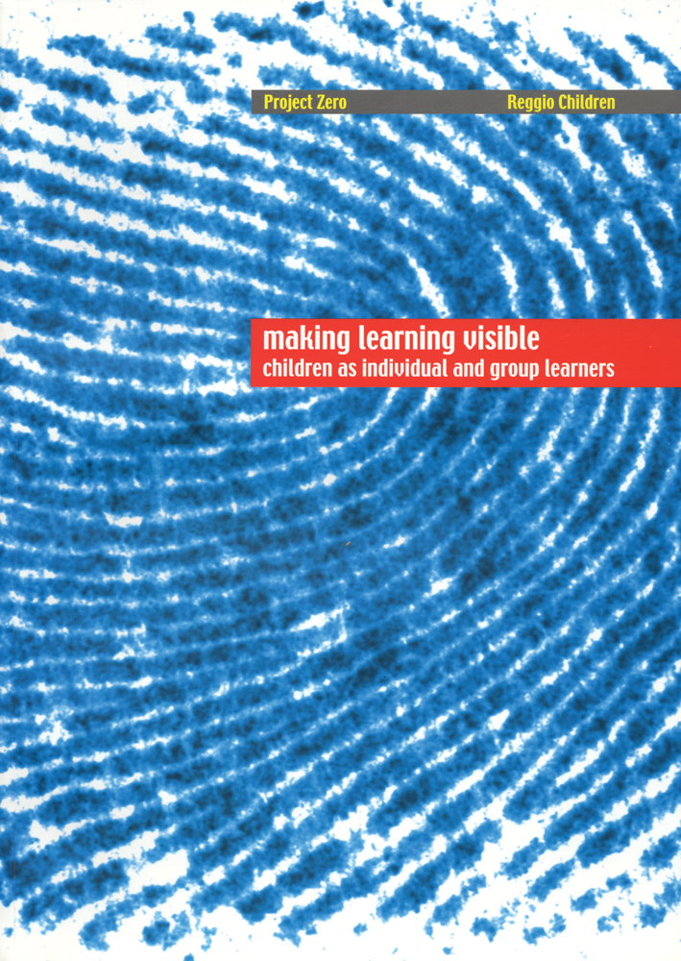
Notes:
These two books from Project Zero and Reggio Children have lots more information about the practice of documentation. Will give a snapshot today

Slide 32
An example of documentation
Carl explains his work: Jag gör ett hav. Jag behöver den här till sjögräs. Jag ska ta den här tjusiga skatten. I’m doing a sea. I’m gonna take spirals. Look at these spirals.
Teacher: på svenska heter de spiral Carl: Måste ta spiralerna. Titta - de här två är fina. Lila lila. Jag ska sätta dem baklänges för jag gillar dem. Teacher: Lila lila Carl: Pink pink.
Notes:
An example of documentation - this is a 2 year old child, bilingual Swedish and English speaker, working with natural materials freely. His teacher wrote down what he was saying as he worked.

Slide 33
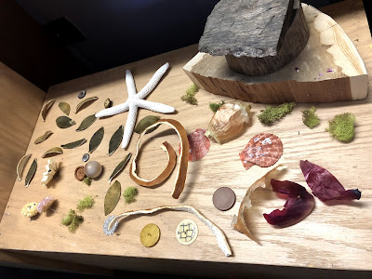
Notes:
The work Carl was describing. Imagine that without the transcription of his words, what would be lost in just have a picture.

Slide 34
Definition of Documentation
The practice of observing, recording, interpreting, and sharing through different media the processes and products of learning in order to deepen learning
From the Making Learning Visible book
Notes:
This is the definition of documentation from the Making Learning Visible book – notice all the verbs. It’s a process, and the purpose – to deepen learning

Slide 35
We often think of teaching as telling and learning as listening, when we should think of teaching as listening and learning as telling.
Debbie Meier

Slide 36
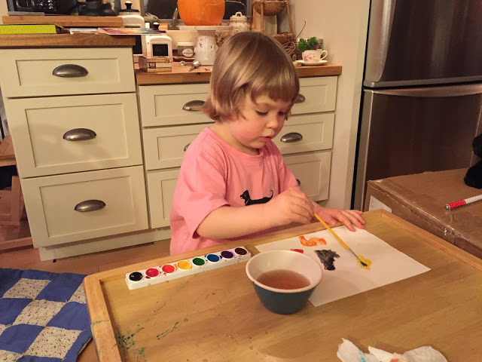
Notes:
Here’s a quick example of the process of capturing documentation. Here’s a child painting. We could just look at the finished paintings and think “Oh, so pretty”. But then we don’t capture anything about the process of learning taking place during the painting.

Slide 37
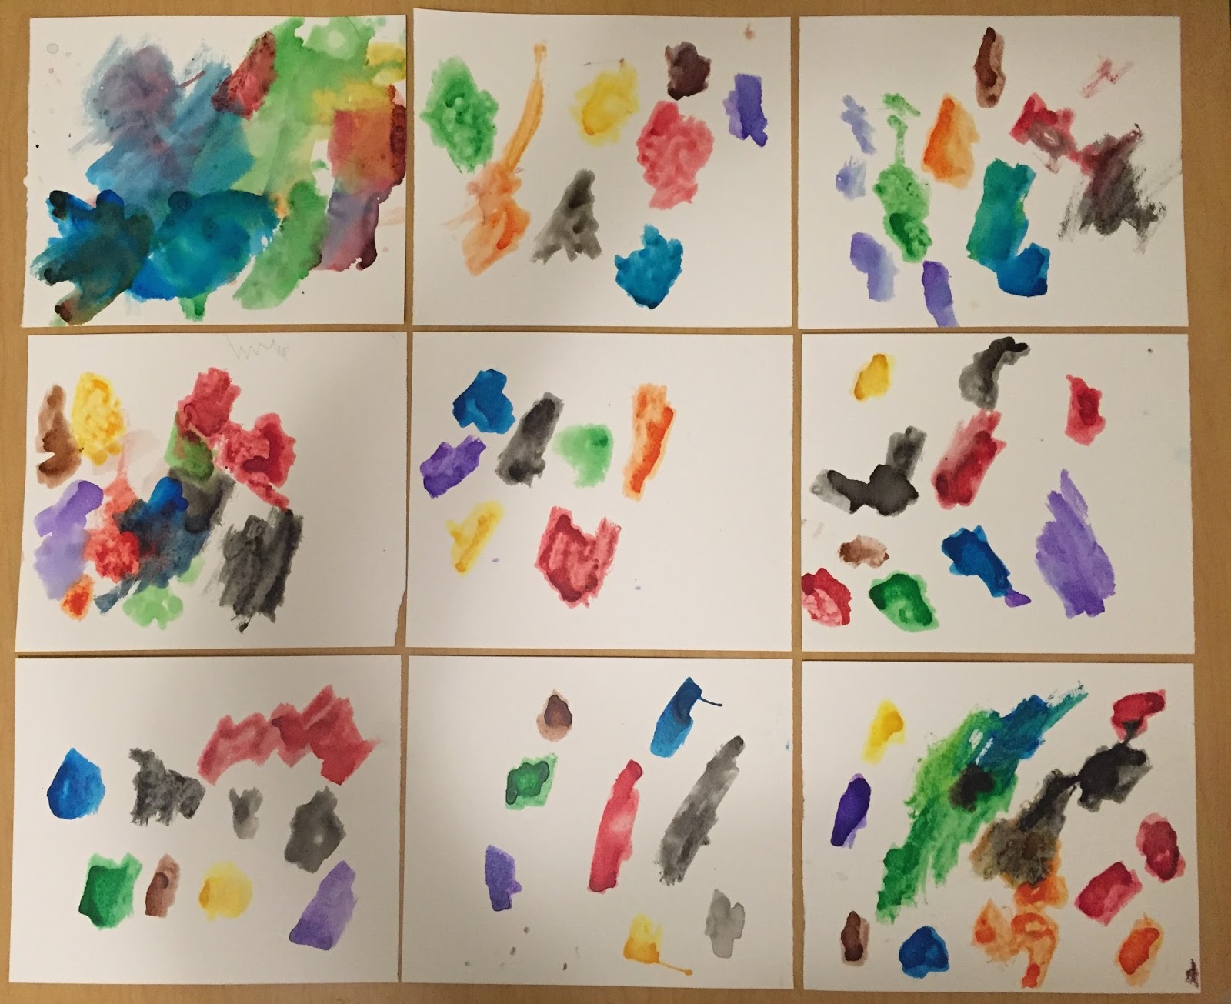
Notes:
So instead of just capturing the finished works,

Slide 38
Notes:
The teacher here grabbed some paper that was nearby and wrote down what the child was saying and doing while painting. This is documentation. Now the teacher understands better the child’s thinking, her language, her intention.. And can better provide next learning experiences to support that child and deepen her learning.

Slide 39
Definition of Documentation
The practice of observing, recording, interpreting, and sharing through different media the processes and products of learning in order to deepen learning
What aspects of this definition of documentation did you see in the example of the child painting?

Slide 40
The Airplane Activity
Learners
The challenge: to come up with two different designs (as a group) for paper airplanes that can fly at least 4 meters, carrying at least 7 pennies.
Notes:
Let’s try an activity now to practice documentation.
(See activity card for more detail about how to run this activity)

Slide 41
Documenter/Observers
Please observe with the following question in mind:
What do you notice about the individual and group's process of building knowledge about aerodynamics and what can you point to that makes you say that?

Slide 42
Documenter/Observers
Please observe with the following question in mind:
What do you notice about the individual and group's process of building knowledge about aerodynamics and what can you point to that makes you say that?
Learners
The challenge: to come up with two different designs (as a group) for paper airplanes that can fly at least 4 meters, carrying at least 7 pennies.

Slide 43
Small Group Debriefing
Documenters: Choose from your documentation 1-2 key moments or shifts in the way ideas about aerodynamics were being developed to share with the group. Ground your interpretations in your observations. Please be respectful of the feelings of the learners!
Learners: Respond to the documenters' comments and share your own reflections about key moments or shifts regarding how you and/or the group learned about aerodynamics.

Slide 44
WHOLE GROUP DISCUSSION
What is one thing your group learned about documentation?
Notes:
Headlines

Slide 45
Playful Participatory Research as teacher professional learning
Research on professional learning tells us:
Single, mandated workshops are not effective
Sustained professional learning that is responsive to teachers’ needs and interests is most powerful
Participatory Action Research has been shown across fields as a powerful tool for driving change
Playful Participatory Research comes out of this tradition, with a playful spin
Notes:
Good to know – PPR is both a research approach and also a professional development tool. Some schools use this as an ongoing way of doing professional learning.

Slide 46
Choosing PPR Questions
Notes:
Choosing a good question for your PPR process is important. So we are going to work on that now.

Slide 47
Choosing PPR Questions
Of interest to you and perhaps others
Relevant to your daily practice
Open-ended - you don’t already know the answer
Optional (depending on your focus/context)
About play
Connected to issues of equity and social justice
Notes:
Here are some criteria that can be helpful in choosing a question.

Slide 48
Choosing PPR Questions
Make it a manageable size (e.g. confined to a particular activity, group of participants, time frame, etc).
Make sure you could gather documentation for this question in 30 min or less.
Try a question starter:
“How do I …”
“How can I…”
“What happens when…”
“How does X impact/affect/change/influence Y?”
“What can I learn about…”
and other open-ended “how” or “what” questions.

Slide 49
Sample Questions
How can I use play to support learning of another language?
How could role play support learning about local history?
What happens when I try using playful approaches for teaching science via remote learning platforms?
What happens when I engage fourth graders in playful activities related to exploring racial identity?
How do I integrate anti-bias ideas into choice time activities?
What can I learn about the children’s interests and beliefs during outdoor play/recess/break time?

