Slide 1
Facilitating Play or Play in the Learning Domains
© 2023 President and Fellows of Harvard College. This work is licensed under Creative Commons Attribution-NonCommercial-ShareAlike 4.0 International. Funded by the LEGO Foundation, this resource was developed by Pedagogy of Play at Project Zero.

Slide 2
Gameplan
Today is all about learning how to scaffold and facilitate play, ensuring that learners explore and learn concepts in specific learning domains (e.g., literacy, mathematics, science) through play.

Slide 3
Note to instructors:
The following slides focus mainly on scaffolding and facilitating play, and may be more appropriate for teachers of younger learners
If you are working with older learners or in a context in which learning domains are taught as separate subjects in school, use this session as a time to think specifically about your domain and ways in which you could teach that particular content (e.g. math, science, literacy) through play

Slide 4
Revisiting: PoP Practices and Strategies
Empower learners to lead their own learning
Get to know your learners
Involve learners in decision-making
Co-construct rules
Say yes to students’ spontaneous ideas
Reflect on learning with learners
Build a culture of collaborative learning
Use play to build relationships
Facilitate purposeful conversations to build knowledge
Nurture a culture of feedback
Document learning through play
Foster peer-to-peer teaching
Promote experimentation and risk-taking
Design open-ended investigations
Value risk-taking as a strategy for learning
Focus on process as well as product
Model risk-taking and experimentation
Encourage imaginative thinking
Share stories to engage and enhance learning
Ask questions that invite curiosity
Use role play and pretend scenarios
Provide materials that encourage hands-on learning
Welcome all emotions generated through play
Design for joy
Make learning meaningful and relevant
Use play to explore complicated issues
Support learners in working through frustration
Notes:
Use this slide for the ”revisiting” activity at the start of class

Slide 5
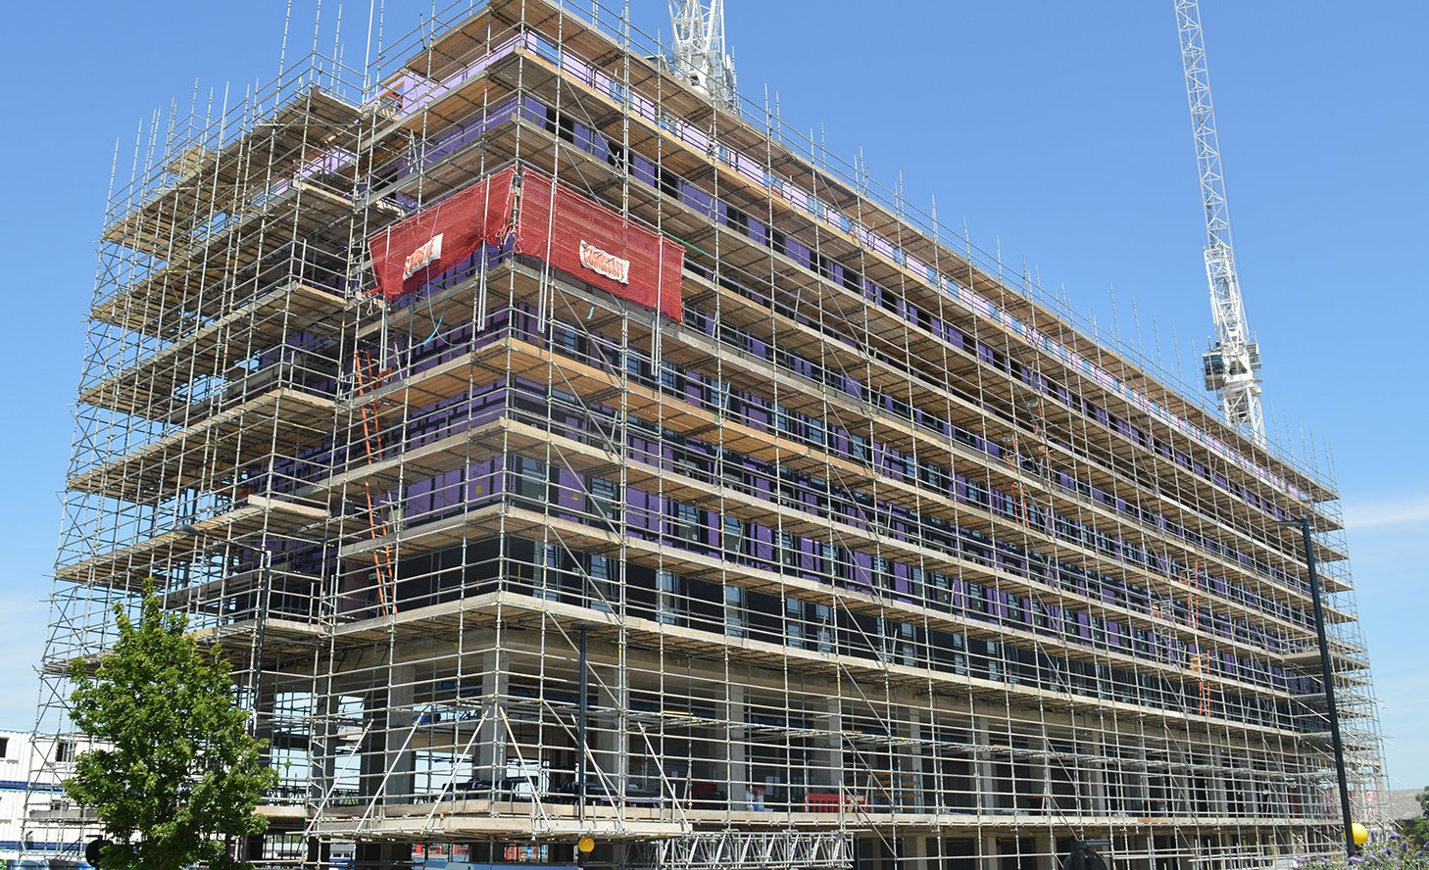
Notes:
Scaffolding – a metaphor for supporting children during play
Explain that today will be focused on teacher’s role to create contexts for playful learning

Slide 6
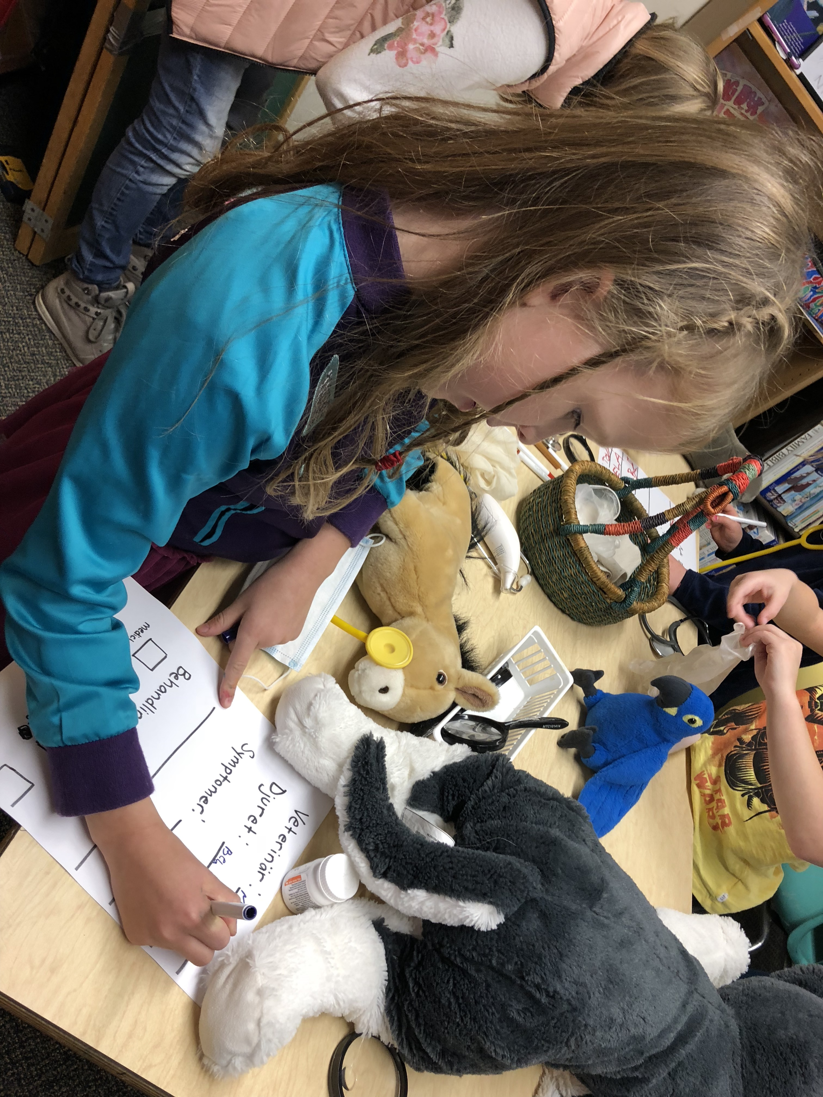
Notes:
Example of scaffolding learning through play for young learners – setting the stage (stage manager) and creating a “visual scaffold” – in this case a template for children to write down veterinarian notes as they pretend to care for stuffed animals, which scaffolds opportunities for learning literacy within a dramatic play context.
You could replace this with an example of older learners or from your context.

Slide 7
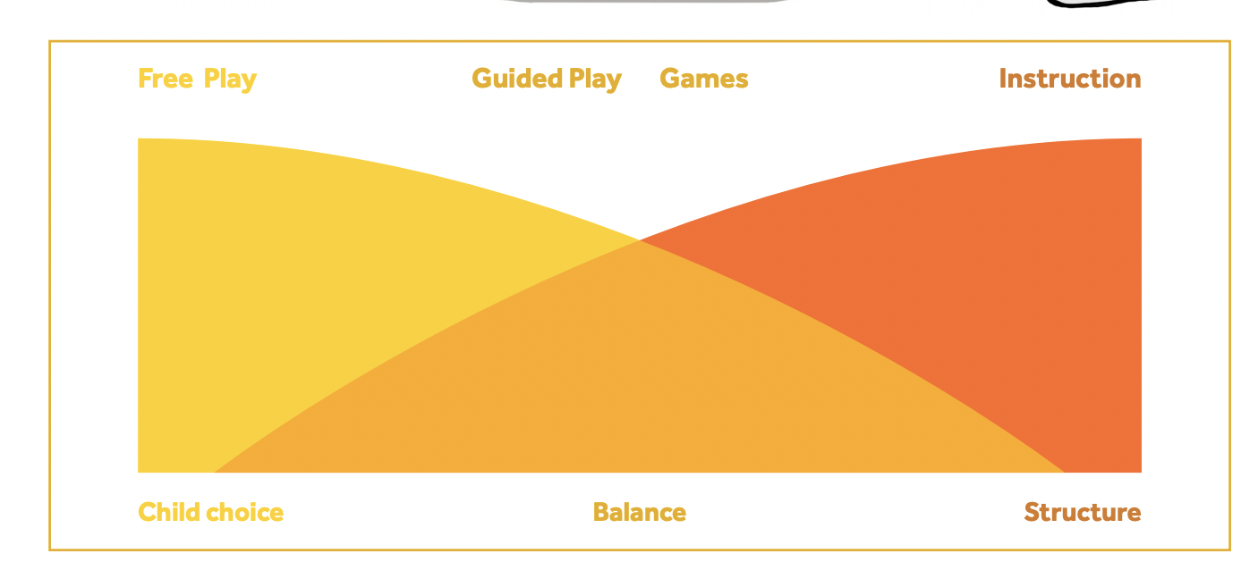
Notes:
Image from the Play Facilitation Guide. Use this to discuss the Play Facilitation Guide reading – what stood out to your students? What questions do they have?

Slide 8
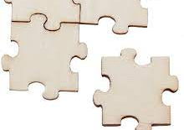
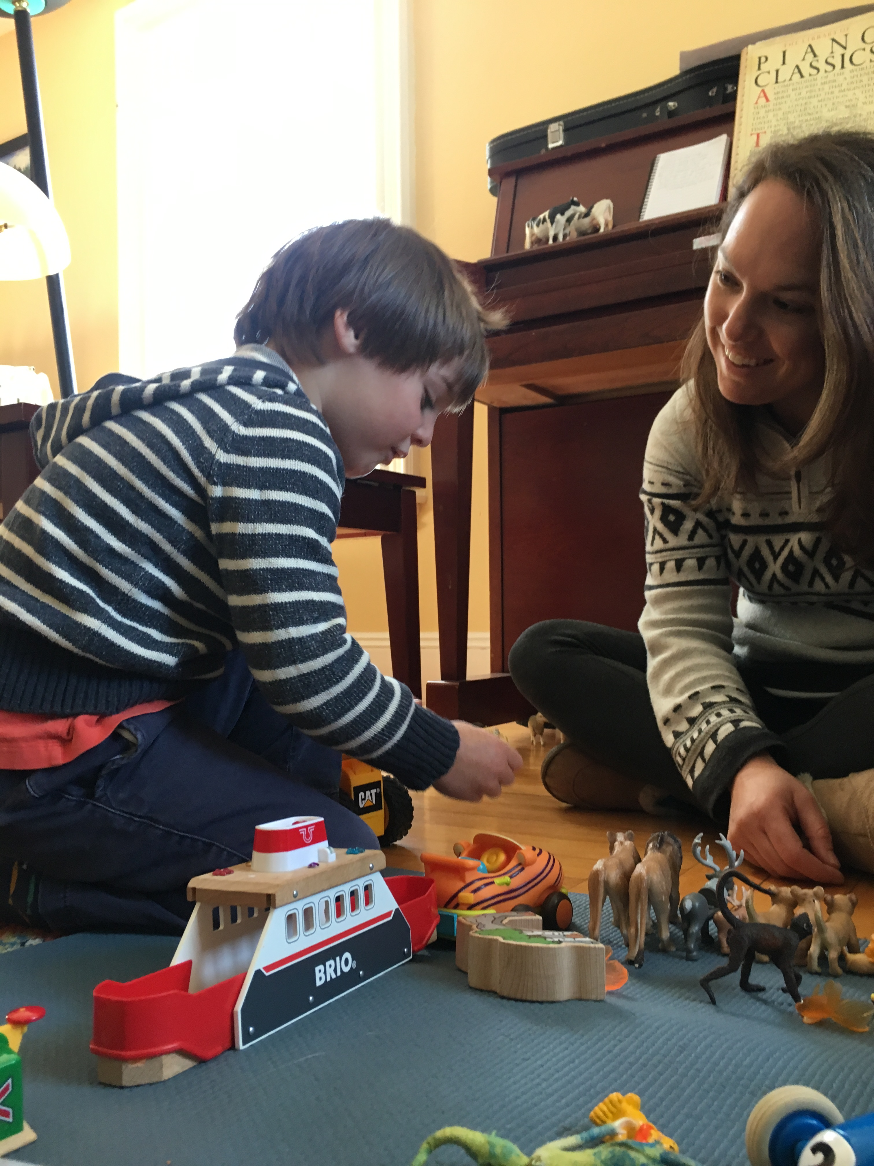
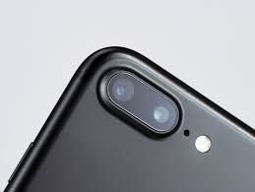
During play you can…
Notes:
Offer some strategies for supporting play:
Be a player.
Take on a role in the play and follow the children’s lead.
Be a mirror.
Describe in detail what children are doing, using rich vocabulary. E.g. “you’re drawing a curved yellow line using the thin paintbrush…”
Be a connector.
Scaffold children to connect with each other around a common goal or play theme.
Be a rubber band.
Stretch and extend the play through open-ended questions, embedding vocabulary and reinforcing teaching of concepts. Try the question stems in the next slide
Be a steering wheel.
When play becomes unproductive, repetitive, or unsafe, steer it back in a positive direction.
Be a documenter.
Record learning processes in order to deepen and extend learning

Slide 9
Questions to extend play and deepen thinking
How did you create this?
What part did you do first? What could you add?
What else could you try?
Tell us more about your (painting, structure, game…)
What do you notice about (that structure, object, etc…)?
What do you wonder?
What do you think is going on?
Why do you think that?
What might happen if….?
What is the problem? What ideas do you have to solve that problem?
Can you teach me/us how to…?

Slide 10
Play Facilitation Tool

Slide 11
Notes:
If you used this book in your class… if not you can delete this and the following slides

Slide 12
Jones & Reynolds – Roles for Supporting Play
Observer
Stage Manager
Mediator
Player
Interrupter
Scribe
Assessor & Communicator
Planner

Slide 13
Observer
Carefully watching and listening to children at play
Documenting
To understand the learning taking place
To share back with learners to relaunch and deepen learning
To share more widely (with other educators, with families…)

Slide 14
Stage Manager
Prepares the environment for play
Organizes and reorganizes materials
Prepares provocations to spark children’s thinking and interest
Creates and provides physical scaffolds (e.g. graphic organizers, templates) to scaffold play

Slide 15
Mediator
Teaching conflict resolution skills
Keeping play safe

Slide 16
Player – NOT Interrupter
Joining children in play, following their lead
Taking on a role
Using and modeling materials
Takes care not to interrupt or take over children’s play! Watches first to be sure the children need a player

Slide 17
Scribe
Recording children’s ideas, to share back with them and further the play
E.g. writing down a storyline for dramatic play

Slide 18
Assessor and Communicator
Using documentation gathered during play to assess children’s learning and plan next steps
Using documentation to communicate to others about the power of learning through play

Slide 19
Planner
Planning emergent curriculum based on children’s interests
Planning for embedding curriculum content and skills in children’s play themes
Literacy
Mathematics
Science
Arts
Social and emotional opportunities

Slide 20
PoP Practices
Empower learners to lead their own learning
Build a culture of collaborative learning
Promote experimentation and risk-taking
Encourage imaginative thinking
Welcome all emotions generated through play
Notes:
Discuss how these teacher roles can contribute to promoting the PoP teaching practices. E.g. stepping back to be an observer and document can offer a chance for learners to lead their own learning

Slide 21
Principles Guiding Play Orchestration
Taking the child’s view
Being a keen observer
Seeing meaning as it is constructed
Being a stage manager
From Van Hoorn et al. (2015) p.81-83
Notes:
Another perspective on guided play

Slide 22
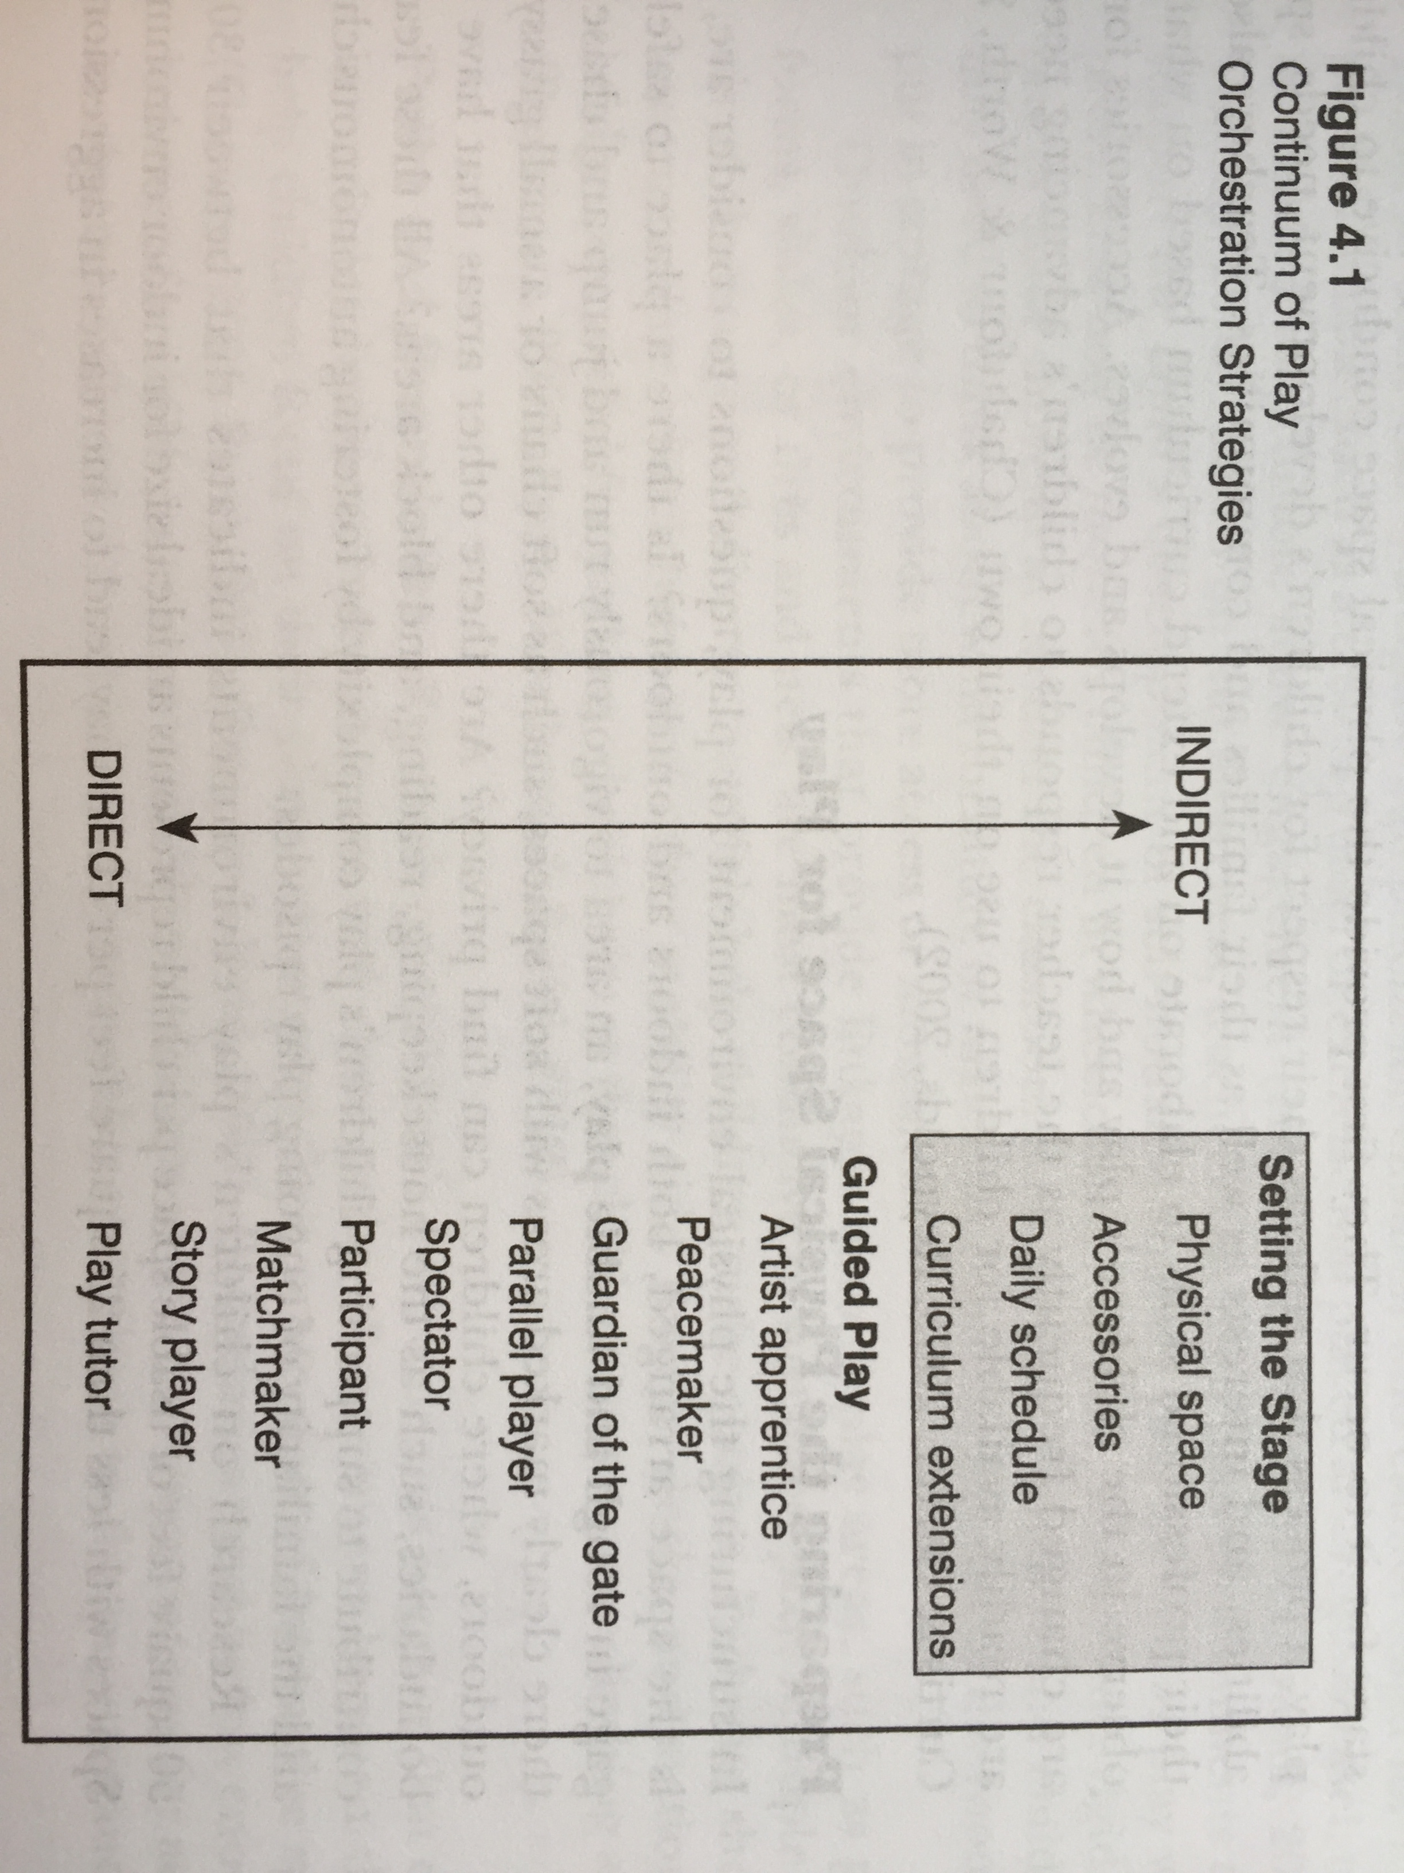
From Van Hoorn et al. (2015)
p.83
Notes:
And a useful visual, if you want to share, of the continuum of how a teacher might facilitate play, from being directly involved, to indirectly setting the stage.

