Slide 1
Advocating for Play Gallery Walk
Process:
Part 1 - Gallery walk (10-15 min)
Browse across the Padlet – exploring as many of the posts as you have time for.
Use the “add comment” feature to add at least two written comments to colleagues that include:
Clarifying questions – is there anything that is unclear or missing in the presentation?
Appreciations- what is working well?
Suggestions – how could the presenter advocate for play even more effectively?
Part 2 - Focused looking/feedback (10-15 min)
In partners, look more closely at each other’s posts, and any feedback colleagues have added. Ask each other clarifying questions, offer appreciations, and make suggestions to improve the work. (5-7 minutes to focus on the first person’s work, then switch roles)
© 2023 President and Fellows of Harvard College. This work is licensed under Creative Commons Attribution-NonCommercial-ShareAlike 4.0 International. Funded by the LEGO Foundation, this resource was developed by Pedagogy of Play at Project Zero.

Slide 2
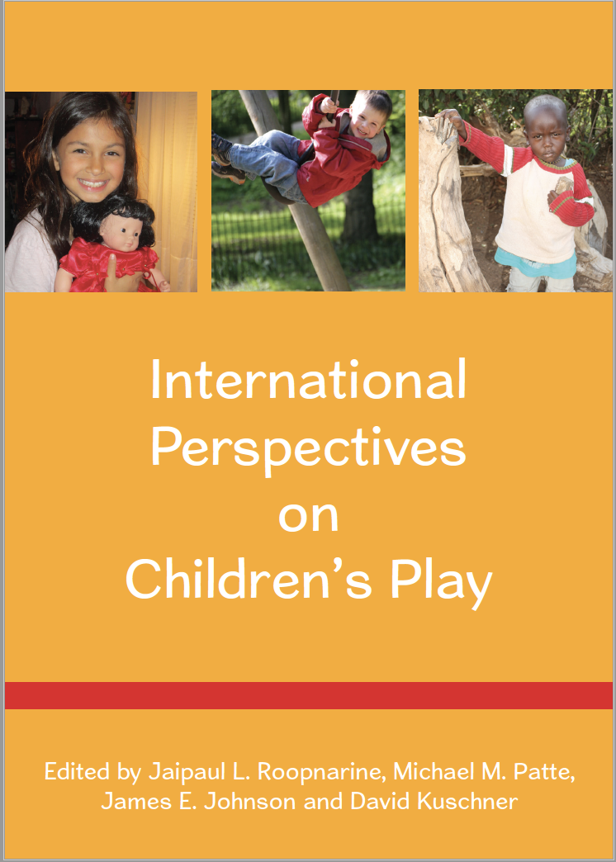
Play Across Cultural Contexts
What did you learn about play in your reading?
What resonated with your personal/cultural understandings of play?
What struck you as different from your personal/cultural understandings of play?
Write-pair-share
5 min to review/write in your bubble catcher
Conversation in pairs – add notes to your bubbles
whole group discussion
Notes:
Use these if appropriate – or just use as inspiration to create your own related to the other resources you have invited students to use to explore play across cultural contexts

Slide 3
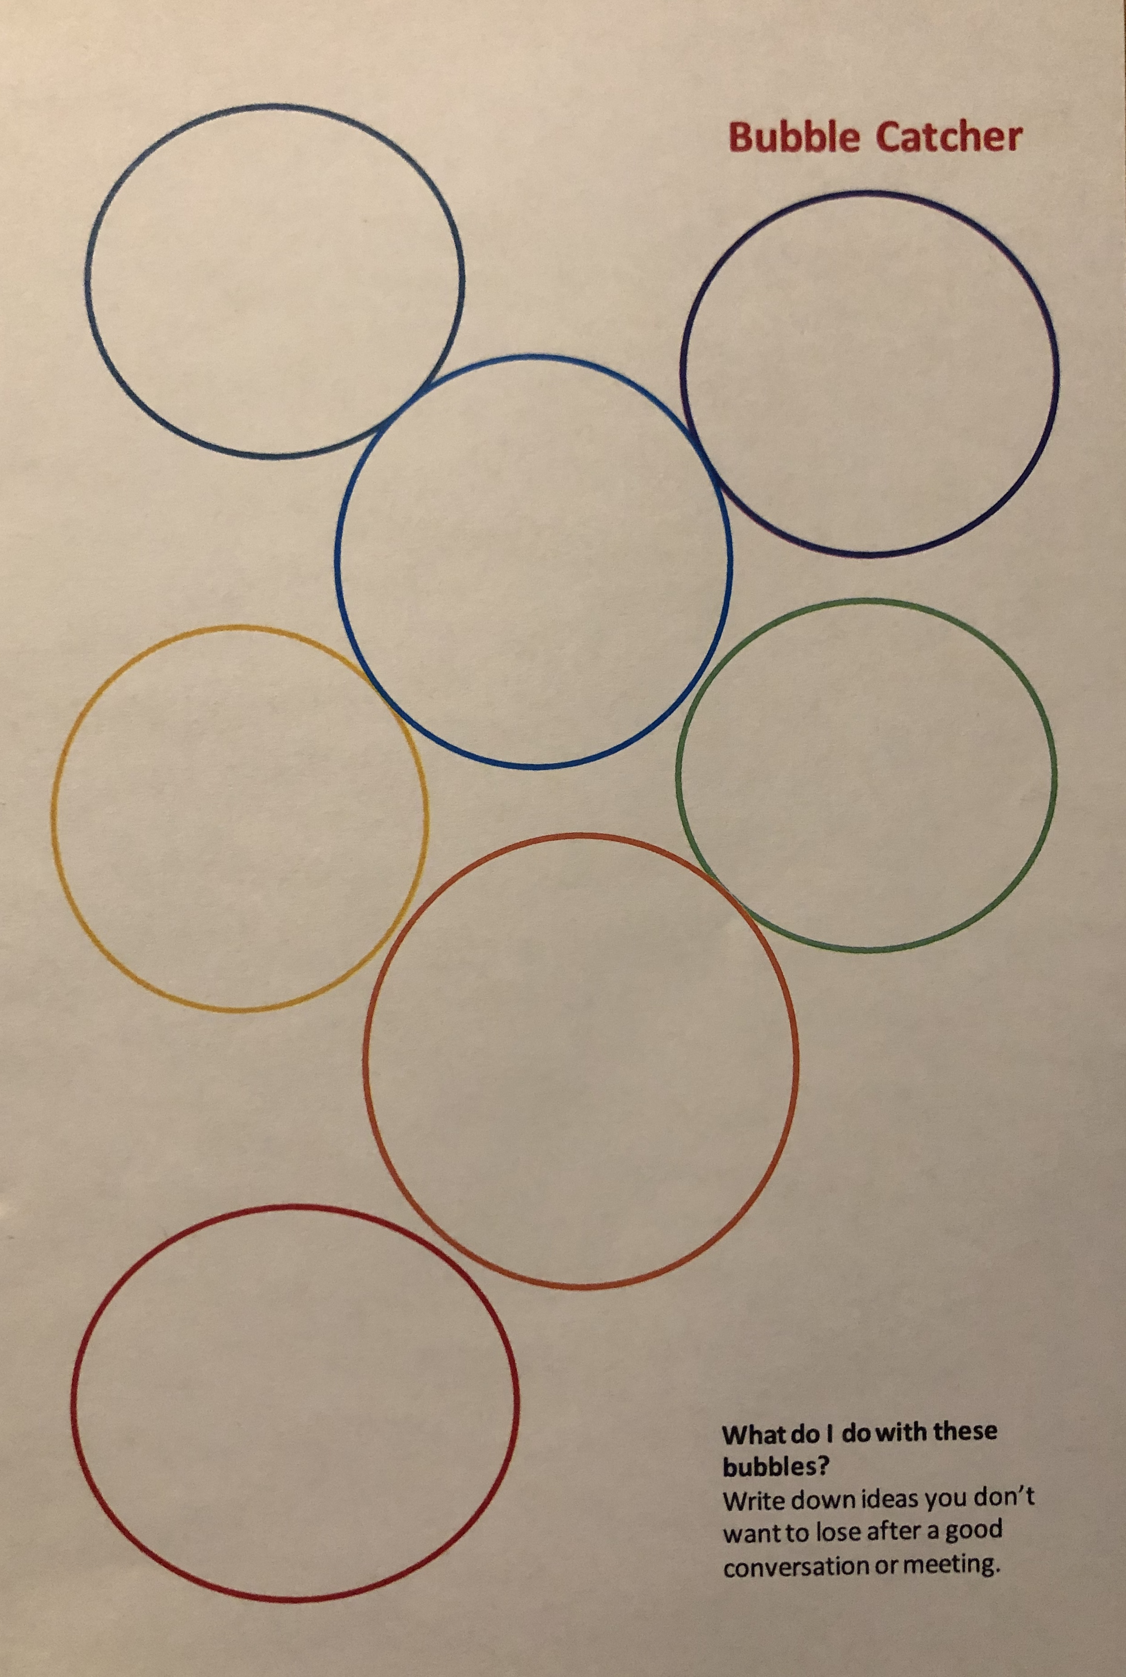
Notes:
This is an example of a “bubble catcher”. Bubble catchers are a playful way of keeping track of ideas so they don’t float away.

Slide 4
Native American Play
“For traditional Native people, nature-based play was more than an activity occurring in nature. It was a means of learning about and becoming an inseparable part of the natural world. It was part of a nature-based spiritual tradition. This play in nature may be seen as a way for children to practice skills that they would use in everyday adult life, but, equally important, it was also a way to inculcate spiritual values, most notably values related to people’s connection to the earth and natural world.”
Notes:
This and the following slides are summaries from the Roopnarine et al. book mentioned as optional reading. Please use if relevant and useful, but take care to explain to students that these are summaries and are not intended to represent a whole culture. They are intended to spark conversation

Slide 5
Turkana Kenyan Children’s Play
“The sociodramatic play of both Mexican and Turkana children reflect their cultural funds of knowledge consisting, for example, of family values, food, holidays, music, beliefs, gender roles, language and other aspects of their cultural heritage…”
“The narrative of Turkana children’s play highlights the role of play as a social agent that children use to acquire the skills they need to develop as competent individuals who can fit into their culture and contribute to the growth and survival of their families.”

Slide 6
Taiwanese Children’s Play
“The Western belief of learning through play is in conflict with the mechanical way of learning held by Confucianism. Imagination or pretend play is never related to learning in society (Kim 2007). Play is not considered as important as work. Play has long been established as lying within the physical development domain that is separated from intellectual development in the culture. To many parents, working hard is the primary path to learning, with play perceived as recreational and not educational in its purpose (Cooney and Sha 1999). Parents arrange formal education for their children at an extremely young age so that children can engage in what parents perceive to be learning (Kim 2007). Leu (2008) claims that Taiwanese parents tend to believe that only goal-oriented activities can be counted as learning.”

Slide 7
Turkish Children’s Play
“Play is increasingly viewed as the most important work of children and as an inseparable part of their lives (MONE 2013). This point of view has placed play at the center of the curriculum as a primary strategy for learning and teaching.”
“In the Turkish curriculum, children’s play activities are divided into three main categories: unstructured, semi-structured and structured play.”
“There is an urgent need to create awareness of the new view of play among Turkish ECE teachers.”

Slide 8
Mayan’s Children’s Play
“The high cultural value placed on children’s learning to be productive workers leads adults to curtail play when there is work to be done, in contrast with cultures where play is either actively cultivated or merely accepted (Gaskins et al. 2007). Children themselves appear to share this cultural value, volunteering to do chores (Gaskins 2000, in press a) and usually complying when called away from playing in order to work.”
“Children are given a great deal of leeway to decide their activities from moment to moment, as well as to make major decisions for themselves. This respect for children’s agency, when paired with beliefs about the relative unimportance of play and the inappropriateness of adult engagement in play, ensures that play is motivated by and organized by children—usually the oldest children in the immediate play group.”

Slide 9
Caribbean Children’s Play
“Contrary to middle-class aspirations in North America (Morelli et al. 2003), play is rarely viewed in terms of school readiness and social adjustment. Because Caribbean parents construct and interpret their childrearing roles in the context of facilitating academic preparation, learning manners, being obedient to adults, and in providing food, clothing, and basic school materials for children, there is less of an emphasis on fostering curiosity and creativity through play… Findings of parents’ and teachers’ perceptions of what children should learn in preschool also show a lack of emphasis on play and learning.”

Slide 10
Whole Group Discussion
Why could it be problematic to assume that play is understood and treated in the same way across cultures?
What implications does this have for teaching?
Continuing to learn more – more reading, talking with families in your school
Revisit the idea of staying curious, not furious when dissonance arises
Noticing that families’ desire for the best for their children was often described in these chapters as a reason to push play out – in place of more “learning” through academics – so some of our work is advocating for helping parents/policy makers understand that play = learning
Listen to families and engage in respectful dialogue about differences in perspectives

Slide 11
Planning Playful Learning Experiences
Notes:
Here, students will use the Playful Learning Planner (see the PoP Toolbox) to try out planning a learning experience. You can share the tool digitally as a download or share paper copies.

Slide 12
Inquiry Groups!
Directions:
1) Introduce each other to your questions. Write your question on a piece or strip of paper using marker (or share some other way)
2) Make a plan for when each person in the group will bring documentation to share during class. Each person will bring documentation to class TWICE during the semester.
ADD DATES HERE FOR WHEN STUDENTS WILL BRING DOCUMENTATION TO THEIR GROUPS. FOR EXAMPLE…
10/21 – 1 person shares documentation
10/28 – 1 share
11/4 – 1 share
11/11 – 2 shares
11/18 – 2 shares
12/2 – 1 share

Slide 13
The Playful Participatory Research Process
Choose
Choose a context and research question
Memo
Write up a plan for your PPR
Document
Document to explore your question
Play
Reflect
Share your documentation and explore playfully with your inquiry group; repeat
review your documentation and notes from inquiry group meetings and reflect on what you've learned about your question
Share
Share what you learned by writing, making a poster, presenting to colleagues…
Notes:
To remind students of the PPR process they will now be starting in Inquiry Groups

Slide 14
Choosing Research Questions
Of interest to you and perhaps others
Relevant to your daily practice
Open-ended - you don’t already know the answer
Focused on play and playful learning
Connected to issues of equity and social justice
Notes:
A reminder that it’s always ok for questions to shift and change

Slide 15
Looking Playfully at Documentation Protocol
Listening: The presenting teacher names their question and gives context about the documentation they are sharing (2 min)
Looking: Look carefully at the documentation for a few minutes (2-3 min)
Clarifying: Presenter answers short, fact-based questions from the group (2 min)
Noticing and Wondering: a round of “I notice” (just saying what you see/hear in the documentation without judgement), and then ”I wonder” statements. The presenter listens and is silent (4 min)
Pretending: Take on roles, act out a scenario from the documentation (2-3 min)
Noticing/Wondering again: Did the playing help you notice anything new? (2 min)
Inspiring: Repeat the presenter’s question. What could the presenter try as next steps in their teaching? Or share ideas of what to document next. (5 min)
Closing: The presenter has the last word to share their take-aways/questions. (2 min)
Notes:
This is a protocol to use for sharing documentation in the inquiry groups. Will use this for the rest of the semester

